Slide 1
Diagnostic ultrasonography in animals – Principles & Instrumentation
Dr. R. P. Pandey
Prof. Dept. of Veterinary Surgery & Radiology
and
P.I. DIMSCA
COVSc & AH, DUVASU, Mathura

Slide 2
Objectives
Be able to discuss the physics of ultrasound and understand the diagnostic ultrasound machine
Be able to inspect and evaluate the performance of ultrasonic instrument
Be able to describe the operation of ultrasonic transducers
Be able to list and describe the operation of diagnostic ultrasound machine

Slide 3
Ultrasound ?
Sound wave having frequency more than 20000 Hz
Diagnostic ultrasound systems operate at frequencies of up to 10MHz or more (10MHz +)
Ultrasonography is a medical imaging technique that uses high frequency sound waves and their echoes.
The technique is similar to the echolocation used by bats, whales and dolphins, as well as SONAR used by submarines.
An ultrasonic wave is acoustical: is a mechanical wave in a gaseous, liquid, or solid medium
The mechanical wave consists of alternating areas of higher and lower pressure

Slide 4
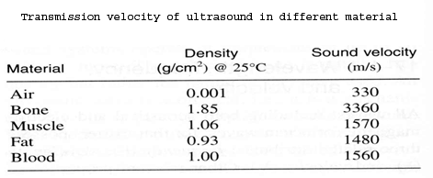
Ultrasound in tissues

Slide 5
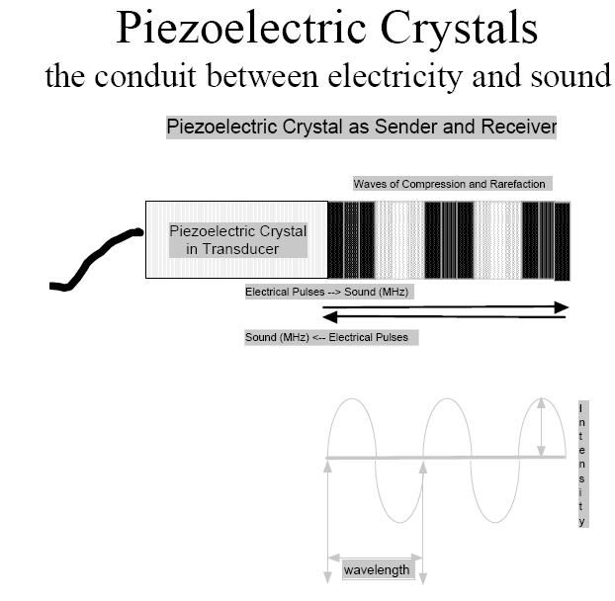

Slide 6
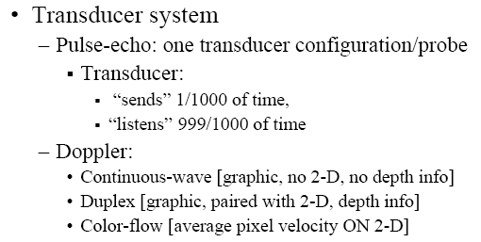

Slide 7
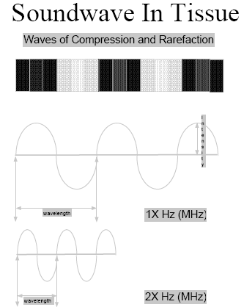

Slide 8
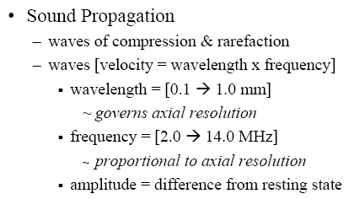

Slide 9
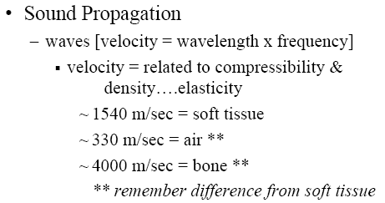

Slide 10
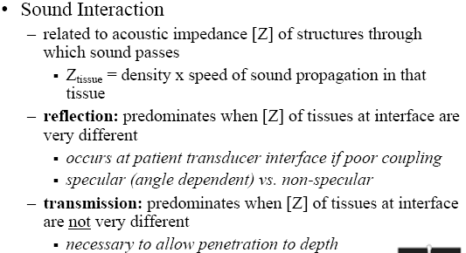

Slide 11
Radio signal vs Ultrasound signal
Radio signals: are electromagnetic waves i.e:
If an alternating current (ac) oscillation of 2500kHz, is connected to an appropriate antenna radio would be launched.
Ultrasound signals: are acoustical i.e:
If that same 2500kHz ac signal is applied to an ultrasound transducer, then an acoustical signal would be launched.

Slide 12
Imaging System
Pulse
Generation and Timing
Transmitter/
Receiver
Circuit
Control
Circuit
Acoustic absorbers
Blockers
Piezoelectric crystal
Data-Acquisition
Analog to Digital Converter
Computer
Imaging Storage and Processing
Display
Imaging
Object
A schematic diagram of a conventional ultrasound imaging system

Slide 13
In ultrasound, the following events happen:
  The ultrasound machine transmits high-frequency (1 to 20 megahertz) sound pulses into your body using a probe.
  The sound waves travel into your body and hit a boundary between tissues (e.g. between fluid and soft tissue, soft tissue and bone).
  Some of the sound waves get reflected back to the probe, while some travel on further until they reach another boundary and get reflected.
  The reflected waves are picked up by the probe and relayed to the machine.

Slide 14
  The machine calculates the distance from the probe to the tissue or organ (boundaries) using the speed of sound in tissue (1540 m/s) and the time of the each echo's return (usually on the order of millionths of a second).

Slide 15
In a typical ultrasound, millions of pulses and echoes are sent and received each second.
  The probe can be moved along the surface of the body and angled to obtain various views.

Slide 16
The Ultrasound Machine
A basic ultrasound machine has the following parts:
  transducer probe - probe that sends and receives the sound waves
  central processing unit (CPU) - computer that does all of the calculations and contains the electrical power supplies for itself and the transducer probe
  transducer pulse controls - changes the amplitude, frequency and duration of the pulses emitted from the transducer probe
  display - displays the image from the ultrasound data processed by the CPU
  keyboard/cursor - inputs data and takes measurements from the display
  disk storage device (hard, floppy, CD) - stores the acquired images
  printer - prints the image from the displayed data

Slide 17
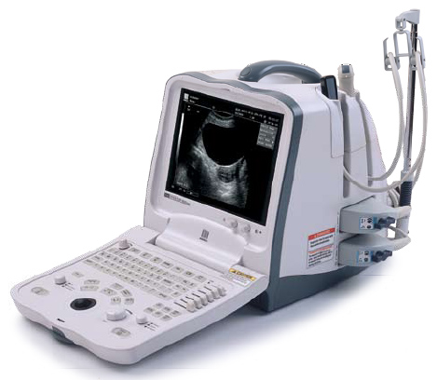
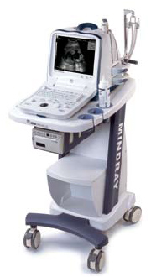
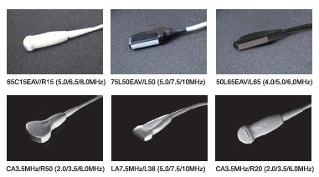
Machine….trolley….probes

Slide 18
Transducer Probe
The transducer probe is the main part of the ultrasound machine.
  The transducer probe makes the sound waves and receives the echoes.

Slide 19
Transducer is, so to speak, the mouth and ears of the ultrasound machine.
The transducer probe generates and receives sound waves using a principle called the piezoelectric (pressure electricity) effect, which was discovered by Pierre and Jacques Curie in 1880.

Slide 20
In the probe, there are one or more quartz crystals called piezoelectric crystals.
  When an electric current is applied to these crystals, they change shape rapidly…..i.e. expand and contract

Slide 21
The rapid shape changes, or vibrations, of the crystals produce sound waves that travel outward.
  Conversely, when sound or pressure waves hit the crystals, they emit electrical currents.

Slide 22
Therefore, the same crystals can be used to send and receive sound waves.
  The probe also has a sound absorbing substance to eliminate back reflections from the probe itself, and an acoustic lens to help focus the emitted sound waves.

Slide 23
Transducer probes come in many shapes and sizes, as shown in the photo above.
  The shape of the probe determines its field of view, and the frequency of emitted sound waves determines how deep the sound waves penetrate and the resolution of the image.

Slide 24
The machine displays the distances and intensities of the echoes on the screen, forming a two dimensional image like the one shown below.

Slide 25
Transducer probes may contain one or more crystal elements; in multiple-element probes, each crystal has its own circuit.
Multiple-element probes have the advantage that the ultrasound beam can be "steered" by changing the timing in which each element gets pulsed; steering the beam is especially important for cardiac ultrasound.

Slide 26
In addition to probes that can be moved across the surface of the body,
  Some probes are designed to be inserted through various openings of the body (vagina, rectum, esophagus) so that they can get closer to the organ being examined (uterus, prostate gland, stomach); getting closer to the organ can allow for more detailed views.

Slide 27
Central Processing Unit (CPU)
The CPU is the brain of the ultrasound machine.
  The CPU is basically a computer that contains the microprocessor, memory, amplifiers and power supplies for the microprocessor and transducer probe.

Slide 28
The CPU sends electrical currents to the transducer probe to emit sound waves, and also receives the electrical pulses from the probes that were created from the returning echoes.
  The CPU does all of the calculations involved in processing the data.

Slide 29
Once the raw data are processed, the CPU forms the image on the monitor.
  The CPU can also store the processed data and/or image on disk.

Slide 30
Transducer Pulse Controls
The transducer pulse controls allow the operator, called the ultrasonographer, to set and change the frequency and duration of the ultrasound pulses, as well as the scan mode of the machine.
  The commands from the operator are translated into changing electric currents that are applied to the piezoelectric crystals in the transducer probe.

Slide 31
Display
The display is a computer monitor that shows the processed data from the CPU.
  Displays can be black-and-white or color, depending upon the model of the ultrasound machine.

Slide 32
Keyboard/Cursor
Ultrasound machines have a keyboard and a cursor, such as a trackball, built in.
  These devices allow the operator to add notes to and take measurements from the data.

Slide 33
Disk Storage
The processed data and/ or images can be stored on disk.
  The disks can be hard disks, floppy disks, compact discs (CDs) or digital video discs (DVDs).
    Typically, a patient's ultrasound scans are stored on a floppy disk and archived with the patient's medical records.

Slide 34
Printers
Many ultrasound machines have thermal printers that can be used to capture a hard copy of the image from the display.

Slide 35
Different Types of Ultrasound

Slide 36
The ultrasound that we have described so far presents a two dimensional image, or "slice," of a three dimensional object (fetus, organ).
  Two other types of ultrasound are currently in use, 3D ultrasound imaging and Doppler ultrasound. 3D Ultrasound Imaging

Slide 37
In the past two years, ultrasound machines capable of three-dimensional imaging have been developed. In these machines, several two-dimensional images are acquired by moving the probes across the body surface or rotating inserted probes.

Slide 38
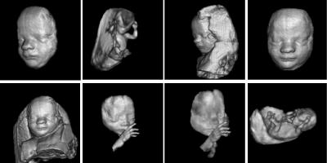
The two-dimensional scans are then combined by specialized computer software to form 3D images.
3D imaging allows you to get a better look at the organ being examined and is best used for:

Slide 39
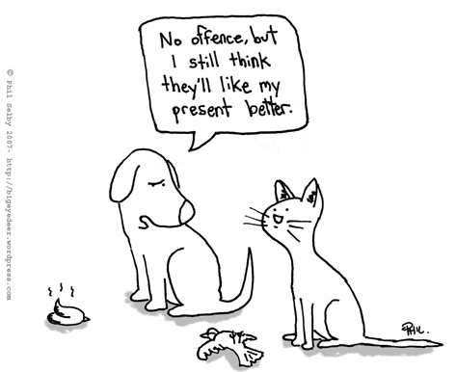
Introduction to Ultrasound

Slide 40
Indications
As a compliment to abdominal radiographs
  To rule in/out intestinal obstruction (foreign body)
  To determine the origin of an abdominal mass
    Spleen, Liver
  To facilitate fine needle aspiration/cystocentesis
  To evaluate organ parenchyma
  To assess fetal viability in pregnant animals
  If clinical signs or history indicate abdominal ultrasound, then it should be performed even if radiographs are normal!!!

Slide 41
Pitfalls of Ultrasound
Ultrasound cannot penetrate air or bone
  May be difficult to assess the GI tract in animals with aerophagia
  Size of organs is largely subjective
    Except renal size in cats
  Unable to evaluate extra-abdominal structures
    May still need to perform abdominal radiographs
  Cost
  User dependent results

Slide 42
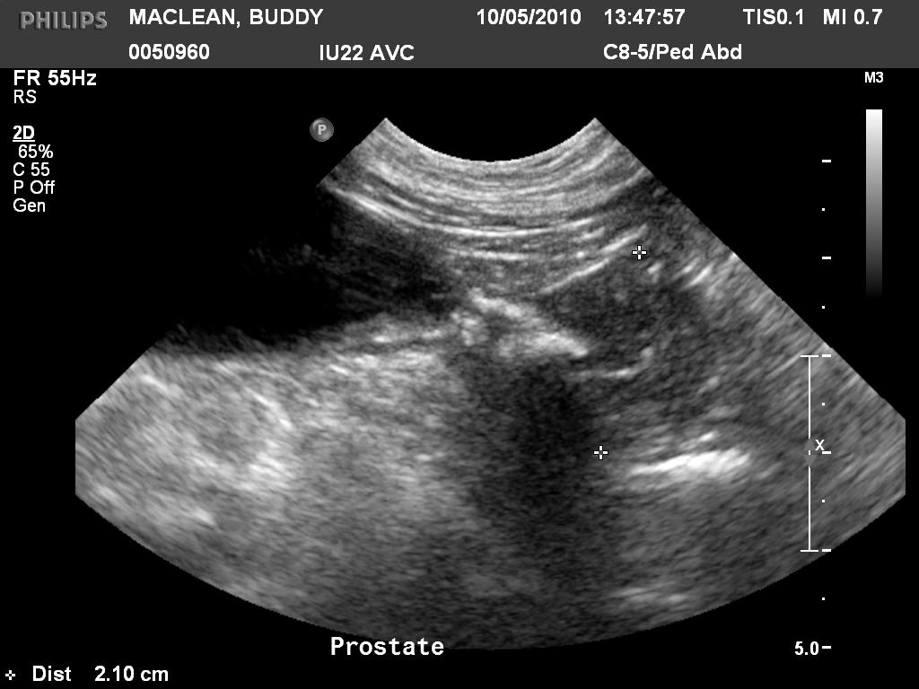
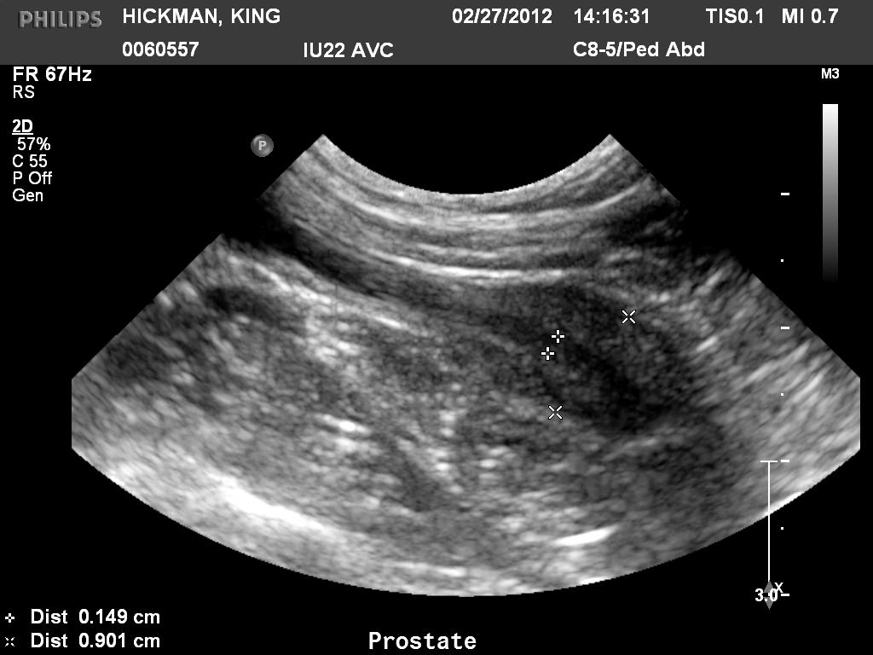
Examples
Prostate
Abnormal
Normal (Neutered Dog)

Slide 43
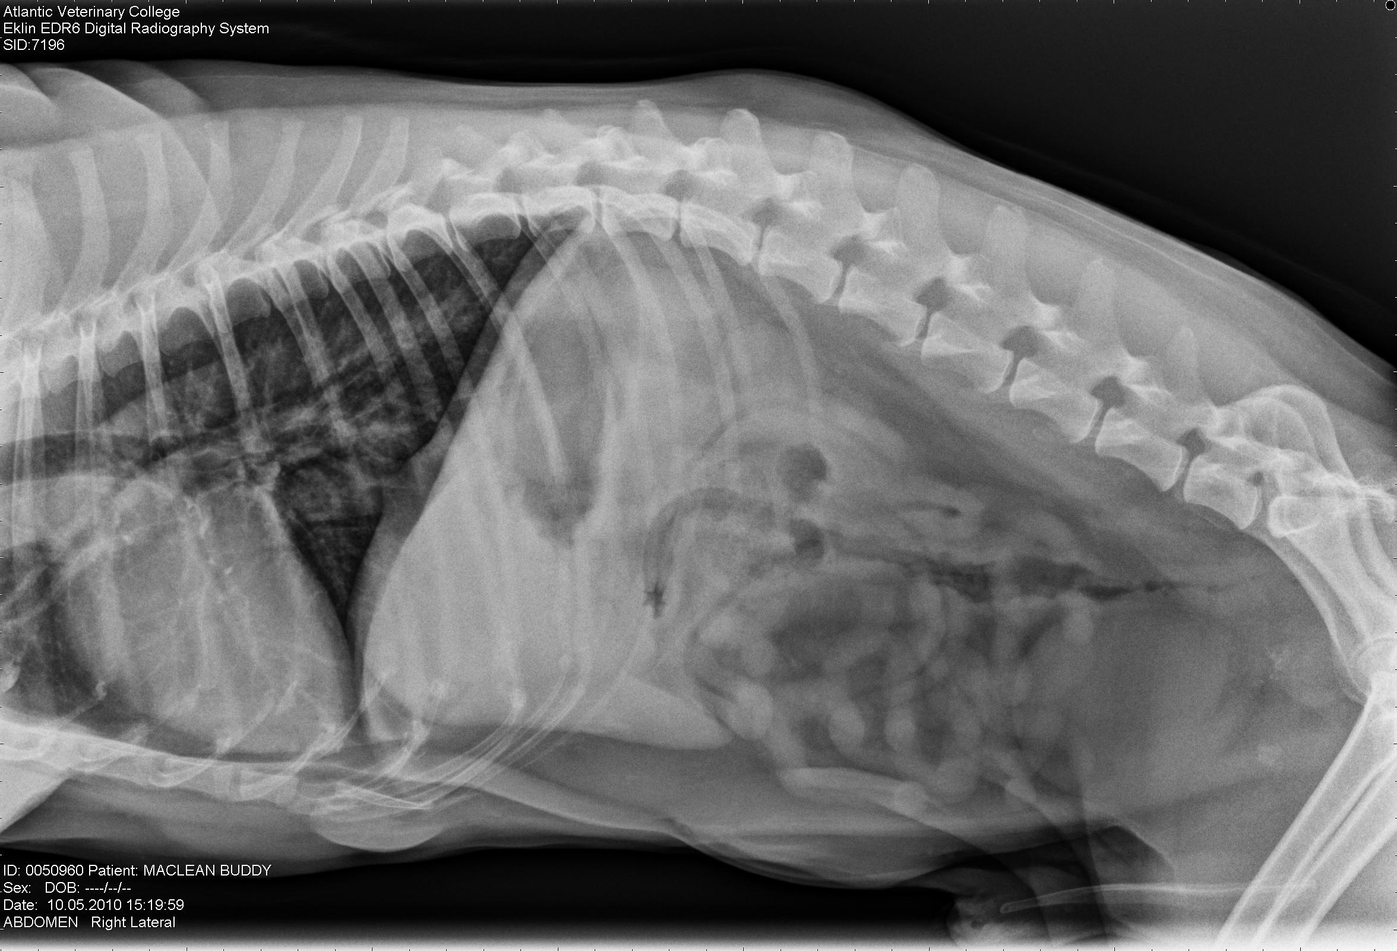
Need radiographs to properly evaluate the spine for metastasis

Slide 44
Ultrasound Physics
Characterized by sound waves of high frequency
  Higher than the range of human hearing
Sound waves are measured in Hertz (Hz)
  Diagnostic U/S = 1-20 MHz
Sound waves are produced by a transducer

Slide 45
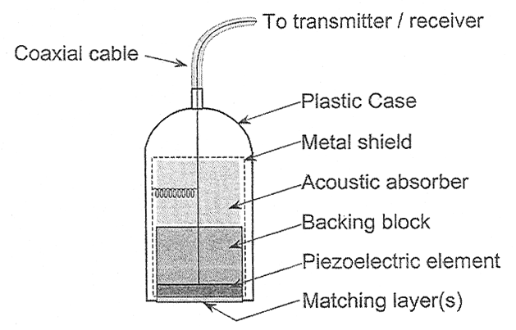
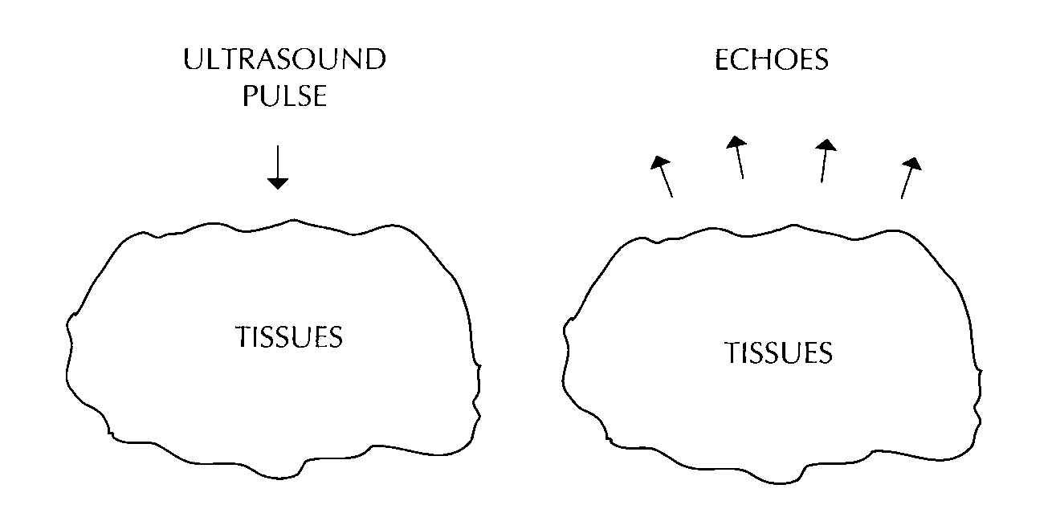
Ultrasound Physics
Transducer (probe)
  Piezoelectric crystal
    Emit sound after electric charge applied
    Sound reflected from patient
    Returning echo is converted to electric signal → grayscale image on monitor
    Echo may be reflected, transmitted or refracted
    Transmit 1% and receive 99% of the time

Slide 46
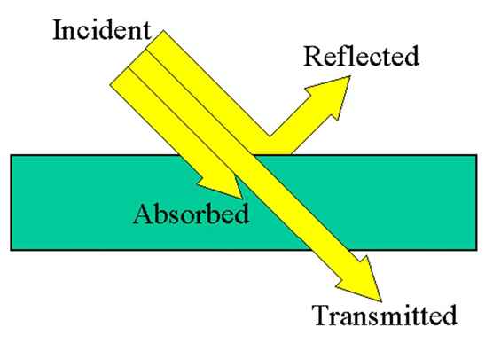

Slide 47
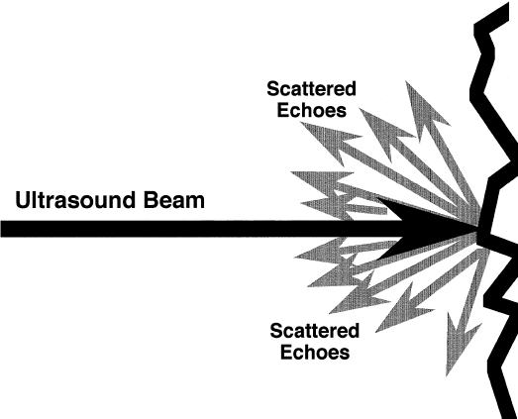
Attenuation
Absorption = energy is captured by the tissue then converted to heat
Reflection = occurs at interfaces between tissues of different acoustic properties
Scattering = beam hits irregular interface – beam gets scattered

Slide 48
Acoustic Impedance
The product of the tissue’s density and the sound velocity within the tissue
Amplitude of returning echo is proportional to the difference in acoustic impedance between the two tissues
Velocities:
  Soft tissues = 1400-1600m/sec
  Bone = 4080
  Air = 330
Thus, when an ultrasound beam encounters two regions of very different acoustic impedances, the beam is reflected or absorbed
  Cannot penetrate
  Example: soft tissue – bone interface

Slide 49
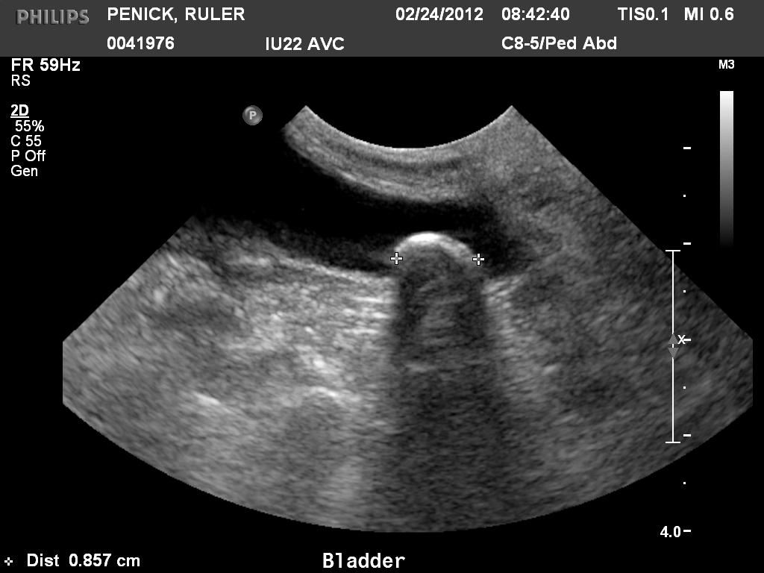
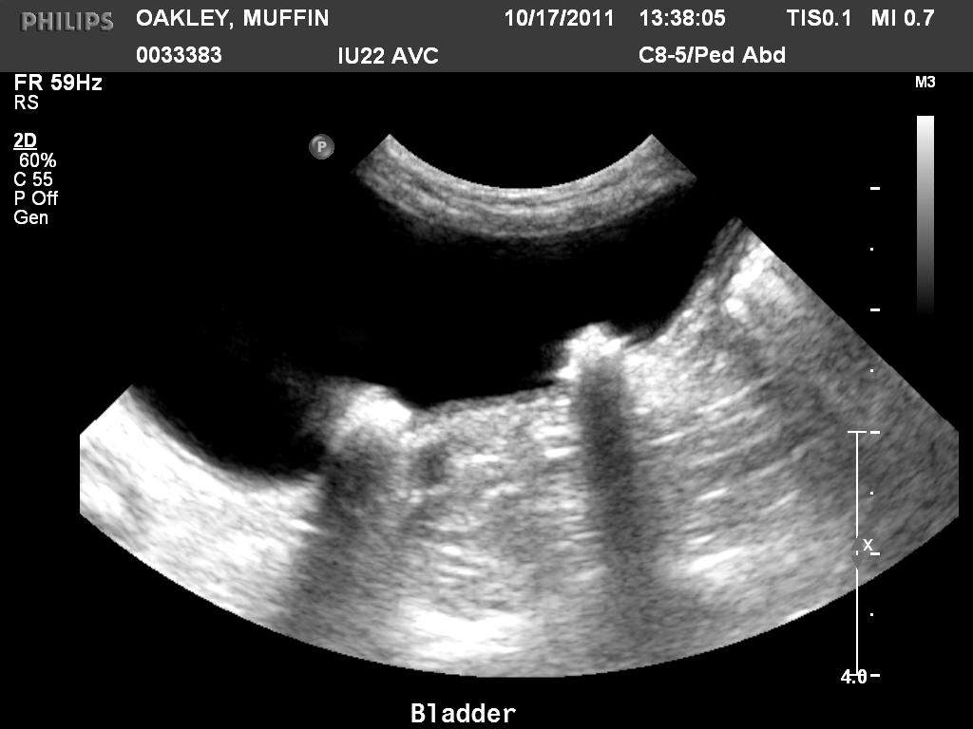

Slide 50
Frequency and Resolution
As frequency increases, resolution improves
As frequency increases, depth of penetration decreases
  Use higher frequency transducers to image more superficial structures
    Ex: Equine Tendons
Frequency
Penetration

Slide 51
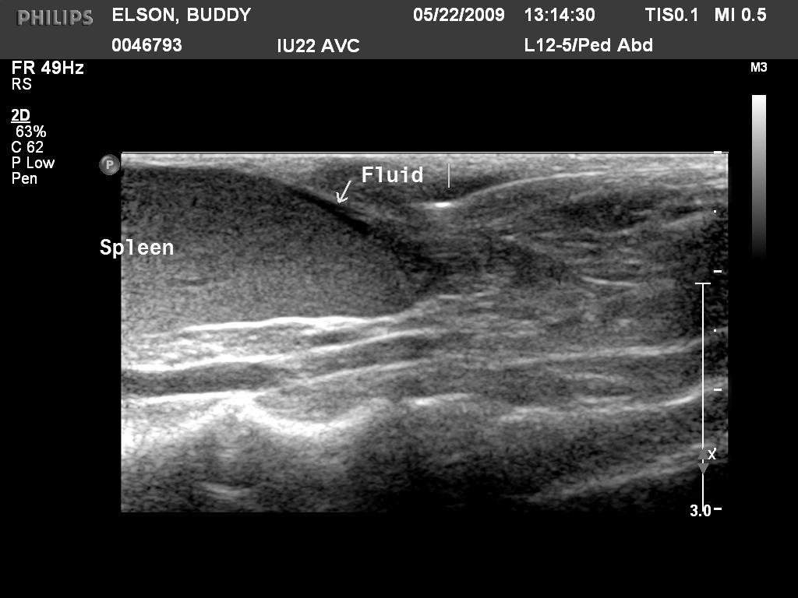

Slide 52
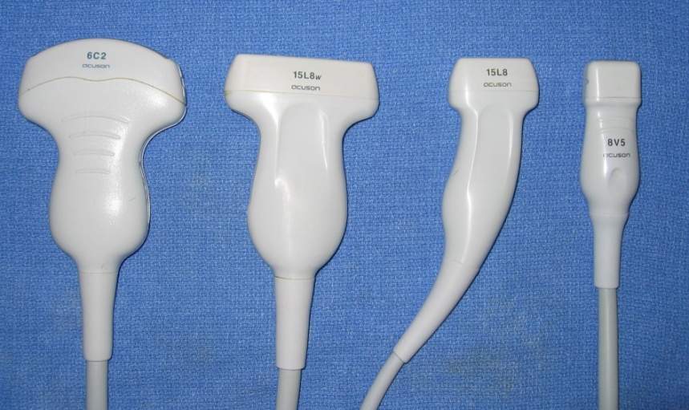
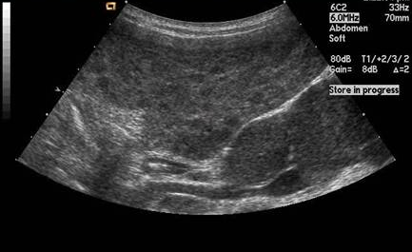
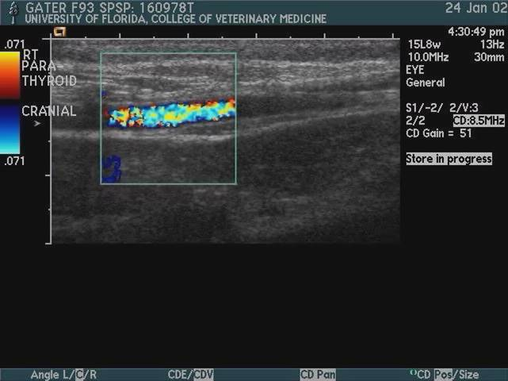
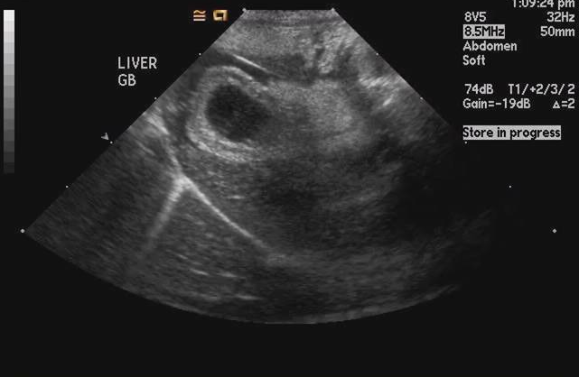
Instrumentation - Ultrasound Probes
A
B
C
A
B
C

Slide 53

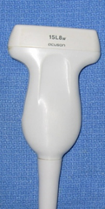
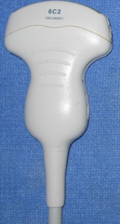
Transducers/Probes
Sector scanner
  Fan-shaped beam
  Small surface required for contact
  Cardiac imaging
Linear scanner
  Rectanglular beam
  Large contact area required
Curvi-linear scanner
  Smaller scan head
  Wider field of view

Slide 54
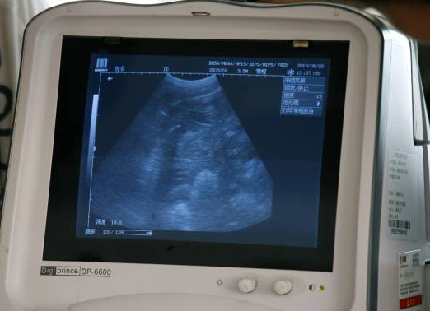
Monitor and Computer
Converts signal to an image/ archive
Tools for image manipulation
  Gain – amplification of returning echoes
    Overall brightness
  Time gain compensation (curve)
    Adjust brightness at different depths
  Freeze
  Depth
    Zoom in for superficial view
    Zoom out for wide view
    Depth limited by frequency
  Focal zone
    Optimal resolution wherever focal zone is

Slide 55
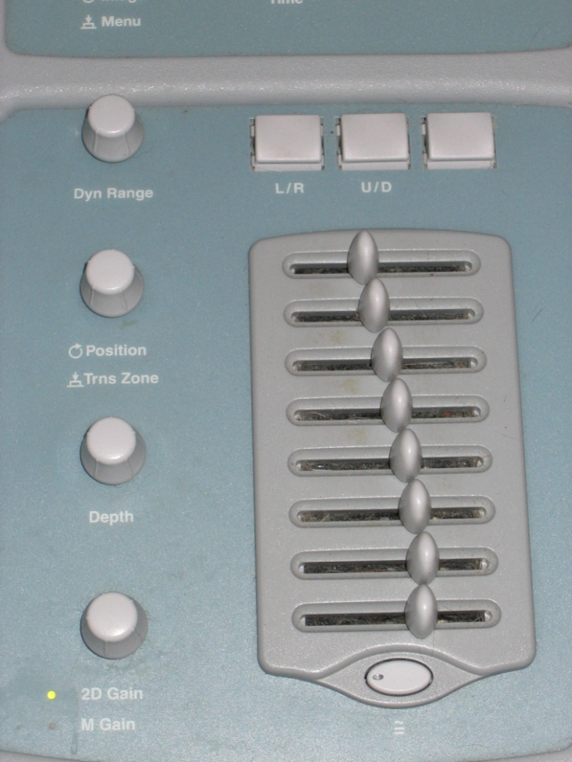
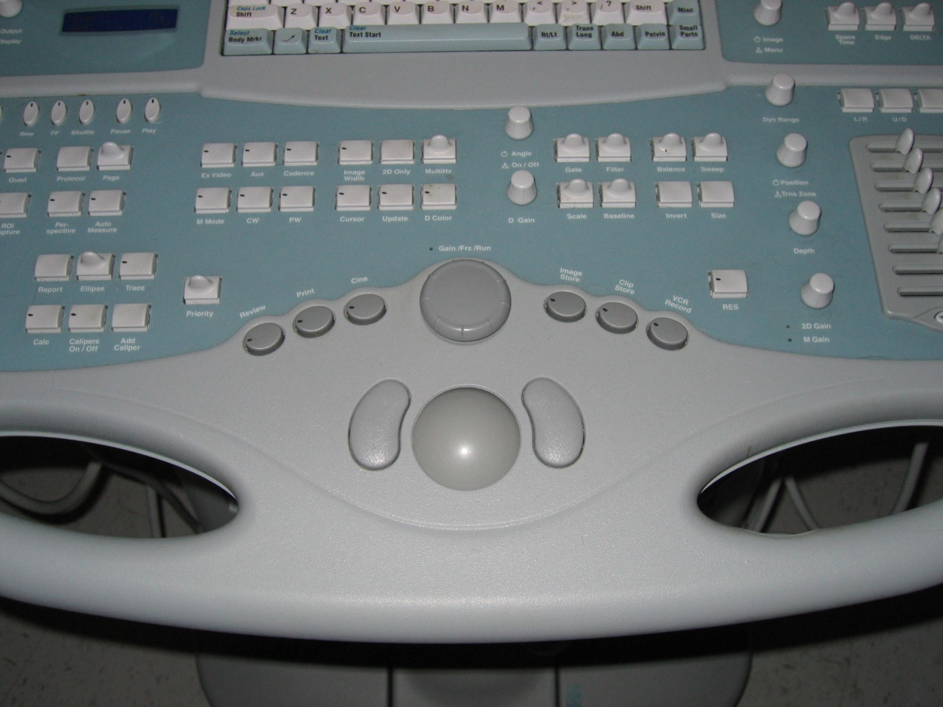
Image controls

Slide 56
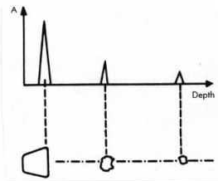
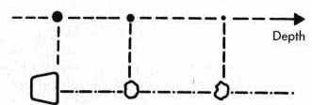
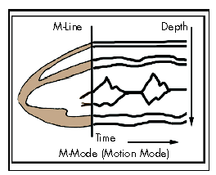
Modes of Display
A mode
  Spikes – where precise length and depth measurements are needed – ophtho
B mode (brightness) – used most often
  2 D reconstruction of the image slice
M mode – motion mode
  Moving 1D image – cardiac mainly

Slide 57
Artifacts
Artifacts lead to the improper display of the structures to be imaged
  Affect the quality of images
Improper machine settings – gain
  Image too bright or too dark
  Can disguise underlying pathology

Slide 58
Artifacts
Reverberation
  Time delays due to travel of echoes when there are 2 or more reflectors in the sound path
  Mirror image – liver, diaphragm and GB
    Return of echoes to transducer takes longer because reflected from diaphragm
    A second image of the structure is placed deeper than it really is
  Comet tail – gas bubble
  Ring down – skin transducer surface

Slide 59
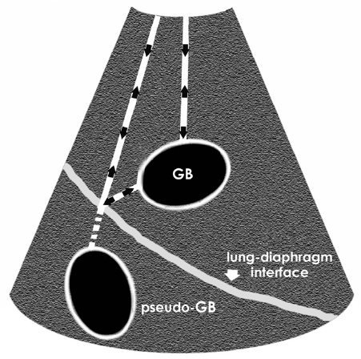
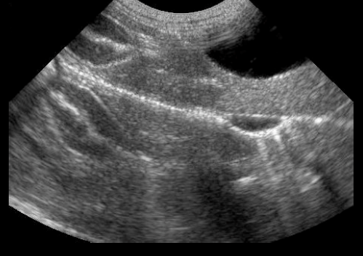
Mirror Image Artifact

Slide 60
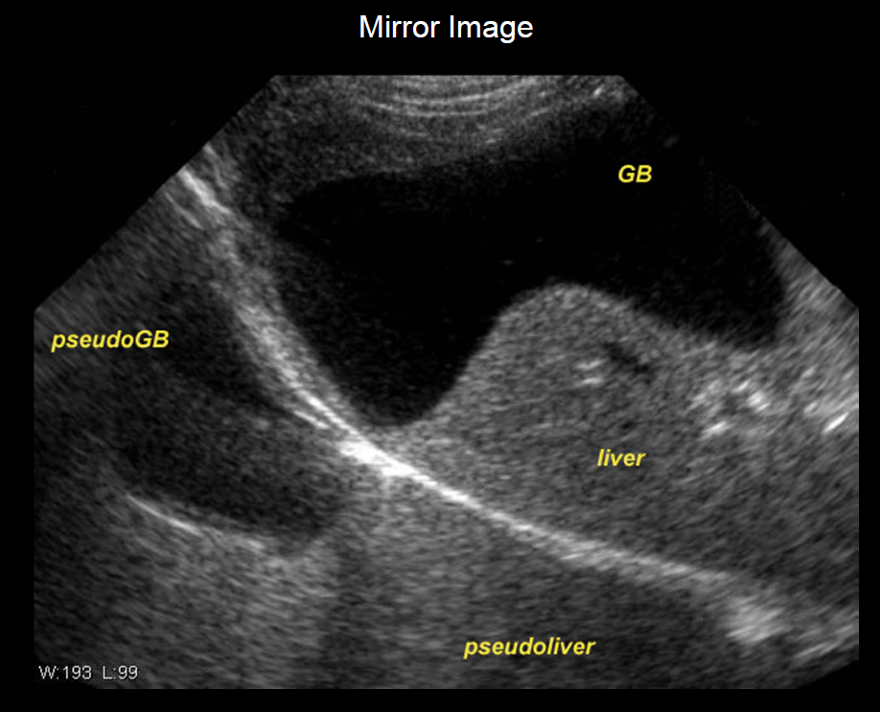

Slide 61
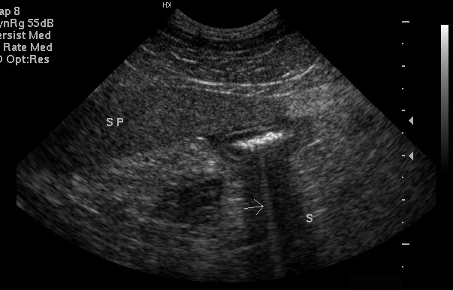
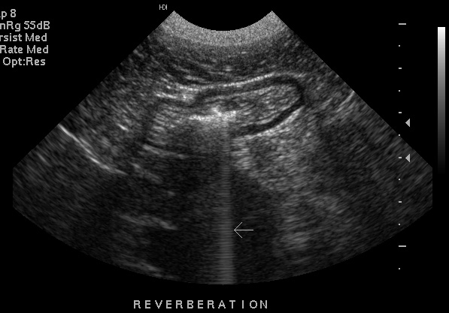
Comet Tails

Slide 62
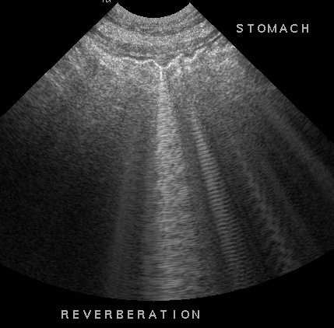
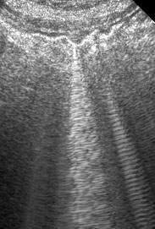
Reverberation

Slide 63
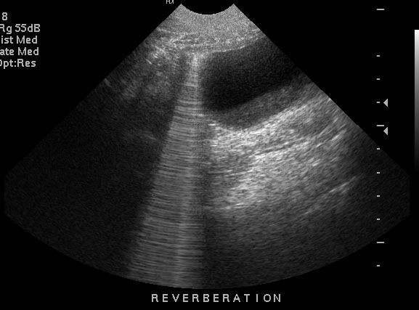
What Happened Here?

Slide 64
Artifacts
Acoustic shadowing
  U/S beam does not pass through an object because of reflection or absorption
  Black area beyond the surface of the reflector
  Examples: cystic calculi, bones
Acoustic enhancement
  Hyperintense (bright) regions below objects of low U/S beam attenuation
  Through transmission
  Examples: cyst or urinary bladder

Slide 65
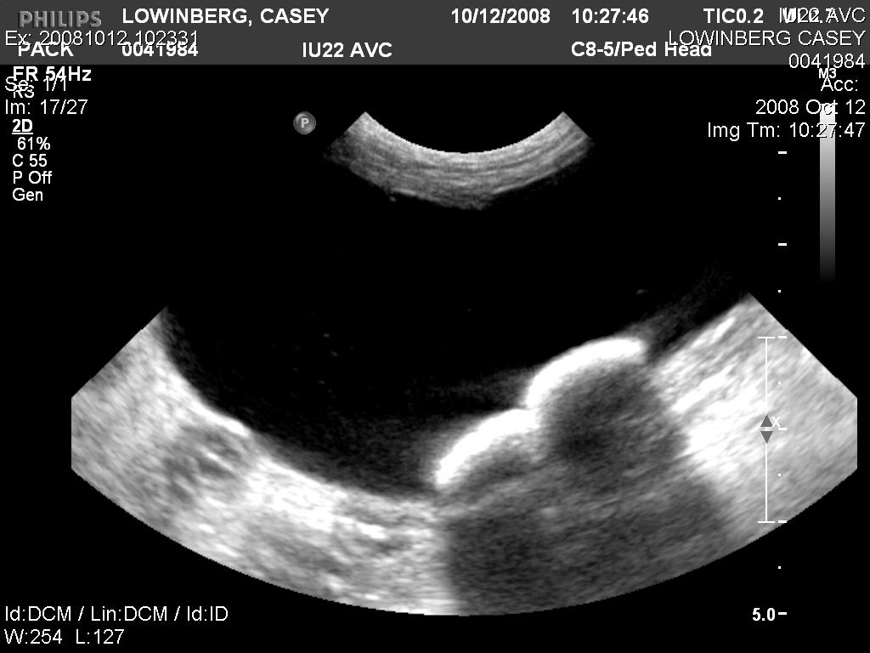
Acoustic Shadowing

Slide 66
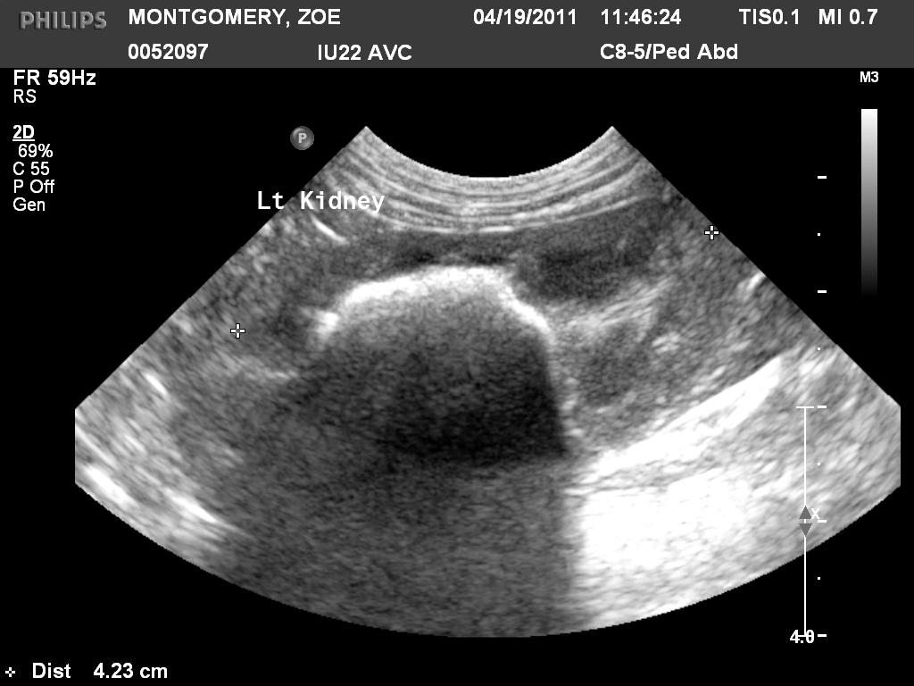

Slide 67
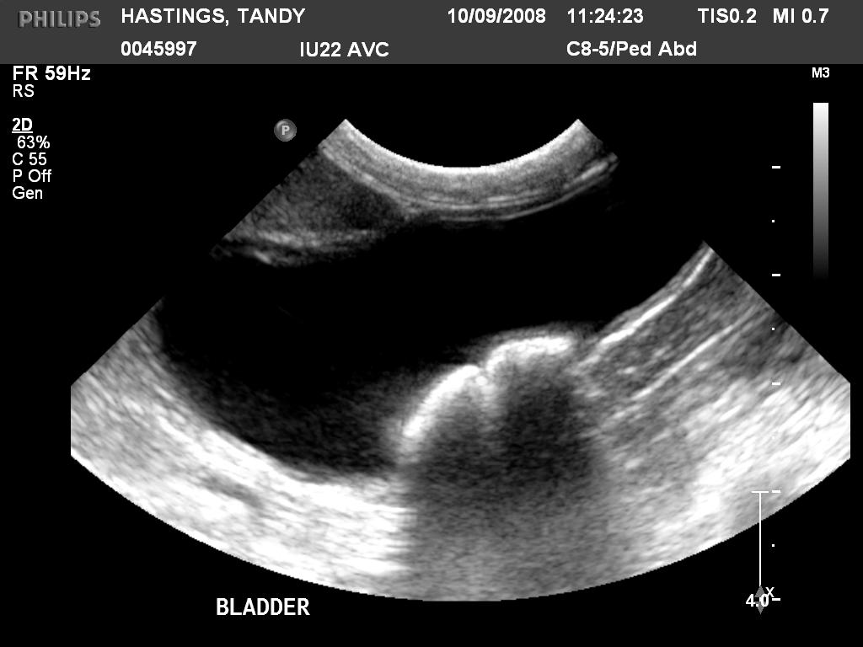

Slide 68
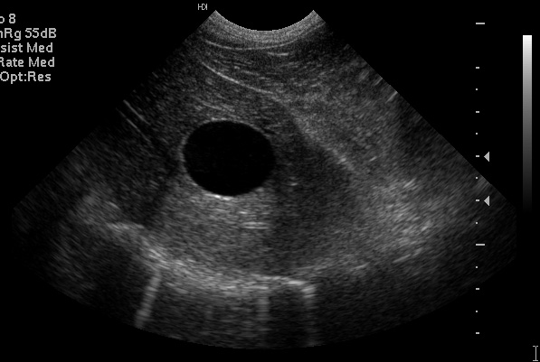
Acoustic Enhancement

Slide 69
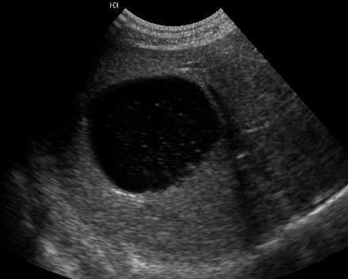
Acoustic Enhancement

Slide 70
Artifacts
Refraction:
  Occurs when the sound wave reaches two tissues of differing acoustic impedances
  U/S beam reaching the second tissue changes direction
  May cause an organ to be improperly displayed

Slide 71
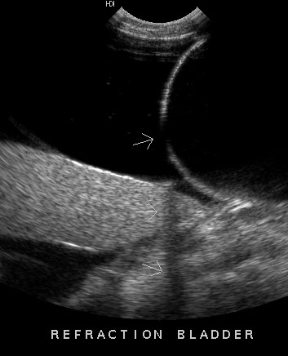
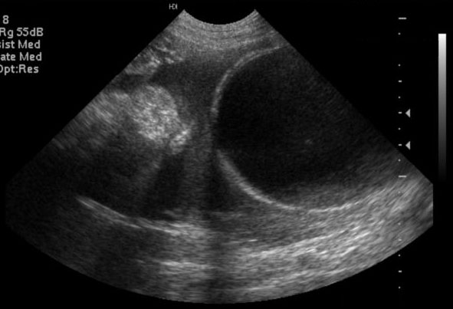

Slide 72
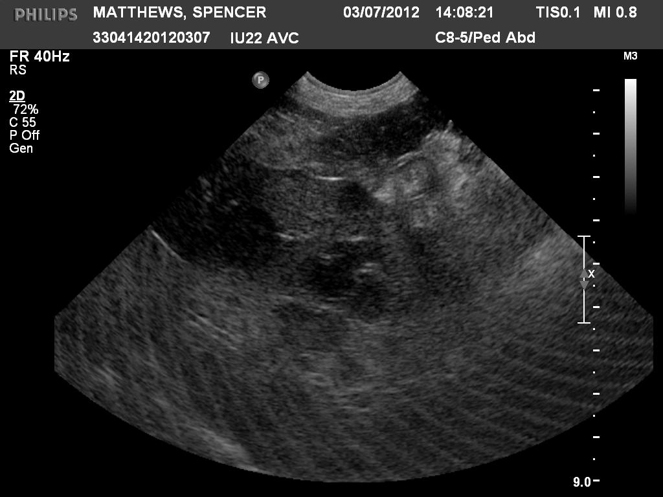
What type of artifact is this?

Slide 73
Ultrasound Terminology
Never use dense, opaque, lucent
Anechoic
  No returning echoes= black (acellular fluid)
Echogenic
  Regarding fluid--some shade of grey due to returning echoes
Relative terms
  Comparison to normal echogenicity of the same organ or other structure
  Hypoechoic, isoechoic, hyperechoic
    Spleen should be hyperechoic to liver
    Liver is hyperechoic to kidneys

Slide 74


Slide 75
Patient Positioning and Preparation
Dorsal recumbency
Lateral recumbency
Standing
Clip hair
  Be sure to check with owners
Apply ultrasound gel
Alcohol can be used – esp. in horses

Slide 76
Image Orientation and Labeling
Must be consistent
Symbol on screen ~ dot on transducer
“dot” to head and “dot” to patients right
“dot” lateral for transverse and proximal for longitudinal images
Label images carefully
  Organ
  Patient’s name
  Date of examination

Slide 77
Ultrasound-Guided FNA/ Biopsies
NORMAL ABD U/S FINDINGS DO NOT MEAN ORGANS ARE NORMAL!!!
  ***Do FNA if suspect disease
Abnormal U/S findings nonspecific
  Benign and malignant masses identical
  Bright liver may be secondary to Cushing’s dz or lymphoma
Aspirate abnormal structures (with few exceptions)!!!
  Obtain owner approval prior to exam
  Warn owner of risks
  +/- Clotting profile

Slide 78
Ultrasound-Guided FNA/ Biopsies
Risks of FNA’s
  Fatal hemorrhage
  Pneumothorax w/ pulmonary masses
  Seeding of tumors
    TCC
  Sepsis
    Abscesses

Slide 79
Ultrasound-Guided FNA/ Biopsies
Routinely aspirate:
  Liver (masses and diffuse disease)
  Spleen (nodules and diffuse disease)
  Gastrointestinal masses
  Enlarged lymph nodes
  Enlarged prostate
  Pulmonary/ mediastinal masses (usually don’t biopsy due to risk of pneumothorax
Occasionally aspirate:
  Kidneys (esp. if enlarged)
  Pancreas
  Urinary bladder masses
Never aspirate:
  Adrenal glands
  Gall bladder

Slide 80

Ultrasound-Guided FNA/Biopsies
Non-aspiration Technique
  22g 1.5in needle
  6 cc syringe
  Short jabs into organ
  Spray onto slide, smear, and check abdomen for hemorrhage

Slide 81
Ultrasound-Guided FNA
Aspiration technique
  Same set up as with non-aspiration technique
  With needle in structure, pull back plunger vigorously several times
  Remove needle, fill syringe with air
  Spray onto slide and smear

Slide 82

Ultrasound-Guided Core Biopsies
Use a special biopsy “gun”
  14-20g
  Insert through small skin incision
Much more representative sample
  Tissue not just cells
  Sometimes it is necessary to get the answer
  But…. MUCH MORE LIKELY TO BLEED!

Slide 83


Biopsy – Bleeding???

Slide 84

Catheter in Bladder

Slide 85
Summary
Know your limitations
  Lack of expertise
For abdomen or thorax, do radiographs first
If safe and reasonable, do FNA’s of all suspected abnormal structures based on history, clinical signs, or the ultrasound examination
  Abnormal structures can look normal
  Of the structures that do look abnormal, benign and malignant processes can be identical
Documentation – save images in some fashion

Slide 86
The End

