Slide 1
THERMAL INJURIES
Dr. Rudra Pratap Pandey

Slide 2
Definition
Burn is thermal injury by dry heat
Scald is thermal injury by hot liquids and stream. Scalding is more common then burns
Etiological classification
tissue exposure to temperature extremes (either high or low) sufficient to cause cellular damage
exposure to chemicals that cause tissue necrosis via chemical reactivity (or secondary thermal effects) results in chemical burns;
electrical burns occur when an electrical current of sufficient energy passes through the patient, causing cellular necrosis along its path; and
radiation burns are caused by exposure to ionizing radiation at levels that cause acute cell death, an injury that is most commonly seen from exposure to solar radiation or as a side effect of radiation therapy for neoplastic disease.

Slide 3
Thermal burns
a flame or fire or direct contact with a hot object
scalds from hot liquids or steam
extent of tissue damage is directly related to temperature and duration.
At 40° to 44° C, failure of the cell membrane sodium pump occurs;
epidermal necrosis (partial-thickness burn) occurs if the skin temperature reaches 60° C for one second;
skin temperatures above 70° C result in full-thickness burns in less than 1 second.

Slide 4
Thermal burns - Classification
Class | Dermal layers involved | Wound characteristic | Healing
Superficial Aka 1st D | Epidermis | Red desquamation, dry flaky look | 3-5 days re-epithelization, little scar
Superficial partial thickness Aka 2nd D | Epidermis + 1/3 dermis | Blisters, little scar, edema, eschar (leathery surface of dead tissue) | 2-3 weeks, surgical intervention to avoid big scar
Full thickness Aka 3rd D | Epidermis, dermis, s/c tissue | Bloodless, white, eschar, hairs easily come off | Surgical intervention needed

Slide 5
Dupuytren’s Classification
1st Degree: Erythema or simple redness with superficial inflammation and slight swelling, may subside
2nd Degree: Vesicle formation with acute inflammation. Skin blackened and hair is singed. Superficial layers of the epithelium are destroyed. Scars not present after healing
3rd Degree: Destruction of cuticle and part of true skin. Very painful, nerve endings exposed. Healing may leaves scar.
4th Degree: Whole skin is destroyed with formation of slough (yellowish-brown/parchment-like). Surface is ulcerated and on healing a dense fibrous scar tissue develop. Scar may subsequently contract and cause deformity of the part. Not painful: complete destruction of the nerve endings.
5th Degree: Deep fascia and muscles involved. Severe scarring effect and deformity.
6th Degree: Carbonization or Charring of the limb involving subjacent tissues, organs, and bone

Slide 6
Burn zones
Zone of coagulation (aka zone of necrosis or zone of destruction): Inner most zone…no viable tissue remains in this zone.
The zone of ischemia or stasis: Decreased perfusion, reduction of vascular luminal diameter from increased interstitial pressure secondary to increased capillary permeability. Increased capillary permeability depends on the severity of the burn: in a canine model of scald burns, local lymph flow and protein content increased proportionally with scald temperature. Tissues in the zone of stasis are vulnerable; whereas further insult leads to necrosis, effective therapy can restore perfusion and maintain viability.
Zone of congestion or hyperemia, which is the primary area of the inflammatory response to the burn. Tissues in the zone of hyperemia are viable and heal if no further injury is sustained
Mnemonic….CIC…Coagulation Ischemia Congestion

Slide 7
Electrical burn – cause and signs
Electrical injuries in animals occur most often accidentally
Severity depends on type of circuit, voltage, current and duration of exposure and conditions of the animal e.g. wet or dry hair coat and pathway of current through the body.
Lesions may be absent or may include early or localized rigor mortis, acute circulatory failure, or severe thermoelectrical burns.
Signs include external current marks, singed hair or feathers, metallization of the skin
rarely internal electroporation injury (muscle necrosis, hemolysis, vascular damage with thrombosis), injury to brain and spinal cord, or skeletal fractures.
Lightning strike in animals may cause no lesions, external signs of linear or punctate burns, keraunographic markings (markings simulating the surroundings…myth?), or exit burns on the soles of the hooves or the coronary bands.

Slide 8
Superficial burns (epidermal and partial thickness)
effect on keratinocytes
monocyte and macrophage activation
Pro-inflammatory cytokine release
1. nociceptor stimulation and pain
2. increased vascular permeability
3. vasodilation
interstitial edema
hypotension
blistering
warmth
blanching erythema

Slide 9
Deep burns (partial and full thickness)
Superficial burn changes and Destruction of blood vessels
dry non blanching edema inelastic surface
moist injury-blister rupture
low sensation
Dry
All parts of skin and SC involved
No sensation
Fluid shift from intravascular to interstitium
Hypotension
Shock

Slide 10
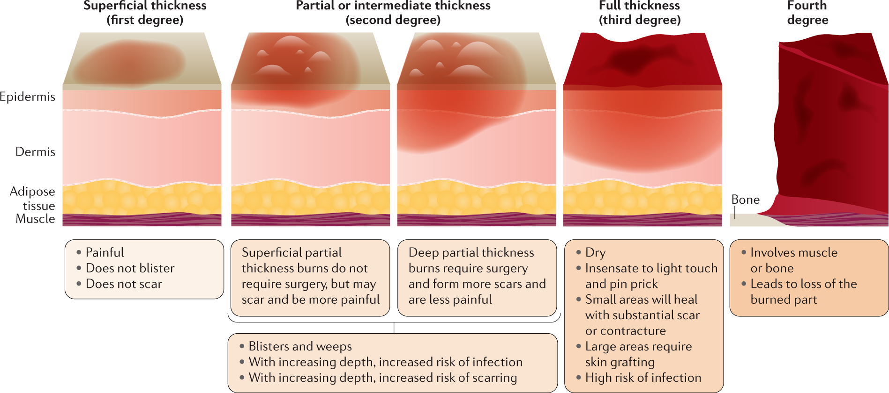
Superficial thickness- 1st degree

Slide 11
Partial thickness- 2nd degree

Slide 12
Full thickness- 3rd and 4th degree

Slide 13
Burn assessment and care
General physical condition, systemic compromise, amount of body and surface affected, plus degree of local injury.
If the loss of skin is large enough, euthanasia can be recommended.
Special attention …..facial,eyes and perineal burn
Rule of nine (9 for head/neck, chest/abdomen (front and back), 9 arms, 9 for front of the leg, 9 for back of the leg and 1% for perineum ….rule of 11 (?)
Card area

Slide 14
First 36 hours
Airway, breathing, circulation
Direct cold application….irrigation or packs
Potassium….hyperkalemia due to cell destruction, hypoptoteinemia <3
Analgesics ….opioid or morphine
Hair clipping (?), wound cleaning to remove necrotic part and FB
Antiseptics…povidone or chlorhexidine sol
Manage shock
Systemic antibiotics do not penetrate scar, topical therapy with antibiotic ointments and creams. Gentamycin, polymyxin, neomycin, and bacitracin, fluoroquinolones, silver sulphadiazine cream.
Aloe vera shows certain anti-prostaglandin effects and helps to maintain normal dermal vasculature

Slide 15
36 hours to 5 days
Transition from flow phase of shock to the hypermetabolic phase.
Pulmonary problems..cough…laryngoscopy intubation oxygenation. Antibiobitcs for bacterial tracheobronchitis
hemodynamic stability….evaporation loss…. Fluids with 5% glucose with small amount of sodium are indicated, because no major losses of sodium occur during this stage. Non-aggressive fluid therapy is currently indicated with end goals of 60–70 mm Hg as MAP, urine production around 1–2 ml/kg/hour. Albumin level around 2,5 g/dL is the goal, and hematocrit should be kept over 30%, considering whole blood transfusion
renal function…fluid and diuretics. Electrolyte profile
burn wounds care….. . Wound cleaning, excision, and escharectomy are regular procedures and can be used to obtain proper samples for culture
pain and anxiety control… morphine, oxymorphone, butorphanol and low doses of benzodiazepines could be used. Phenothiazines must be avoided because of their extrapyramidal side effects in burn patients.

Slide 16
After 5 days…III Stage
Inflammation-Infection Period
After 1 week Sepsis, systemic inflammatory response syndrome (SIRS) and septic shock are common during this period. Adequate nutritional support is very important to clinical outcome. Feeding tubes are first choices in starving animals (pharyngostomy tube in dogs)
Pulmonary infections and RADS (Respiratory Acute Distress Syndrome) remain as major causes of mortality during this period. Partial ventilatory support could be useful if necessary.

Slide 17
Burn treatment – Topical application-1
Agent | Indication | Effectiveness | CI
Silver sulfadiazine (1% cream) with or without cerium | Small, medium, and large surface area burns | Decreased colonization of wounds Alleviates pain Broad spectrum | Burns near eyes Signs of reepithelialization
Silver containing dressings | Small, medium, and large surface area burns | Stronger antimicrobial activity, longer duration of action than silver sulfadiazine | Burns near eyes Pregnancy Allergic to silver
Bacitracin ointment 500 units/gram | Small surface area burns, Face, Ears Perineum, Graft sites | Ease of application and of removal Painless Frequent dressing changes | Bacterial resistance Signs of reepithelialization

Slide 18
Burn treatment – Topical application-2
Agent | Indication | Effectiveness | CI
Combination antibiotic ointment (eg, bacitracin, neomycin, and polymyxin B) | Small surface area burns, Face, Ears Perineum, Graft sites | Ease of application and of removal Painless Frequent dressing changes | Bacterial resistance Allergic reaction Signs of reepithelialization
Mupirocin ointment/cream 2% | Small surface area burns, Face, Ears Perineum, Graft sites | G +ve converage includes methicillin-resistant Staphylococcus aureus (MRSA) Ease of application and of removal, Painless Frequent dressing changes | Bacterial resistance Allergic reaction Signs of reepithelialization
Mafenide (8.5% cream, 5% solution) | Ears, Nose Dense bacterial proliferation | Excellent eschar penetration Penetrates cartilage G -ve coverage includes Pseudomonas | Burns >40% total body surface area Allergic to sulfonamides

Slide 19
Burn treatment – Topical application-3
Agent | Indication | Effectiveness | CI
Chlorhexidine | Only superficial burns | Does not interfere with reepithelialization Can be used with silver sulfadiazine Generally used as a cleansing agent | Deep burns Caution in neonates – rare association with cutaneous burns
Povidone-iodine | Small, medium surface area burns | Only when no other agent is available | Thyroid disorders Signs of reepithelialization
Acetic acid | Antiseptic, topical agent often used in a diluted form as an adjunct in the setting of Pseudomonas aeruginosa | Gram-negative bacteria including P. aeruginosa | Superficial burns have been described from misuse

Slide 20
Burn treatment – Alternate medicine
For extensive area application in farm animals
Coconut oil - camphor (10:1 to 20:1)
Camphor – sesame oil – honey (1:1:1)
Aloe vera – carrot – cucumber paste (1:1:1)
Honey – coconut oil (1:1)

Slide 21
summary
The initial assessment…consider euthanasia in very large area burns
Check for oral, nasal burn, perineum burn…entubate and catheterize if needed
100% oxygen @ 100-150 ml/Kg/ per minute if smoke inhalation is known. Entubate. SPO₂ measurement fails to distinguish between oxygenated hemoglobin and carboxyhemoglobin…not reliable (ABG!)
Pain relief with cold water, soak towels. NSAIDs/butorphanol for farm animals, neuroleptanalgesia in dogs, Diazepam Ketamine in cats
Fluid replacement at upto 4 ml/Kg per hour. Lactated Ringer´s or normal Saline is the first choice (No Free glucose fluids because of hyperglycemia and glucosuria after deep burns).
Increased K⁺due to cells damage in first 24 hours. Monitor
Check serum protein, urine production, hematocrit, hemoglobin, electrolytes and blood gases. If total protein drops below 3 gm/dl, fresh plasma or colloids should be added.
Correct aidosis with sodabicarb 5 mEq/Kg of bwt every 30-60 minutes.
For HCT <20% or Hb falls below 7 gm/dl consider blood transfusion (Hct > 30% is the goal)
Initiate local wound care and manage complications
Consider grafting, manage special location burns like udder etc

Slide 22
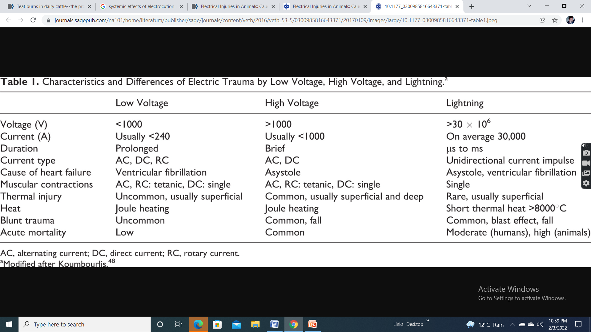
Effect of low voltage electric injury
Parameter/effect

Slide 23
Effect of high voltage electric injury
Parameter/effect

Slide 24
Effect of lightning
Parameter/effect

Slide 25
Treatment of electrical injury
Burn injury management
Management of pulmonary edema
Electric cord bites in dogs
Signs include oral ulcerations, singeing of the fur, cough, tachypnea, open mouth breathing, mucus membranes cyanosis, crackling sound when breathing, excess salivation, difficulty in swallowing and restlessness.
Supportive treatment ….crystalloid, colloid, diuretics (for pulmonary edema), pain management.

Slide 26
Chemical burns – causative agents
Ammonia
Battery acid
Bleach
Concrete mix
Drain or toilet bowl cleaners
Metal cleaners
Caustic soda
Phenol
Halogenated acids e.g. HCl, HF

Slide 27
Signs
Chemical burns are more severe than thermal
Alkali burns are more severe than acid
All signs…CIC ….present
Systemic absorption and toxic effects may occur in phenol burn and HF
Accidental or malafide

Slide 28
Chemical burn - treatment
Prolonged rinsing to wash off….most effective
Nutralization with weak acetic acid (5%) or milk or carbonated water.
Treatment similar to burn
Systemic effects of phenol and HF can occur in addition to local burn lesion.
Signs of phenol toxicity include convulsions, sudden collapse, coma, nausea, vomiting, diarrhea, methemoglobinemia, hemolytic anemia, profuse sweating, hypotension, arrhythmia, pulmonary edema, and tachycardia.
Signs of HF toxicity may include Drooling, Breathing difficulty, Abdominal pain, Hematemesis, Collapse (from low blood pressure or shock) and Irregular heartbeat.
Supportive and symptomatic treatment

Slide 29
Friction burns aka rope burns
Identified by redness, intense irritation, blisters and bleeding
Treatment consists of wound care.. cooling….removal of shreds… astringents (keolin paste/Caladryl lotion) …aloe vera paste
Pain management
Antimicrobial therapy

Slide 30
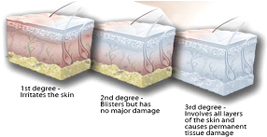
Frost bite
Cause is prolonged low temperature exposure…common parts are ears, paw, foot, tail or even skin coat
Cold exposure <0⁰C causes the blood vessels near the skin to narrow. Predisposing causes are heart disease or diabetes mellitus, wet fur, short hair, small size, illness or old age.
At extremely low temperature intracellular water freezes, microvascular circulation fails and cells rupture and ulcers may form
Damage degrees similar to burns

Slide 31
Frost bite - treatment
Warm water bath (warm (37-39 C) not Hot)
No rubbing, no hot air blow, no heating
Once the area has been thawed any dead tissue that remains will need to be removed surgically.
Topical treatments…anti-inflammatories, aloe vera gel, and nitroglycerin (to increase blood circulation to the area) may be recommended during healing of the wounds
Calcium channel blockers and vasodilators may be considered (amlodipine/nifedipine)
Surgical intervention if gangrene …dry….supervenes

