Slide 1
STERILIZATION AND DISINFECTION
Dr. Rudra Pratap Pandey

Slide 2
Important terms
Cleaning
Disinfection
Degermination
Decontamination
Antisepsis
Sterilization
Asepsis

Slide 3
Cleaning
is the removal of visible organic and inorganic material from objects and surfaces
is accomplished manually or mechanically or by using ultrasonic cleaners using water with detergents or enzymatic products.

Slide 4
Disinfection etc.
Disinfection describes a process that eliminates many or all pathogenic microorganisms, except bacterial spores, on inanimate objects usually by liquid chemicals or wet pasteurization.
Decontamination removes pathogenic microorganisms from objects so they are safe to handle, use, or discard.
Antiseptics are germicides applied to living tissue and skin (degermination)
Disinfectants are antimicrobials applied only to inanimate objects.

Slide 5
Disinfection etc
Disinfectants are not sporicidal.
Disinfectants that kill spores with prolonged exposure times (3–12 hours) are called chemical sterilants.
high-level disinfectants kill all microorganisms except large numbers of bacterial spores at shorter exposure periods (e.g., 20 minutes for 2% glutaraldehyde).
Low-level disinfectants can kill most vegetative bacteria, some fungi, and some viruses in a practical period of time (≤10 minutes).
Intermediate-level disinfectants might be cidal for mycobacteria, vegetative bacteria, most viruses, and most fungi but do not kill bacterial spores.

Slide 6
SPAULDING CLASSIFICATION
Critical – Objects which enter normally sterile tissue or the vascular system and require sterilization
Semi‐critical – Objects that contact mucous membranes or non‐intact skin and require high‐level disinfection.
Non‐critical – Objects that contact intact skin but not mucous membranes, and require low‐level disinfection

Slide 7
Method – item relation
Remember – critical items require sterilization or high level disinfection
Sterile HLD ILD LLD Decontamination
CRITICAL…….. SEMI NON CRITICAL…………..
CRITICAL

Slide 8
Sterilization
a process that destroys all forms of microbial life
is carried out by physical or chemical methods.
conveys an absolute meaning!
There is nothing like partially or almost sterile. All or None…..Sterile or Contaminated

Slide 9
Factors that affect the efficacy of disinfection and sterilization
organic and inorganic load present
type and level of microbial contamination
concentration of and exposure time to the germicide
physical nature of the object (crevices, hinges, and lumen)
temperature, pressure, duration (autoclaving)
presence of biofilms
temperature and pH of the disinfection process
relative humidity of the sterilization (ethylene oxide)

Slide 10
Methods of Sterilization
Dry heat sterilization – flaming, hot air oven, glass bead sterilization
Moist heat sterilization – boiling, autoclaving, flash steam sterilization
Cold or chemical sterilization (gluteraldehyde)
Gas sterilization (ethylene diaoxide)
Irradiation (ionizing gamma and x rays; non ionizing UV radiation)

Slide 11
Dry heat sterilization
Flaming – needle/blade over gas flame till red hot. Not practiced except in emergency
Hot air oven - metal instruments and glassware. A temperature of 120⁰C for 8 hours, 140⁰C for 2.5 hours, 160⁰C for 1 hour and 180⁰C for 20-30 minutes is sufficient. Not practiced as sharp edges become blunt.
Glass beads when red hot can be used to sterilize scalpel and instrument tips. Used during or between surgeries. Not practiced.

Slide 12
Moist heat sterilization - boiling
An effective method of sterilization in emergency.
Adding 2% sodium carbonate to boiling water helps in destruction of microbial spores.
After water starts boiling at 100⁰C keep the items for minimum15 minutes.
Moisture on items is a disadvantage.

Slide 13
Moist heat sterilization - autoclaving
Most effective and practiced method.
Two types….gravity displacement and high speed prevacuum.
Common setting is 30 minutes at 121 ⁰C in a gravity displacement sterilizer or 4 minutes at 132 ⁰C in a prevacuum sterilizer
Temperature-pressure-time relationship
Gravity displacement steam autoclaves
121⁰C 15psi 15-30 min
Pre-vacuum autoclaves
unwrapped items 132 ⁰C 30psi 3min (flash sterilization)
lightly wrapped items 132 ⁰C 30psi 8min
heavily wrapped items 132 ⁰C 30psi 10min
In field conditions large pressure cooker can be used to steam sterilize the pack. Duration of exposure – 45 min

Slide 14
Cold or chemical sterilization
Alcohols – ethyl, isopropyl, trichlorobutanol
Aldehydes – formaldehyde, glutaraldehyde
Halogens
Phenols
Surface active agents
Metallic salts
Gases – ethylene oxide, formaldehyde, betapropiolactone.

Slide 15
Ideal properties of chemical sterilization agents
Wide spectrum of activity
Active in the presence of organic matter
Effective in acid as well as alkaline media
Speedy action
High penetrating power
Stable
Compatible with other antiseptics and disinfectants
Should be non corrosive
Not cause local irritation or sensitization
Not interfere with healing
Not be toxic if absorbed into circulation
Cheap and easily available
Safe and easy to use

Slide 16
MODES OF ACTION OF CHEMICAL DISINFECTANTS
Protein coagulation
Disruption of cell membrane resulting in exposure, damage or loss of the contents
Removal of free sulphydryl groups essential for the functioning of the enzymes
Substrate competition by misleading the enzymes necessary for the metabolism of the cells to cause its death.

Slide 17
Chemical sterilization/disinfection methods - Alcohols
Ethanol (80% v/v ethyl alcohol) or 2-propanol (60-70% v/v iso- propyl alcohol) solutions are used to disinfect skin and decontaminate clean surfaces.
Spectrum: Effective against fungi, vegetative bacteria, Mycobacterium species and some lipid-containing viruses.
Limitation: Not effective against spores, most effective at 70% in water, flammable, swell rubber or harden plastics.

Slide 18
ALDEHYDES
13% v/v formalin is a good decontaminant (but has an irritating odour), 8% v/v formalin in 80% v/v alcohol is effective against vegetative bacteria, spores and viruses.
Does not corrode stainless steel.
used to preserve specimens, and for destroying anthrax spores in hair and wool.
10% formalin containing 0.5% sodium tetraborate is used to sterilize clean metal instruments.
Formaldehyde gas is used to sterilize instruments, heat sensitive catheters and for fumigation of wards and laboratories, clothing, bedding, furniture and surface
Paraformaldehyde tablets are used in formalin chambers. Sterilization of contents of the chamber is achieved in 12 hours

Slide 19
ALDEHYDES….conti
Glutaraldehyde available as 2% w/v aqueous solution (alkaline activator 0.3% sodabicarb). Also available in stable glycocomplexed form which does not require addition of alkaline buffer. Stored in air tight containers and away from heat.
A 2% glutaraldehyde solution, for at least 10 hours, can be used to sterilize heat labile items.
Used for immersion of instruments such as endoscopes, rubber and pvc anesthetic tubes, masks, ET tubes, metal instruments.
Glutaraldehyde is known to cause dermatitis and asthma.
Less irritating than formaldehyde but should not be used in an area with little ventilation.
Glutaraldehyde solutions can be used for up to 14 days. \
Solutions should be replaced any time they become cloudy.
20. Advantages…inexpensive…good materials compatibility
Disadvantages…Pungent and irritating odor….Relatively slow mycobactericidal activity……Coagulates blood and fix tissues.

Slide 20
Hypochlorite
inexpensive, broad spectrum chlorine releasing disinfectants of choice against viruses
used in a concentration of 0.2-1%
hypochlorites are inactivated by organic matter.
corrode metals
great widespread use as a laboratory disinfectant on surfaces of bench and in hidden spots.

Slide 21
Iodophores
largely replaced the aqueous and tincture forms of iodine due to less staining and irritation
Iodophores are chemical complexes with iodine bound to a carrier such as polyvinylpyrolidone (povidone) or ethoxylated nonionic detergents gradually releasing iodine.
Commercial PVP in a dilution of 1:2 to 1:100 kills most bacteria including S. aureus.
may become contaminated by organisms like pseudomonas
widely used for antisepsis of skin, mucosa and wounds.

Slide 22
Chlorhexidine
chlorhexidine gluconate is dissolved in 70% alcohol.
effective against Gram positive organisms and HIV.
active in ph range 5.5 - 8.0.
not recommended as a general disinfectant.
not active against sporulating bacteria or non-lipid- containing viruses.
incompatible with soap and anionic detergents.
savlon (chlorhexidine+cetrimide) is widely used in burns, wounds, as bladder irrigant, for surgical instruments and pre-operative disinfection of skin.

Slide 23
HYDROGEN PEROXIDE
A concentration of 3% w/v generally used for disinfection.
Active against a range of microorganisms.
Fungi, spores and enteric viruses require higher concentration.
Non toxic end-products of decomposition.
Not to be used on aluminium, copper, zinc or brass.
H₂O₂ on decomposition liberates free hydroxyl radical which is the active ingredient in the process. H₂O₂ is applied to disinfect plastic implants and surgical prostheses.
Concentrations of hydrogen peroxide from 6% to 25% show promise as chemical sterilants

Slide 24
Ortho-phthalaldehyde (OPA)
is a high-level disinfectant containing 0.55% 1,2-benzene dicarboxaldehyde (OPA). OPA solution is a clear, pale-blue liquid with a pH of 7.5.
excellent stability over a wide pH range (pH 3–9),
is not a known irritant to the eyes and nasal passages, no exposure monitoring needed, has no odor, and doesn’t requires activation.
OPA stains proteins gray (including unprotected skin) hence extensive rinsing needed
As chemical sterilant 0.55% concentration is used

Slide 25
Peracetic Acid (with & without H₂O₂
Peracetic, or peroxyacetic, acid is characterized by rapid action against all microorganisms.
Special advantages are that it lacks harmful decomposition products (i.e., acetic acid, water, oxygen, hydrogen peroxide), enhances removal of organic material and leaves no residue.
It remains effective in the presence of organic matter and is sporicidal even at low temperatures.
It can corrode metals.
It is considered unstable, when diluted; for example, a 1% solution loses half its strength through hydrolysis in 6 days, whereas 40% peracetic acid loses 1%–2% of its active ingredients per month.
Used in 0.35% concentration for disinfection
is chemical sterilant with H₂O₂ (0.08% peracetic acid plus 1.0% hydrogen peroxide and 0.23% peracetic acid plus 7.35% hydrogen peroxide.
Mostly used for disinfection and sterilization of hemodialysis units and sometimes endoscopes

Slide 26
UV radiation
The wavelength of UV radiation ranges from 328 nm to 210 nm (3280 A to 2100 A).
Its maximum bactericidal effect occurs at 240–280 nm.
Mercury vapor lamps emit more than 90% of their radiation at 253.7 nm, which is near the maximum microbicidal activity.
Use is limited to airborne microbes and surface microbes
Efficacy doubtful as no data support the use of UV lamps in isolation rooms
May cause UV-induced skin erythema and kerato-conjunctivitis in hospital patients and staff.

Slide 27
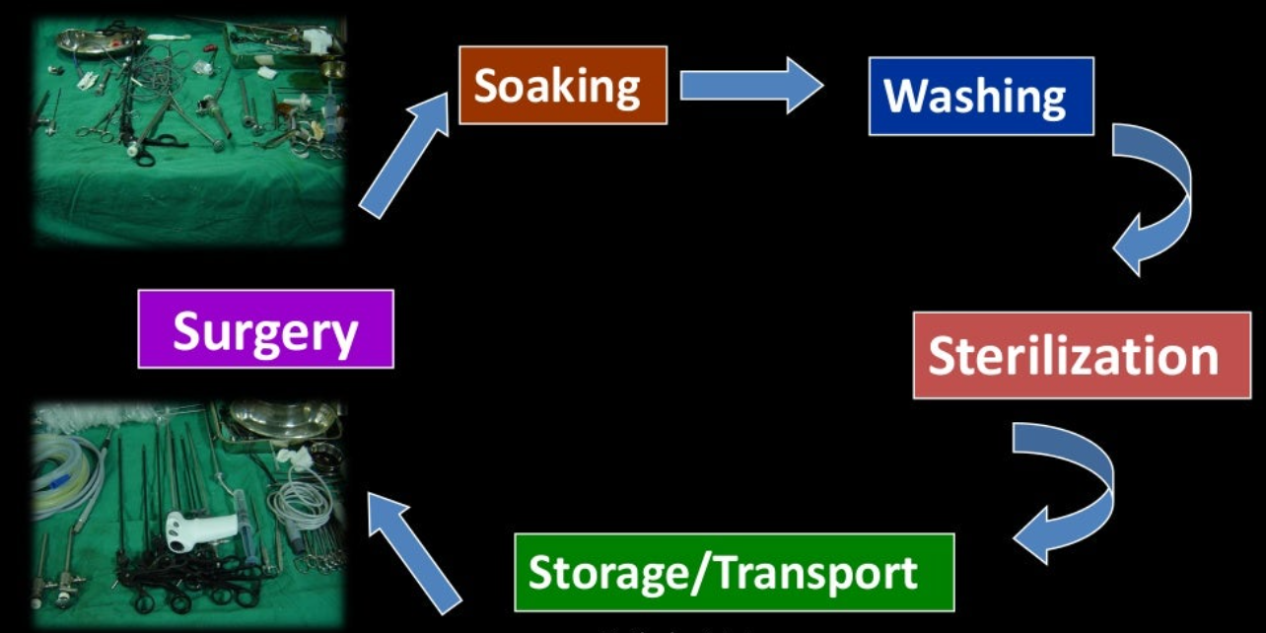
STERILIZATION CYCLE

Slide 28
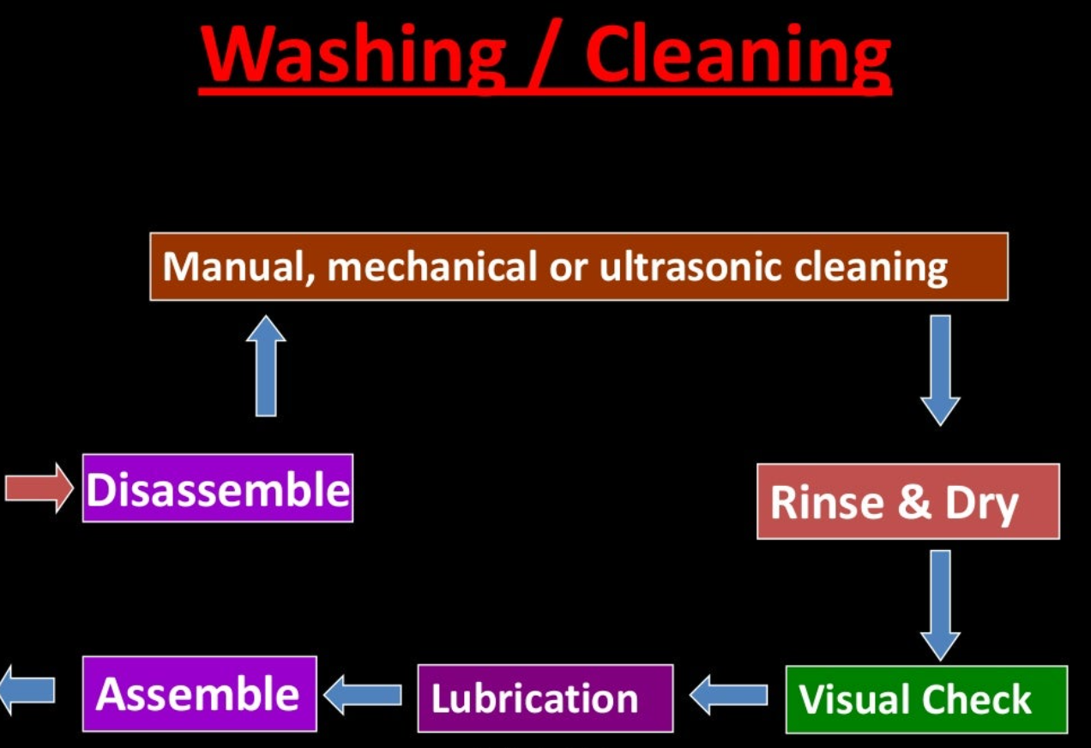
SOAK THEM EARLY-WASH THEM WELL

Slide 29
FRAPPER FORT ET FRAPPER VITE
Paul ehrlich

