Slide 1
Envenomation
-Snake bite & Stinging-
Dr. Rudra P. Pandey
Prof. Surgery & Radiology

Slide 2
Venom & Envenomation
Venom is a fluid produced by modified salivary glands in snakes or specialized glands of insects and arachnids.
Envenomation is a clinical condition produced by injection of venom in the body of a human being or animal after venomous snake bite or stinging.

Slide 3
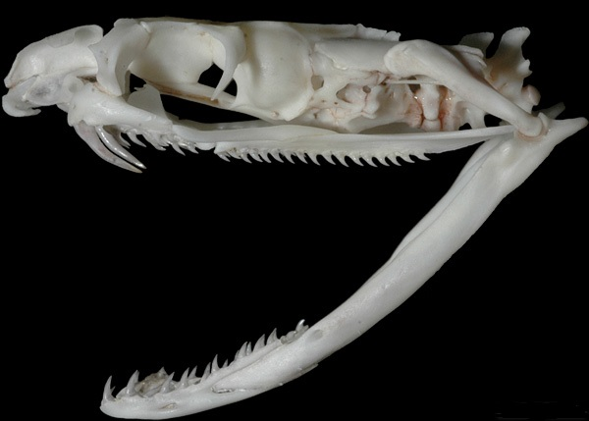
SNAKESSSSSS
are legless reptiles found in every continent….cold blooded
are basically of two types….venomous and non venomous
have two types of teeth…..harmless row of teeth directed backward on upper and lower jaw and the FANGS

Slide 4
Types – on the basis of fangs
Aglyphous – No Fangs
Opisthoglyphous – Back fangs or rear fangs with groove (Colubridae members)
Proteroglyphous – Front fangs with groove (Elapidae members)
Solenoglyphous – Fangs like injection needle (Viperedae members)

Slide 5
Venomous snakes of India
“THE BIG FOUR”
1. Russell’s viper (Daboia russelii)
2. Saw-scaled viper (Echis carinatus)
3. Krait:
a) Common krait (Bungarus caeruleus)
b) Banded Krait (Bungarus fasciatus):
c) Sea kraits
4. Common Indian Cobra or the Spectacled Cobra (Naja naja)

Slide 6
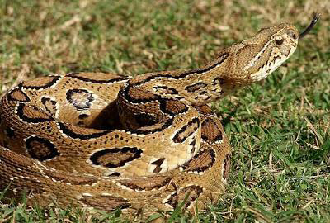
Russell’s viper

Slide 7
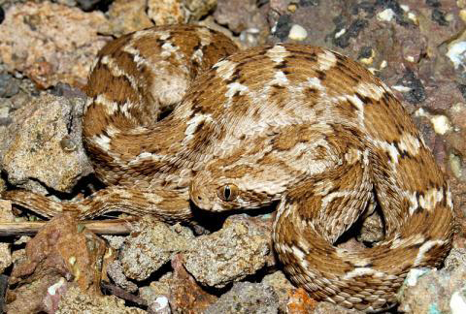
Saw scaled viper

Slide 8
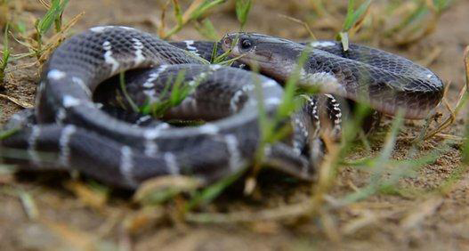
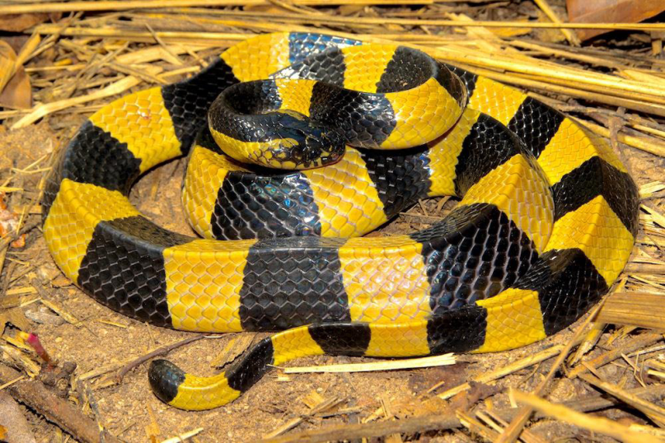
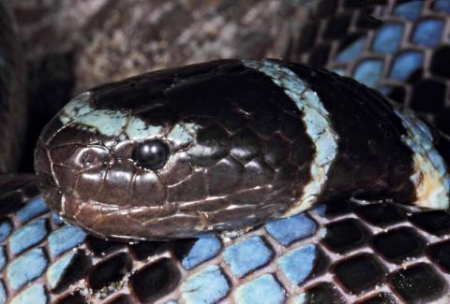
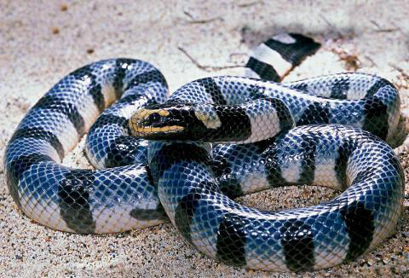
Kraits – Common, Banded, Sea

Slide 9
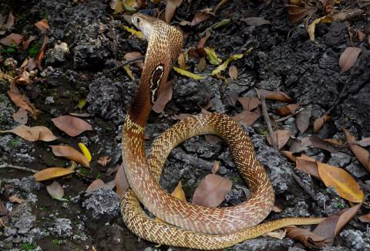
Common or spectacled Indian Cobra

Slide 10
Other venomous snakes of India
Less common ones
1. King Cobra (Ophiophagus hannah):
2. Malabar pit viper (Trimeresurus malabaricus):
3. Bamboo pit viper (Trimeresurus gramineusI):
4. Hump nosed pit viper (Hypnale hypnale):

Slide 11
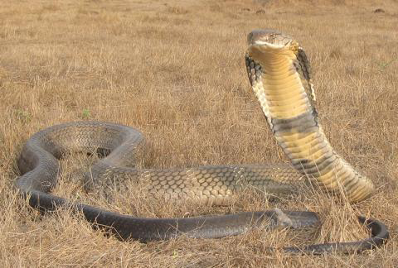
King Cobra

Slide 12
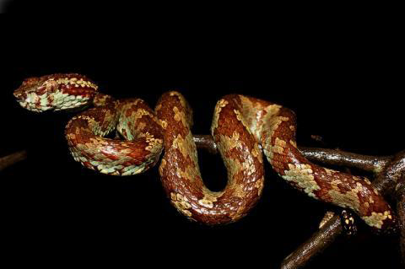
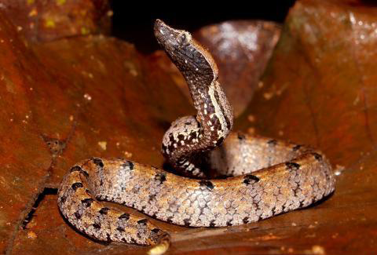
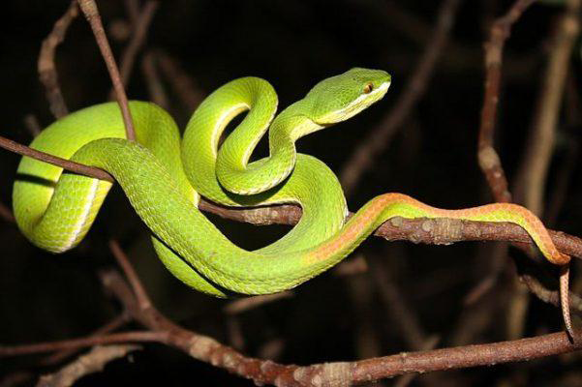
Malabar, Hump Nosed & Bamboo Pit Viper

Slide 13
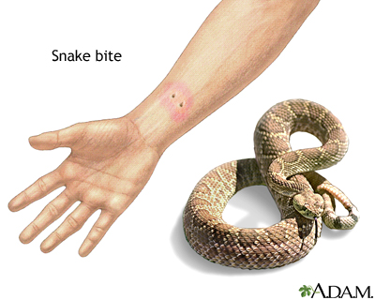
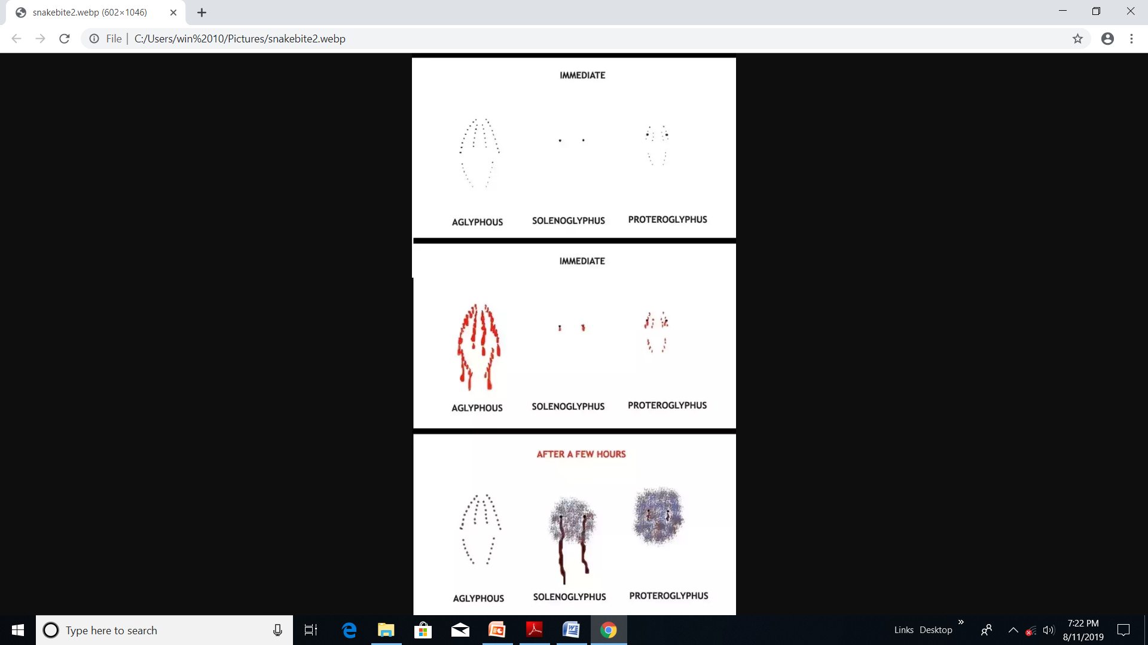
Bite

Slide 14
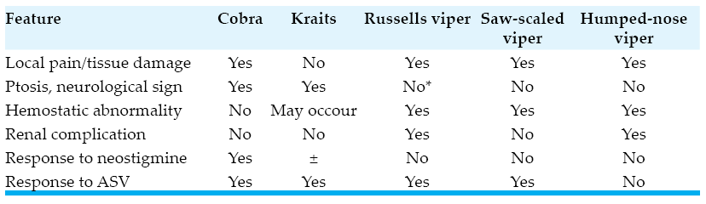
Clinical characteristics

Slide 15
First Aid - “CARRY NO R.I.G.H.T.
CARRY Do not allow victim to walk even for a short distance; just carry him, specially when bite is at leg.
No- Tourniquate
No- Electrotherapy
No- Cutting
No- Pressure immobilization
Nitric oxide donor (Nitrogesic ointment/ Nitrate Spray)
R: Reassure the patient. 70% of all snakebites are from nonvenomous species. Only 50% of bites by venomous species actually envenomate the patient
I: Immobilize in the same way as a fractured limb. Use bandages or cloth to hold the splints, not to block the blood supply or apply pressure. Do not apply any compression in the form of tight ligatures, they don’t work and can be dangerous
GH: Get to Hospital Immediately.

Slide 16
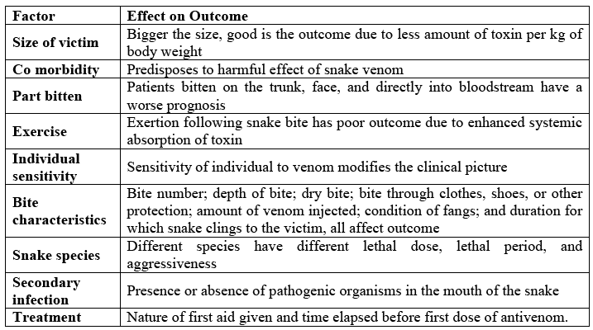
Factors affecting outcome

Slide 17
Antivenom
Polyvalent antivenoms raised in equines against venoms of Bungarus
Caeruleus, Naja naja, Daboia/Vipera russelli, Echis carinatus
Antivenoms are lyophilised (reconstituted to 10ml per vial) or liquid.
Recommended initial dosage for all these antivenoms is:
Bungarus caeruleus: 10-20 vials
Naja naja: 10-20 vials
Daboia/Vipera russelli: 10 vials
Echis carinatus: 5 vials (10 vials for E. c. sochureki in N and NW India)

Slide 18
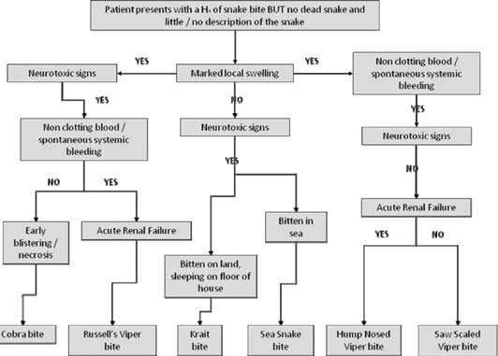

Slide 19
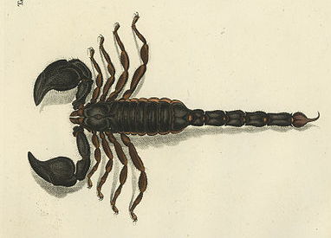
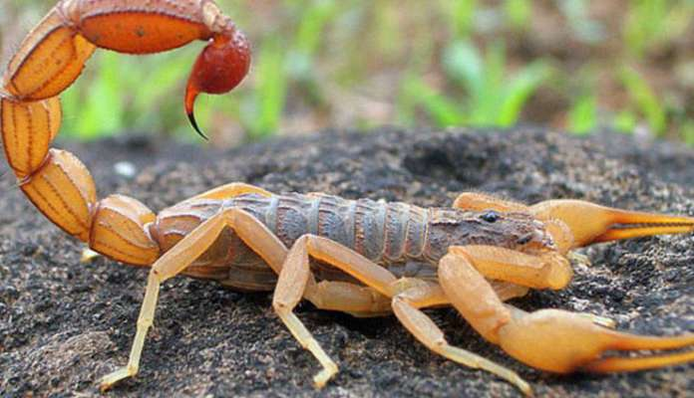
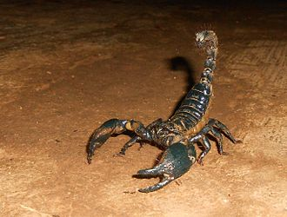
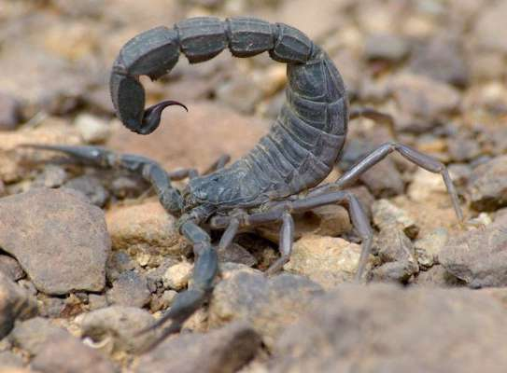
Scorpion – Types & Stinging
Red Indian scorpion
Black Indian scorpion
Giant forest scorpion
Fattali Indian scorpion

Slide 20
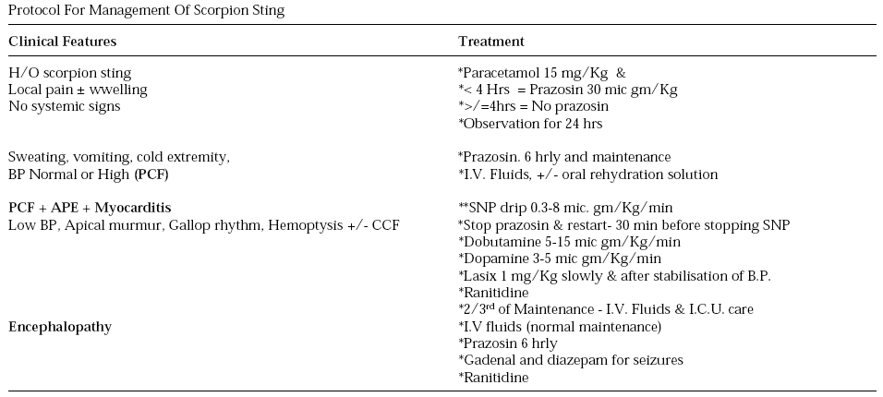
Protocol for management of SS
SS – Scorpion sting, PCF – Peripheral circulatory failure, APE – Acute pulmonary edema

Slide 21
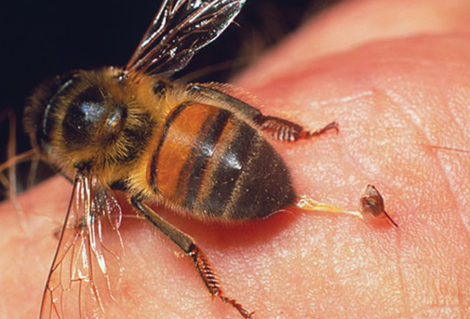
Bee & Wasp Sting

Slide 22
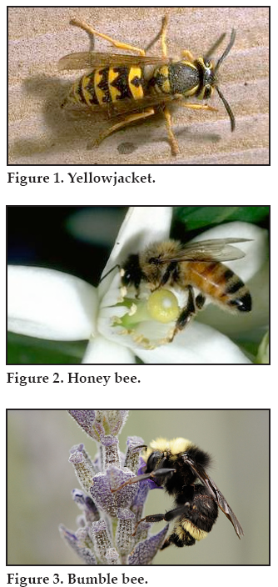
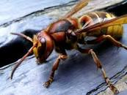
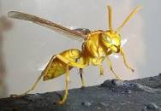
Types
BEE
GIANT ASIAN WASP
YELLOW INDIAN WASP
BUMBLE BEE

Slide 23
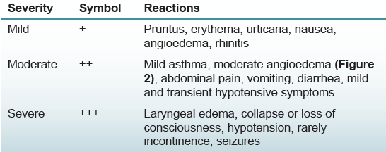
Severity assessment

Slide 24
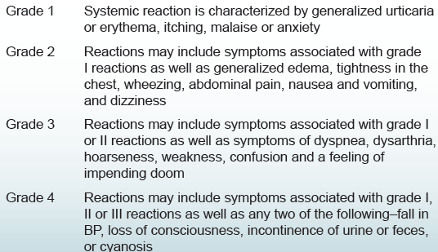
Grading

Slide 25
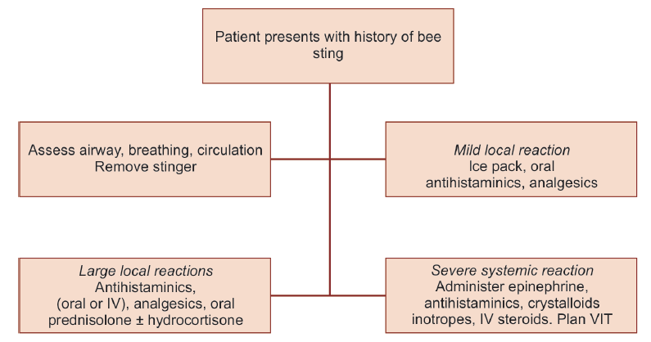

Slide 26
Mild single sting - care
Ice pack/diluted vinegar antihistaminics for bee sting,
Ice pack/soda bi carb for wasp sting.

Slide 27
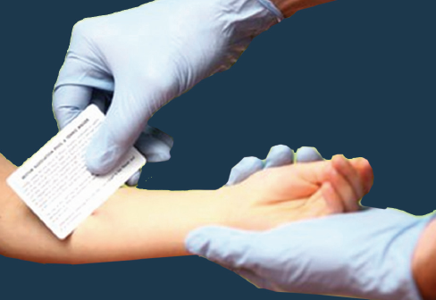
Stinger removal – proper way

Slide 28
Management - specifics
Assess airway patency, breathing and circulation
Aqueous epinephrine (1:1000), in a dose of 0.3–0.5 mL is for adults and 0.01 mL/kg (not exceeding 0.3 mL) for children
In case of hypotension, intravenous crystalloids should be given.
Vasopressors like dopamine and norepinephrine for hypotension
Antihistaminics in addition to epinephrine and not as its substitute
Nebulized β₂ agonist, salbutamol (2.5 mg diluted to 3 mL saline)
Methylprednisolone (125–250 mg IV)
Rapid removal of stinger. DO NOT SQEEZE
Multiple stings – aggressive treatment (epinephrine, antihistaminics, steroids and cal. gluconate (10 mL of 10% slow IV).
Observed for 12–24 hours coagulopathy, renal and neuro damage.
VIT – VENOM IMMUNOTHERAPY

