Slide 1
Ruminant Stomach -stenosis
Gulshan Kumar
Dept. of Veterinary Surgery & Radiology
College of Veterinary Science and Animal Husbandry
U.P. Pt. Deen Dayal Upadhyaya Pashuchikitsa Vigyan Vishwavidyalaya evam Go Anusandhan Sansthan, Mathura- 281 001

Slide 2
reticulo- omasal & pyloric stenosis
Clinically, two types of stenoses are seen in ruminants:
  Cranial Functional Stenosis (reticulo- omasal stenosis)
  Caudal Functional Stenosis (pyloric stenosis)
An animal may suffer from any one of these two or both.
Functional stenosis causes chronic indigestion called Vagal Indigestion or Hoflund’s Syndrome (syndrome described by Hoflund in 1940).
So it is such a dysfunction which impairs the passage of ingesta from the reticulo-rumen to the abomasum or from abomasum into the intestine.
Note: Although termed ‘vagal indigestion’, the vagus nerve may not always be associated in all cases of indigestion.

Slide 3
Clinical findings
Gradual development (over days to weeks) of abdominal distention secondary to rumino-reticular distention. Distention of the dorsal and ventral sacs of the rumen results in an “L-shaped” rumen on rectal examination.
Left dorsal and left and right ventral distention of the abdomen causes a “papple” (pear + apple) shape as viewed from behind.
Diminished appetite, which typically improves temporarily if distention is relieved.

Slide 4
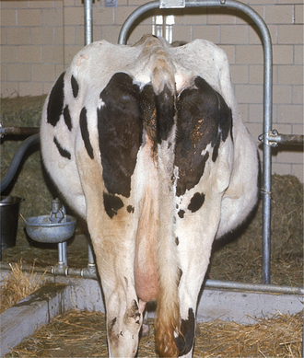
‘Papple’ shaped Abdomen

Slide 5
Clinical findings
Milk production falls, scant and sticky faeces, “splashy” fluid consistency of rumen.
Rumen motility is often increased (3–4 contractions/min) but contractions are weak.
Dehydration in later stages.

Slide 6
Diagnosis
Diagnosis is based on the presence of subacute to chronic rumino-reticular and abdominal distention.
Other causes of abdominal distention, such as ascites and uterine enlargement, are included in the differential diagnosis which can be excluded by rectal palpation because of the absence of rumino-reticular distention.

Slide 7
treatment and prognosis
Medical management alone is usually ineffective.
Laparo-rumenotomy is indicated to remove stenosis/obstruction (a foreign body, abscess etc.) in cranial functional stenosis. However, it is debatable in caudal functional stenosis.
Cathartics may be advised to promote evacuation of the gastrointestinal tract.
Low plasma K and Cl levels prevent resumption of pyloric function, intravenous administration of dextrose saline with k and Cl has been reported to have given favourable results.

Slide 8
Thanks

