Slide 1
Data analysis using computer software (MS-Excel)
by
Dr Rakesh Goel
Assistant Professor,
Deptt of Animal Genetics and Breeding
College of Veterinary Science & A.H., DUVASU, Mathura

Slide 2
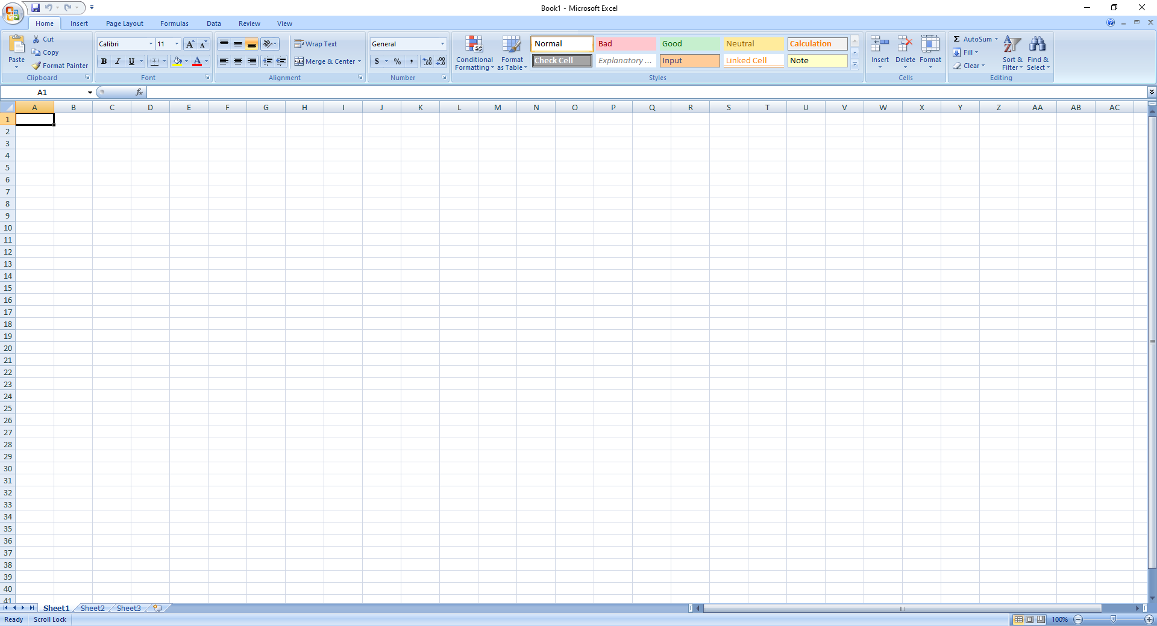
An Introduction to MS-Excel
MS-Excel is a commonly used Microsoft Office application. It is a spreadsheet program which is used to save and analyze numerical data. It is a spreadsheet program where one can record data in the form of rows and columns. It is easy to analyze data in an Excel spreadsheet. The image given below represents how an Excel spreadsheet looks like:

Slide 3
When you start Excel, a blank workbook appears in the document window. The workbook is the main document used in Excel for storing and manipulating data. A workbook consists of individual worksheet, each of which can obtain data. Initially, each new workbook you create contains 3 worksheets like: Sheet 1, Sheet 2 and Sheet 3, but you can add more worksheets later. The total number of worksheets in a workbook is 255. Each worksheet is made up of 16,384 columns and 10,48,576 rows. The columns are lettered across the top of the document window, beginning with A through Z and continuing with AA through AZ, BA through BZ and so on.

Slide 4
What is a Cell?
The intersections of rows and columns form cells, which are the basic units for storing data. Each cell takes its name from this intersection and is referred to as a cell reference. For example, the address of the cell at the intersection of column B and row 5 is referred to as cell B5.
Now, at the bottom of each worksheet is a series of sheet tabs, which enable you to identify each worksheet in the workbook. The tabs initially are labeled as Sheet1, Sheet2, Sheet3 and so on.

Slide 5
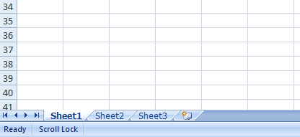
Creating a new spreadsheet
In MS-Excel, three sheets are already opened by default, now to add a new sheet :
In the lowermost pane in Excel, you can find a button.
Click on that button to add a new sheet.
Click to add a new sheet

Slide 6
Features of MS-Excel
Various editing and formatting can be done on an Excel spreadsheet. Discussed below are the various features of MS Excel.
The image below shows the composition of features in MS- Excel:

Slide 7
Home: Comprises options like: font size, font styles, font colour, background colour, alignment, formatting options and styles, insertion and deletion of cells and editing options.
Insert: Comprises options like: table format and style, inserting images and figures, adding graphs and charts, header and footer option, equation and symbols.
Page Layout: Themes, orientation and page setup options are available under the page layout option.
Formulas: Since tables with a large amount of data can be created in MS excel, under this feature, you can add formulas to your table and get quicker solutions.

Slide 8
Data: Adding external data (from the web), filtering options and data tools are available under this category.
Review: Proofreading can be done for an excel sheet (like spell check) in the review category and a reader can add comments in this part
View: Different views in which we want the spreadsheet to be displayed can be edited here. Options to zoom in and zoom out and pane arrangement are available under this category.

Slide 9
Benefits of using MS-Excel
MS Excel is widely used for various purposes because the data is easy to save, and information can be added and removed without any discomfort and less hard work.
Given below are a few important benefits of using MS Excel:
Easy To Store Data: Since there is no limit to the amount of information that can be saved in a spreadsheet, MS Excel is widely used to save data or to analyze data. Filtering information in Excel is easy and convenient.
Easy To Recover Data: If the information is written on a piece of paper, finding it may take longer, however, this is not the case with excel spreadsheets. Finding and recovering data is easy.
Application of Mathematical Formulas: Doing calculations has become easier and less time-taking with the formulas option in MS excel.

Slide 10
More Secure: These spreadsheets can be password secured in a laptop or personal computer and the probability of losing them is way lesser in comparison to data written in registers or piece of paper.
Data at One Place: Earlier, data was to be kept in different files and registers when the paperwork was done. Now, this has become convenient as more than one worksheet can be added in a single MS Excel file.
Neater and Clearer Visibility of Information: When the data is saved in the form of a table, analyzing it becomes easier. Thus, information is a spreadsheet that is more readable and understandable.

Slide 11
Starting MS-Excel
Click on the Start button
Move the mouse pointer to Programs
Select MS-Excel from the Programs and click
The following screen appears:
Name Box
Click here to accept the data
Click here to activate the Edit formula feature
Formula bar
Cell
Click here to reject the data

Slide 12
Entering Text
Text entries consist of alphanumeric characters such as letters, numbers and symbols. You can enter up to 32,767 characters in a single cell, although Excel may not be able to display all the characters. When you enter text in a cell, Excel stores entry as text and align it to the left edge of the cell. When you enter data that consists of numbers and text, Excel evaluates the entry to determine its value. If you want to enter a number as text, For example, Hemoglobin (Hb) would be read as a text entry. You can use the text when you want to enter a number but do not want Excel to interpret it as a value to be used in calculations.
Go to cell B1
Enter Hb in cell B1

Slide 13
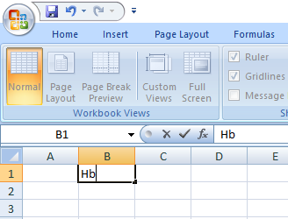
Creating a Series of data Entries
Excel recognizes common numerical data entries. For Example; 11.2, 12.4, 9.8
In cell B1 enter Hb
In cell B2 enter first data i.e. 11.2 then press Enter key
In cell B3 enter second data i.e. 12.4 then press Enter key
In cell B4 enter third data i.e. 9.8 then press Enter key

Slide 14
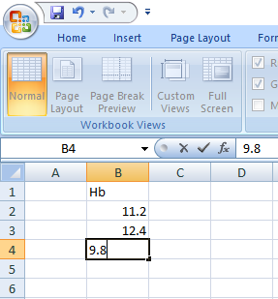
Release the mouse button

Slide 15
MS-Excel shortcuts
Ctrl+N: To open a new workbook.
Ctrl+O: To open a saved workbook.
Ctrl+S: To save a workbook.
Ctrl+C: To copy the selected cells.
Ctrl+V: To paste the copied cells.
Ctrl+X: To cut the selected cells.
Ctrl+W: To close the workbook.
Delete: To remove all the contents from the cell.
Ctrl+P: To print the workbook.
Ctrl+Z: To undo.

Slide 16
Formulas in Excel: An Overview
Choose a cell.
To enter an equal sign, click the cell and type =.
Enter the address of a cell in the selected cell or select a cell from the list.
You need to enter an operator.
Enter the address of the next cell in the selected cell.
Press Enter.
For Example: Suppose we are given the data
Qty | Price per unit
12 | 40
13 | 50
14 | 60
15 | 70

Slide 17
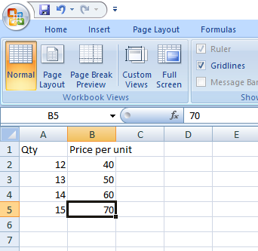
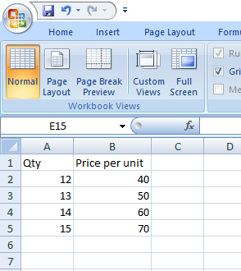
Now, first we enter the data in the worksheet, we see
Now, first we resize the cell of B1 (Because Price per unit is display out the available area of the cell. For adjusted the size, we drag the width of B1 cell and see

Slide 18
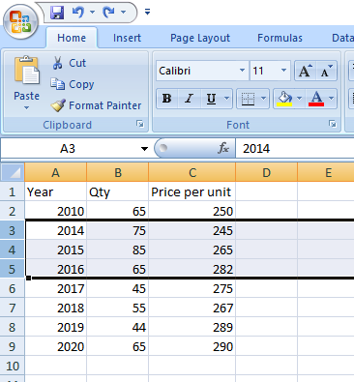
Inserting Rows or Columns
As you work with data, you might find yourself needing to add more rows and columns. Doing this one at a time would be super tedious. Luckily, there's an easier way.
To add multiple rows or columns in a spreadsheet, highlight the number of pre-existing rows or columns that you want to add. Then, right-click and select "Insert."
In this example, I add three rows after the year 2010 to the top of my spreadsheet.
Select three rows after the year 2010

Slide 19
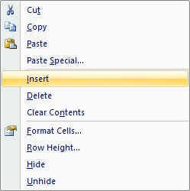
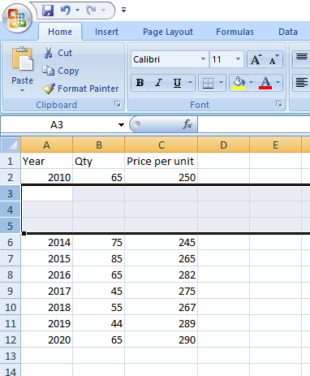
After selecting three rows, right click the mouse button
Press Insert button, then we get three rows after the year 2010

Slide 20
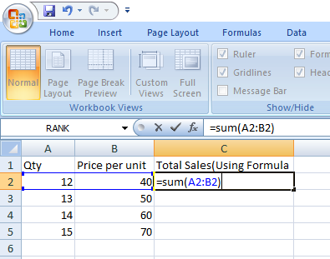
Addition or Sum
The SUM() function, as the name suggests, gives the total of the selected range of cell values. It performs the mathematical operation which is addition.
After entering the data of Qty and Price per unit (As per previous slide)
In cell C1 enter Total Sales (Using formula)
Add two numbers (A2+B2) and displayed in C2
To enter an equal sign, click the cell C2 and type =.
Enter the address of a cell in the selected cell like; =A2+B2 or =SUM(A2:B2)
Release the mouse button
See the result in the cell C2

Slide 21
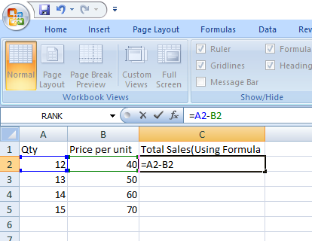
Subtract
After entering the data of Qty and Price per unit (As per previous slide)
In cell C1 enter Total Sales (Using formula)
Subtract two numbers (A2-B2) and displayed in C2
To enter an equal sign, click the cell C2 and type =.
Enter the address of a cell in the selected cell like; =A2-B2
Release the mouse button
See the result in the cell C2

Slide 22
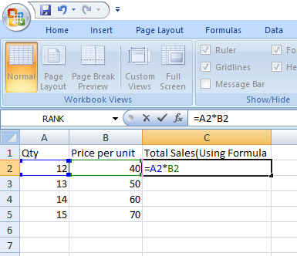
Multiplication
we have used the multiplication formula manually with the ‘*’ operator.
After entering the data of Qty and Price per unit (As per previous slide)
In cell C1 enter Total Sales (Using formula)
Multiply two numbers A2*B2 and displayed in C2
To enter an equal sign, click the cell C2 and type =.
Enter the address of a cell in the selected cell like; =A2*B2
Release the mouse button
See the result in the cell C2

Slide 23
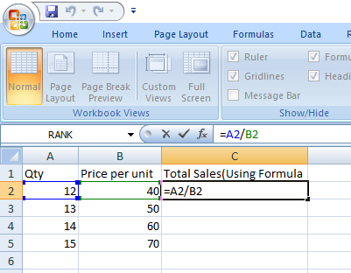
Division
we have used the division formula manually with the ‘/’ operator.
After entering the data of Qty and Price per unit (As per previous slide)
In cell C1 enter Total Sales (Using formula)
Multiply two numbers A2/B2 and displayed in C2
To enter an equal sign, click the cell C2 and type =.
Enter the address of a cell in the selected cell like; =A2/B2
Release the mouse button
See the result in the cell C2

Slide 24
Mathematical Order of Operations
Let's illustrate with a simple formula: 4+2*3
Since the multiplication must be done first, our expression resolves itself to 4+6=10
Let's practice with a more complex formula: (2*4)+3^2-8/4
Step 1 – Parentheses: 2*4 = 8. Now our expression reads: 8+3^2-8/4
Step 2 - Exponents: 3^2=9. Now our expression reads: 8+9-8/4
Step 3 - Multiply and Divide: 8/4=2. Now our expression reads: 8+9-2
Step 4 - Add and Subtract: The answer is 15
Now test your skill on a complicated formula! 3^(6/3)+(3*3)-2*(6-3)
Pass 1- Parentheses: 6/3=2, 3*3=9, and 6-3=2. So now our formula reads: 3^2+9-2*3
Step 2 - Exponents: 3^2=9. So now our formula reads: 9+9-2*3
Step 3 - Multiply and Divide: 2*3=6. So now our formula reads: 9+9-6
Step 4 - Add and Subtract: 12

Slide 25
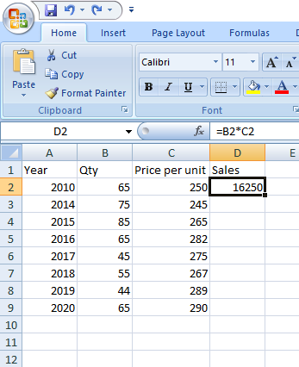
Autofill
Lets you quickly fill adjacent cells with several types of data, including values, series, and formulas.
There are many ways to deploy this feature, but the fill handle is among the easiest.
First, choose the cells you want to be the source.

Slide 26
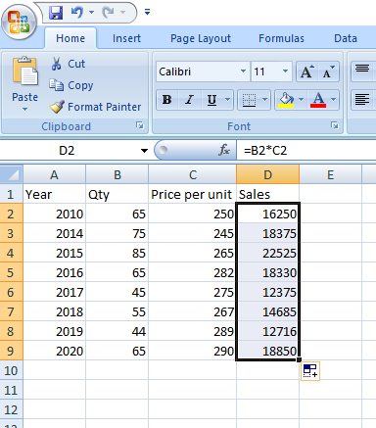
Next, find the fill handle in the lower-right corner of the cell. Then either drag the fill handle to cover the cells you want to fill.

Slide 27
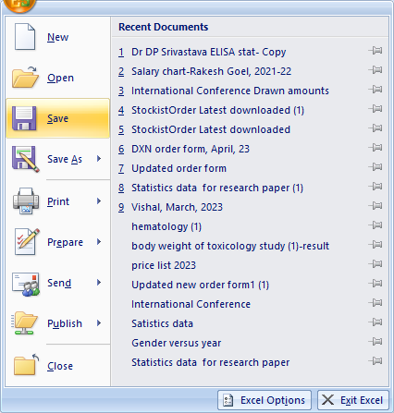
Saving your worksheets
Choose Save from the Office Button
Press Save, then we see a new window

Slide 28
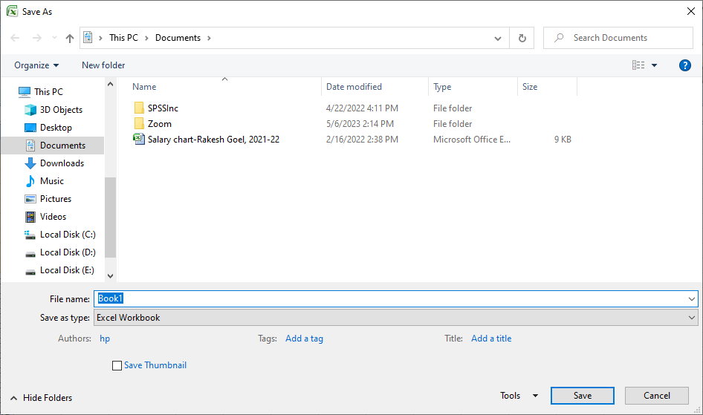
Give the name of file in place of Book1 like: Surjeet
Then, press Save

Slide 29
Average
Excel recognizes common numerical data entries. For example 11.2, 12.4, 9.8, 13.4, 14, 12.4
In this case, cell B1 enter Hb
In cell B2 enter first data i.e. 11.2 then press Enter key
In cell B3 enter second data i.e. 12.4 then press Enter key
In cell B4 enter third data i.e. 9.8 then press Enter key
In cell B5 enter fourth data i.e. 13.4 then press Enter key
In cell B6 enter fifth data i.e. 14 then press Enter key
In cell B7 enter sixth data i.e. 12.4
Release the mouse button

Slide 30
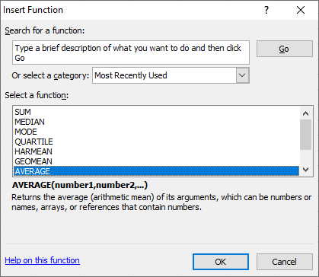
In the cell A8 enter A.M.
In the cell B8 set for calculate Average (Arithmetic Mean)
Then press OK, then in the cell B8 we see the formula = AVERAGE (B2:B7)

Slide 31
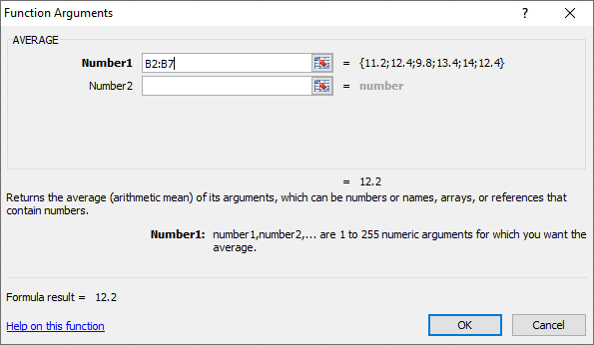
Then modify the formula press = AVERAGE (B2:B7)
Press OK
We see the result of average in the cell B8

Slide 32
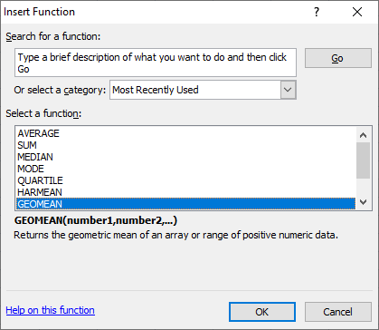
Geometric Mean (G.M.)
In the cell A10 enter G.M.
In the cell B10 set for calculate Geometric Mean i.e. GEOMEAN
Then press OK, then in the cell B10 we set the formula = GEOMEAN (B2:B7)

Slide 33
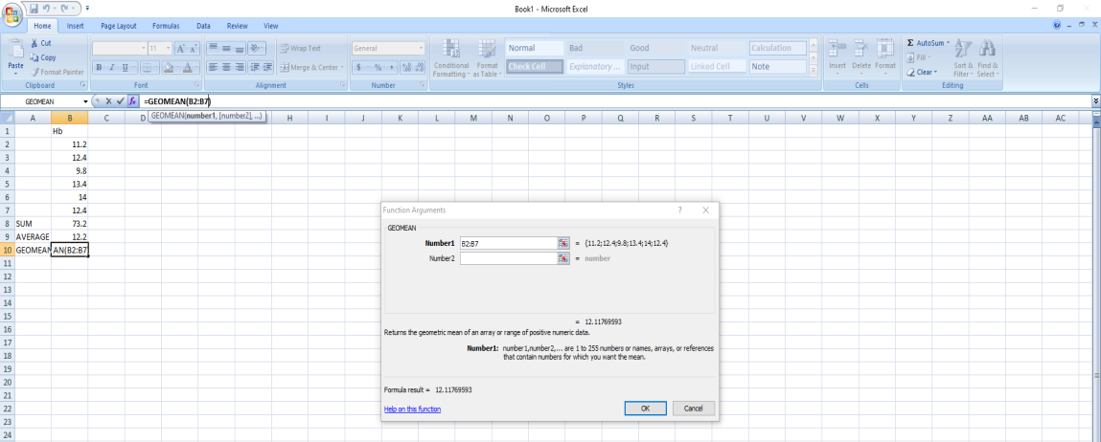
Press OK,
We see the result of Geometric Mean in the cell B10

Slide 34
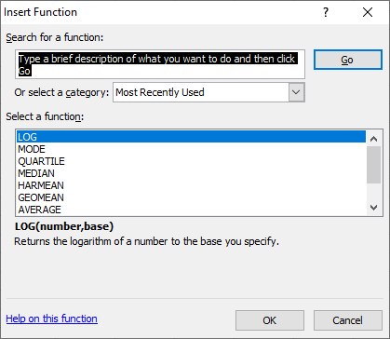
Log and Antilog
In cell C1 enter Log X
In cell C2 enter first data i.e. 11.2 then using formula = LOG (B2) with base of 10
Then press OK
Next select the cell data i.e. B2 and then give base i.e. 10

Slide 35
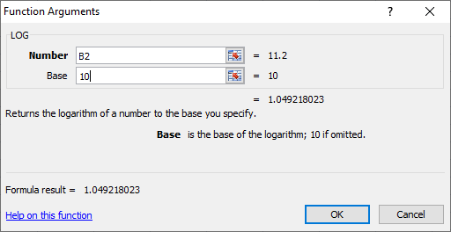
Press OK,
Double click the + sign in cell C2 to fill the remaining values in column C
Now, if we want Antilog of log value in cell D2, use the formula = 10^C2 and press Enter key

Slide 36
Double click the + sign in cell D2 to fill the remaining values in column D

Slide 37
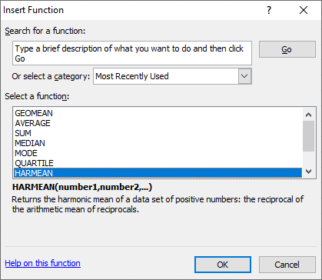
Harmonic Mean (H.M.)
In the cell A11 enter H.M.
In the cell B11 set for calculate Harmonic Mean i.e. HARMEAN
Then press OK, then in the cell B11 we set the formula = HARMEAN (B2:B7)

Slide 38
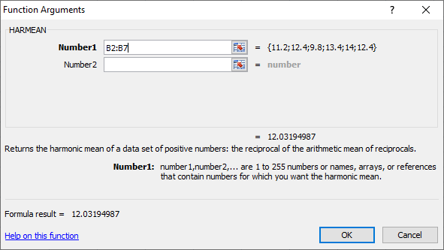
Press OK,
We see the result of Harmonic Mean in the cell B11

Slide 39
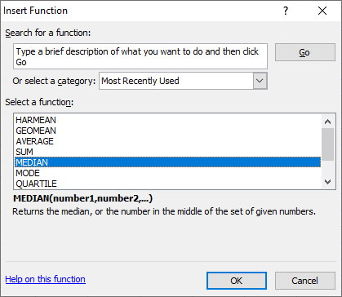
Median
In the cell A12 enter Median
In the cell B12 set for calculate Median
Then press OK, then in the cell B12 we set the formula = MEDIAN (B2:B7)

Slide 40
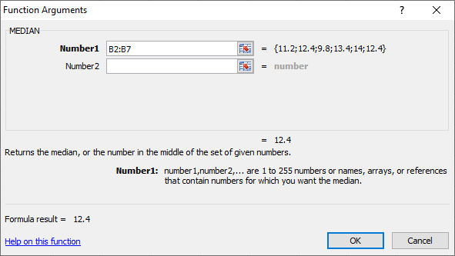
Press OK,
We see the result of Median in the cell B12

Slide 41
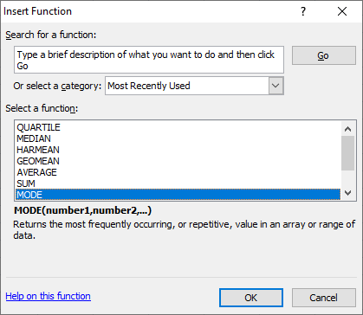
Mode
In the cell A15 enter Mode
In the cell B15 set for calculate Mode
Then press OK, then in the cell B15 we set the formula = MODE (B2:B7)

Slide 42
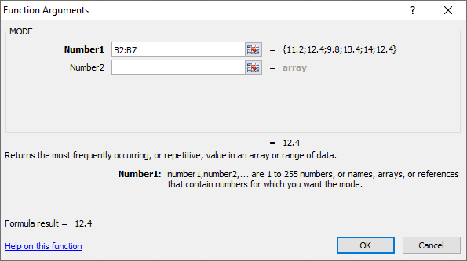
Press OK,
We see the result of Mode in the cell B15

Slide 43
Cumulative Frequency
In cell E1 enter Cumulative frequency less than type (CFLTT)
In cell E2 using formula = B2 then Enter key i.e. we see the data 11.2
New, in cell E3 using formula = E2 + B3, we see the result 23.6
Double click the + sign in cell E3 to fill the remaining values in column E

Slide 44
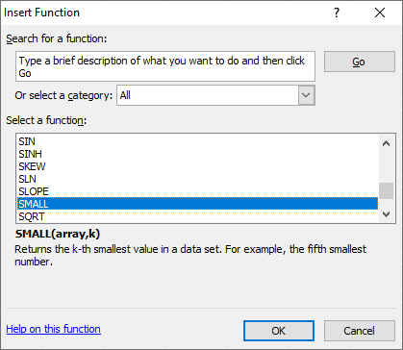
Range
Create a data series in Excel recognizes common numerical data entries. For example Suppose Vitamin D (ng/mL) values in the blood sample of 10 dogs in the OPD as recorded below:
Vitamin D (ng/mL): 11.4 19.2 24.4 32.7 53.4 15.7 44.2 33.7 5.8 12.7
In the cell A12 enter Xmin
In the cell B12 set for calculate for smallest value in data series
Add data in cells B2 to B11.
Put the formula =SMALL(B2:B11) in cell B12

Slide 45
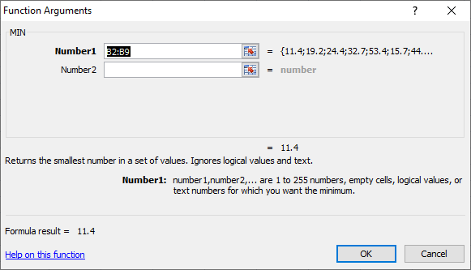
Then press OK, then in the cell B12 we set the formula = MIN(B2:B11)
Press OK
In the cell A13 enter Xmax
In the cell B13 set for calculate for largest value in data series
Add data in cells B2 to B11

Slide 46
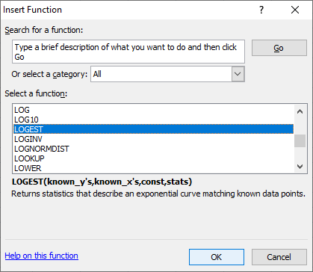
Now, add the formula in cell B13 =LARGE(B2:B11) in cell B13
Then press OK, then in the cell B13 we set the formula = LARGEST (B2:B11)
Press OK
In the cell A13 enter Xmax
In the cell B13 set for calculate for largest value in data series
Add data in cells B2 to B11.
Now, add the formula in cell B13 =LARGE(B2:B11) in cell B13

Slide 47
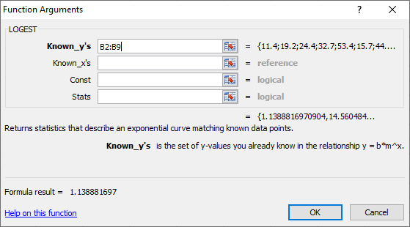
Press OK
Subtract the two formulas by adding =B13-B12 in cell B14
Now, you got the range of data

Slide 48
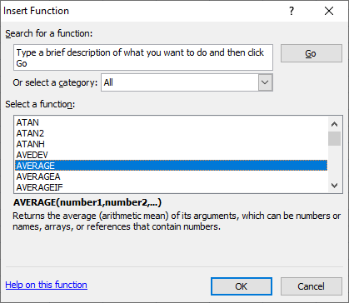
Mean Deviation
In the above example, enter the data values in cells B2:B11
In the cell A15 enter AVERAGE
First, find the mean value in cell B15 and type the formula =AVERAGE (B2:B11)
Then we see the calculated mean value in cell B15

Slide 49
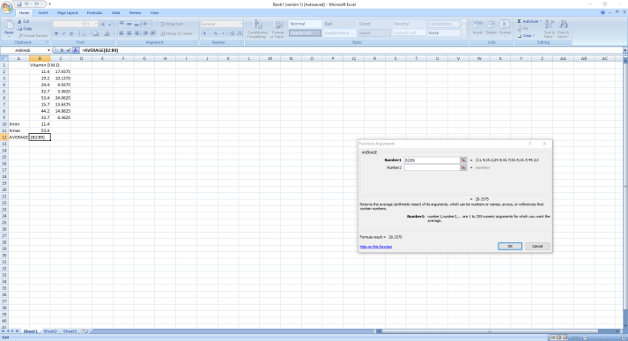
Press OK, then
Press OK
Now, calculate the Absolute deviations in the cells C2,
Using the following formula =ABS(B2-$B$12)

Slide 50
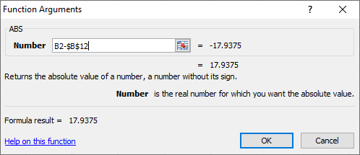
Press OK. This calculates the absolute deviation of the value in cell B2 from the mean value in the dataset.
Double click the + sign in cell C2 to fill the remaining values in column C

Slide 51
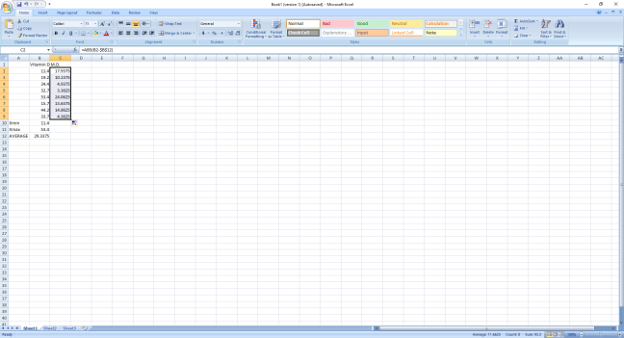
Calculate the Mean Absolute Deviation. In cell C13; type the following formula =AVERAGE(C2:C11)
In the cell A13 enter M.D.
This calculates the mean absolute deviation for the data values

Slide 52
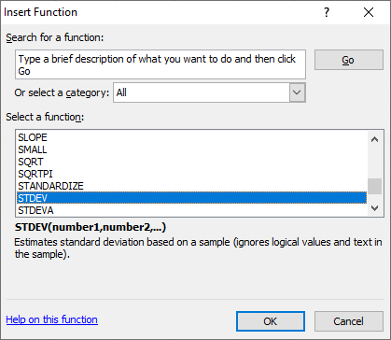
Standard Deviation
In the above example, In the cell A14 enter S.D.
Put the formula =STDEV (B2:B11)

Slide 53
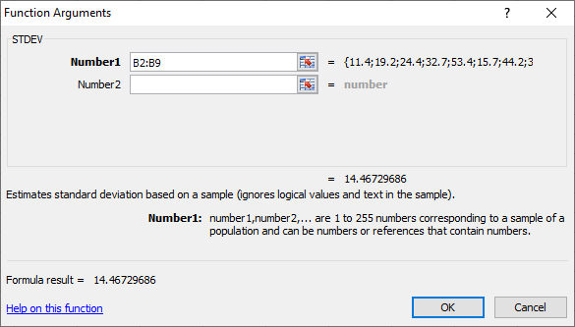
Press OK
Then, again press OK.
We get Standard Deviation for the data values

Slide 54
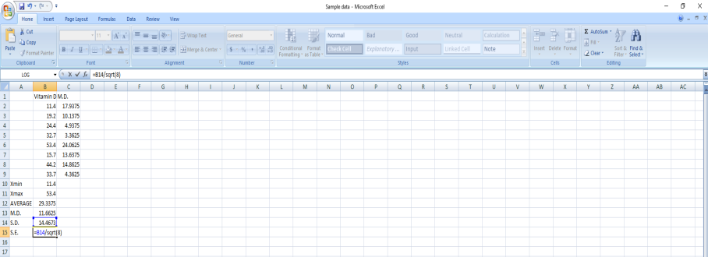
Standard Error
In the above example, In the cell A15 enter S.E.
Put the formula =B14/SQRT(Number)
Press OK.
We get Standard Error for the data values

Slide 55
Variance
In the above example, In the cell A16 enter Variance i.e. (S.D.)²
Put the formula =SUMSQ(A14)
Press OK.
We get the Variance for the data values
Coefficient of Variation
In the above example, In the cell A17 enter C.V.
Put the formula =A14*100/A15
Press OK.
We get Coefficient of Variation for the data values

Slide 56
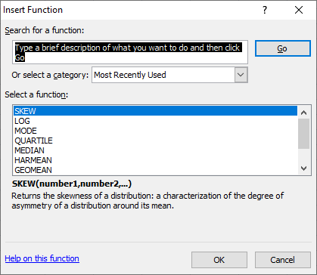
Skewness
Create a data series in Excel recognizes common numerical data entries. For example Calculate skewness for the Hba1C (%) values in the blood of 10 dogs as recorded below:
Hba1C (%): 4.9 5.6 9.8 13.5 11.2 8.9 7.2 5.9 6.2 7.1
In the cell A12 enter Skewness
In the cell B12 set for calculate for Skewness value in data series

Slide 57
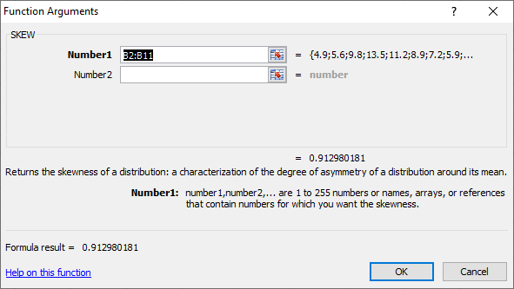
Press OK
Put the formula =SKEW(B2:B11) in cell B12
Press OK

Slide 58
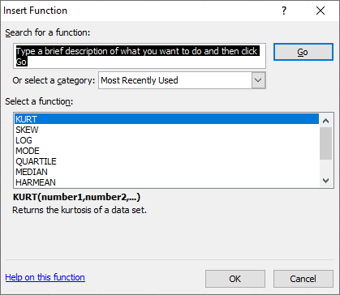
Kurtosis
In the above example, the cell A13 enter Kurtosis
In the cell B13 set for calculate for Kurtosis value in data series
Press OK
Put the formula =KURT(B2:B11) in cell B13

Slide 59
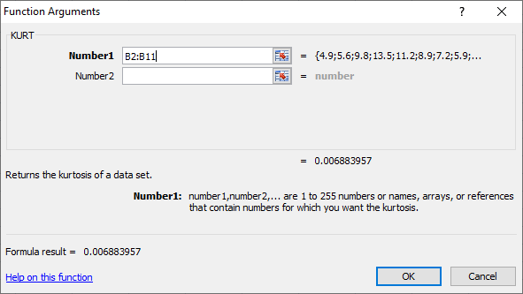
Press OK
Put the formula =SKEW(B2:B11) in cell B12
Press OK
Then, we see the kurtosis value in cell B13, if it is positive, that means, the curve is more peaked than the normal curve i.e. leptokurtic. If it is negative, that means, the curve is less peaked i.e., platykurtic. If it is zero, the curve is less peaked i.e., mesokurtic

Slide 60
Charts and Graphs
Charts and graphs are used to make information clearer and easier to understand. A good picture is worth a thousand numbers. The most common place for people to see charts and graphs is in the news, exhibitions, fairs, etc. News publishers use graphics all the time to show comparisons and explain important trends for things such as weather, gold and silver prices, crime rate, or who is winning an election and by how much.
Charts and graphs are also critical to engineers, scientists and financial analysts who use them to help visualize large amounts of information, make better decisions, and communicate their results to other people.

Slide 61
There are good reasons for learning to create charts by hand, but there are also some great tools that everyone want to learn how to use at some point, such as Excel. There are some common types of charts that we can create with Excel. There are some commonly used charts;
Simple Bar Charts: Create a data series in Excel recognizes common numerical data entries. For example, Create bar chart for the following data gives the number of livestock population at different farms in U.P.
Farms | A | B | C | D | E | F | G
Livestock Population | 100 | 150 | 240 | 450 | 645 | 340 | 275

Slide 62
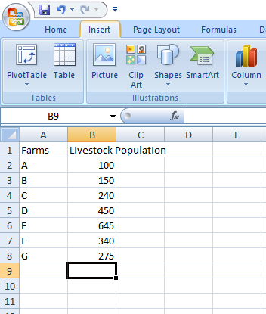
In the cell A1 enter Farms
In the cell B1 enter Livestock population
In cell A2: A8 enter the names of farms like: A, B, C, …,G
In cell B2: B8 enter the data series
Click the Insert tab

Slide 63
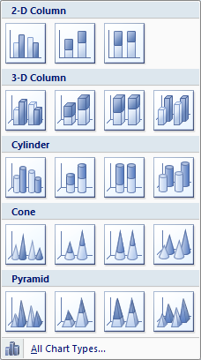
When data has been entered and your cursor is immediately below the entered date, press the F11 key on the top row of your keyboard.
Select the chart type in the charts group
Click a chart subtype

Slide 64
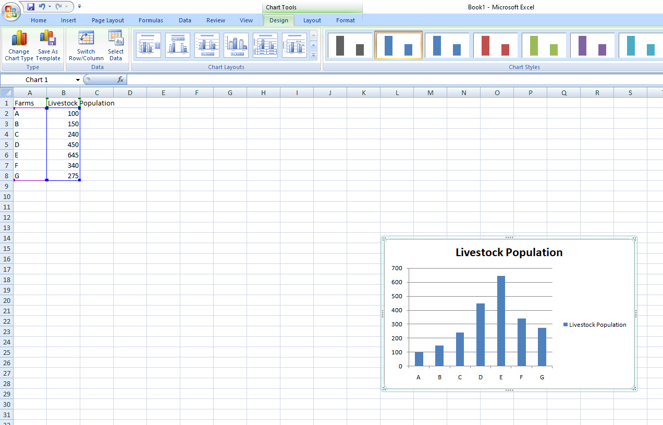
Press OK
The recommended chart is inserted into the worksheet
Viewing the Chart Tab - There are things that you probably wish to change about the chart. The new Office 2007 tabs allow you to quickly make those changes. As soon as the chart is created, a new tab appears on the ribbon, the Chart Tools. Click away from the chart and this tab will disappear. To bring it back, click on the chart one time. To see the tab, click on the Chart Tools tab at the top of the ribbon.

Slide 65
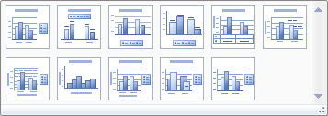
Select and click the chart design in the chart Layouts group and select Layout 9.
Changing the chart type - Click on the change Chart Type button on the left to see all of the available chart type
Changing Chart Layout - On the Chart Tools tab, the third section from the left is named Chart Layouts. Near the bottom right portion of that area you will see a small button which will allow you to see all available layouts. Click one time on the button to see layouts.

Slide 66
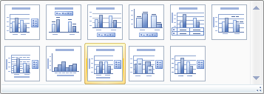
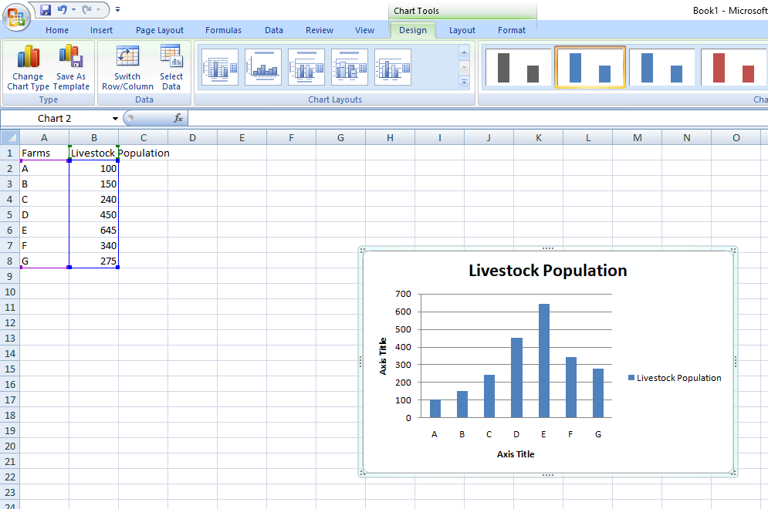
If we want to add the axis titles on both sides i.e. x-axis and y-axis, as per highlighted design.
Then, we see the chart prepared is modified

Slide 67
Now, If we want to delete the index (Here only one variable are their. Then we don’t want to display single variable index.
Right click on the index name
Then, press Delete
we see the chart prepared is modified

Slide 68
Click on Axis title in chart on X-axis and give the name of axis like: Farms, on Y-axis give the name of axis like: Livestock population
Changing the Chart Style - Four dozen different styles are available. On the Chart Tools tab the next area is named Chart Styles. Near the bottom right portion of that area you will see a small button which will allow you to see all available styles. To see all available styles, click one time on the button.

Slide 69
Now, If we want to delete the horizontal gridlines between bars, then go to Layout option.
Press Gridlines option, then we see all available styles.
Press Primary Horizontal Gridlines

Slide 70
Press None option for deleting gridlines

Slide 71
Now, If we want to delete the boundary line of the chart, then press right click on the surface of the chart. Then we see
Press last option Format Chart Area, we see

Slide 72
Press Border Color option. Then select No line
Press Close button

Slide 73
Multiple Bar Charts: Create a data series in Excel recognizes common numerical data entries. For example, Draw multiple bar diagram for the following data gives the yield rate of milk(kg/day) during 2021-22 in five major milk producing states in India (as per Basic Animal Husbandry Statistics 2022):
States | Yield (kg/day)
 | Exotic | Indigenous
Punjab | 13.88 | 9.17
Haryana | 10.14 | 6.63
Gujarat | 9.51 | 4.55
Maharashtra | 10.38 | 2.34
Kerala | 10.39 | 3.29

Slide 74
In the cell A1 enter States
In the cell B1 enter Exotic
In the cell C1 enter Indigenous
In cell A2: A8 enter the names of States like: Punjab, ……, Kerala
In cell B2: B8 enter the data series of yield of Exotic breeds
In cell C2: C8 enter the data series of yield of Indigenous breeds
Click the Insert tab

Slide 75
When data has been entered and your cursor is immediately below the entered date, press the F11 key on the top row of your keyboard.
Select the chart type in the charts group
Click a chart subtype and press first option in 2-D Column

Slide 76
Press OK
The recommended chart is inserted into the worksheet
Select and click the chart design in the chart Layouts group and select Layout 9.
Changing the chart type - Click on the change Chart Type button on the left to see all of the available chart type

Slide 77
Changing Chart Layout - On the Chart Tools tab, the third section from the left is named Chart Layouts. Near the bottom right portion of that area you will see a small button which will allow you to see all available layouts. Click one time on the button to see layouts.
If we want to add the axis titles on both sides i.e. x-axis and y-axis, as per highlighted design.

Slide 78
Then, we see the chart prepared is modified

Slide 79
Now, If we want to show legend at another place like: at top
Select and click the Layout group
Then, press Legend in Labels group
Then, select Show Legend at Top

Slide 80
we see the chart prepared is modified

Slide 81
Now, If we want to change bar color, then single click on any bar
Then, each bar of the same color selected
Place the cursor at any selected bar
Then, right click and we see the chart prepared is modified

Slide 82
Select last option i.e. Format Data Series

Slide 83
Click second option i.e. Fill, then we see

Slide 84
Click second option i.e. Solid Fill, then select color in Theme Colors
Press Close button
Then, we see the color changes in all the bars of same color as well as legend color of that bar.

Slide 85
Sub-divided Bar Charts: Create a data series in Excel recognizes common numerical data entries. For example, Draw sub-divided bar diagram for the following data gives the expenditure on ration (Rs. in Lakh) recorded at U.P. Veterinary University Dairy Farm, Mathura during different years:
Expenditure | Farm-A | Farm-B
Dry Fodder | 125 | 135
Green Fodder | 30 | 40
Concentrate | 15 | 25

Slide 86
In the cell A1 enter Expenditure
In the cell B1 enter Farm-A
In the cell C1 enter Farm-B
In cell A2: A4 enter the names of expenditure like: Dry fodder, Green fodder and Concentrate
In cell B2: B4 enter the data series of expenditure in Farm-A
In cell C2: C4 enter the data series of expenditure in Farm-B
Click the Insert tab

Slide 87
When data has been entered and your cursor is immediately below the entered date, press the F11 key on the top row of your keyboard.
Select the chart type in the charts group
Click a chart subtype and press second option in 2-D Column

Slide 88
Press OK
The recommended chart is inserted into the worksheet
Select and click the chart design in the chart Layouts group and select Layout 9.
Changing the chart type - Click on the change Chart Type button on the left to see all of the available chart type

Slide 89
Changing Chart Layout - On the Chart Tools tab, the third section from the left is named Chart Layouts. Near the bottom right portion of that area you will see a small button which will allow you to see all available layouts. Click one time on the button to see layouts.
If we want to add the axis titles on both sides i.e. x-axis and y-axis, as per highlighted design.

Slide 90
Then, we see the chart prepared is modified

Slide 91
Now, If we want to show legend at another place like: at top
Select and click the Layout group
Then, press Legend in Labels group
Then, select Show Legend at Top

Slide 92
we see the chart prepared is modified

Slide 93
Pie Charts: Create a data series in Excel recognizes common numerical data entries. For example, Draw pie diagram for the following data gives species wise meat contribution (In percentage) in India during the year 2021-22:
Species | Meat Contribution
Cattle | 3.18
Buffalo | 17.49
Sheep | 10.33
Goat | 13.63
Pig | 3.93
Poultry | 51.44

Slide 94
In the cell A1 enter Species
In the cell B1 enter Meat contribution
In cell A2: A7 enter the names of species like: Cattle, Buffalo, ……….., Poultry
In cell B2: B7 enter the data series of meat contribution
Click the Insert tab

Slide 95
When data has been entered and your cursor is immediately below the entered date, press the F11 key on the top row of your keyboard.
Select the chart type in the charts group
Click a chart subtype and press third option in Pie

Slide 96
Press OK
The recommended chart is inserted into the worksheet
Select and click the chart design in the chart Layouts group and select Layout 6.
Changing the chart type - Click on the change Chart Type button on the left to see all of the available chart type

Slide 97
Changing Chart Layout - On the Chart Tools tab, the third section from the left is named Chart Layouts. Near the bottom right portion of that area you will see a small button which will allow you to see all available layouts. Click one time on the button to see layouts.
If we want to add the meat contribution (%), as per highlighted design.

Slide 98
Then, we see the chart prepared is modified

Slide 99
Now, If we want to show Data Labels at another place like: Center
Select and click the Layout group
Then, press Data Labels in Labels group
Then, select second option Center

Slide 100
we see the chart prepared is modified

Slide 101
Line graph: Create a data series in Excel recognizes common numerical data entries. For example, Construct line graph for the following data is related to the expenditure and income statement in different years at a dairy farm:
Years | First | Second | Third | Fourth | Fifth | Sixth | Seventh
Expenditure (Rs. In lakh) | 190 | 195 | 205 | 226 | 238 | 265 | 289
Income (Rs. In lakh) | 175 | 189 | 200 | 215 | 225 | 245 | 260

Slide 102
In the cell A1 enter Years
In the cell B1 enter Expenditure
In the cell C1 enter Income
In cell A2: A8 enter the years like: 2016, 2017, ….., 2022
In cell B2: B8 enter the data series of expenditure
In cell C2: C8 enter the data series of income
Click the Insert tab

Slide 103
When data has been entered and your cursor is immediately below the entered date, select the chart type in the charts group
Click a chart subtype and press second option in Line and select fourth option Line with Markers

Slide 104
Press OK
The recommended chart is inserted into the worksheet
Select and click the chart design in the chart Layouts group and select Layout 10.

Slide 105
Changing Chart Layout - On the Chart Tools tab, the third section from the left is named Chart Layouts. Near the bottom right portion of that area you will see a small button which will allow you to see all available layouts. Click one time on the button to see layouts.
Then, we see the chart prepared is modified

Slide 106
Histogram: Create a data series in Excel recognizes common numerical data entries. For example, Construct histogram for body weight (kg) of goats are as follows:
In the cell A1 enter Body weight
In the cell B1 enter No. of goats
In cell A2: A8 enter the data of body weight like: 38-40, 40-42, ……….., 50-52
In cell B2: B8 enter the data series of number of goats
Click the Insert tab
Body weight (kg) | 38-40 | 40-42 | 42-44 | 44-46 | 46-48 | 48-50 | 50-52
No. of goats | 18 | 24 | 35 | 45 | 40 | 32 | 22

Slide 107
When data has been entered and your cursor is immediately below the entered date, select the chart type in the charts group
Click a chart subtype and press first option in Column and select first option in 2-D Column

Slide 108
Press OK
The recommended chart is inserted into the worksheet

Slide 109
Select and click the chart design in the chart Layouts group and select Layout 9.

Slide 110
Changing Chart Layout - On the Chart Tools tab, the third section from the left is named Chart Layouts. Near the bottom right portion of that area you will see a small button which will allow you to see all available layouts. Click one time on the button to see layouts.
Then, we see the chart prepared is modified

Slide 111
Now, cursor moves on any bar and click the mouse
Then, we see all bars are selected
Right click the mouse and select last option Format Data Series, we see
Then, press OK, we see

Slide 112
Now, we see Gap Width, which is automatically 150%
Move the pointer left side and Gap Width change to 0%
We see in the left side showing No Gap and press Close at bottom
Then, we see the chart prepared is modified

Slide 113
Now, Right Click on Legend place on right side of the graph
We see the chart prepared is modified
Then, press first option Delete
Now, right click on the surface of bar
We see the chart prepared is modified

Slide 114
Now, If we want to delete the horizontal gridlines between bars, then go to Layout option.
Press Gridlines option, then we see all available styles.
Press Primary Horizontal Gridlines

Slide 115
We see the chart prepared is modified

Slide 116
Now, cursor moves on any bar and click the mouse
Then, we see all bars are selected
Right click the mouse and select last option Format Data Series, we see
Then, first select No Fill and press Close, we see

Slide 117
Press None option for deleting gridlines

