Slide 1
Basic Concept of Radiographic Evaluation of Veterinary Patients Dr Sanjay Purohit Department of Surgery and Radiology, DUVASU, Mathura
Prof. Sanjay Purohit – Educational & Confidential - contents – collected from different sources -not permitted for replication & commercial purposes

Slide 2
Radiograph
shadowgraph…..geometric rules applicable to the formation of shadows are also valid for radiographs.
Outlines an object in only two planes, at least two views, made at right angles to one another (orthogonal views), are required to demonstrate the object in a three-dimensional representation

Slide 3
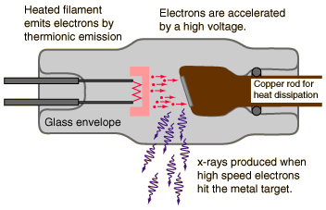
X-ray production
High energy electrons, accelerated by thousands of kilovolts of potential, interact with a metal target in an x-ray tube.

Slide 4
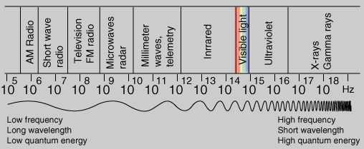
X-rays
Frequencies: >3 x 10¹⁶ Hz.
Wavelengths: <10 nm.
Quantum energies: >124 eV.

Slide 5
Five radiographic opacities can be recognized:
Metal…….. ………………….Bright white
Bone or mineral…………………. White
Fluid or soft tissue……………… Grey
Fat. …………………………..Darker grey
Gas (air)…………………………….. Black

Slide 6
RADIOLOGIC CHANGES
Changes in outline.
Changes in position.
Changes in opacity

Slide 7
STANDARD VIEWS

Slide 8
Factors affecting image detail:
Motion
Film speed
Focal spot size
Focal spot-film distance
Object-film distance
Intensifying screens
Grids
Distortion

Slide 10
Film Marking:
White ink:
Lead Marking
About:
Radiographic View
Body part
Place
Date
Age
Sex
etc

Slide 11
Radiographic evaluation:
Step 1: Case History
Step 2: Physical examination
Step 3: Correct Radiographic procedure; Two views
Step 4: Location of Lesion:
Knowledge of anatomy
Basic Roentgen signs of pathology
Size
Architecture
Contour
Density
Position
Function

Slide 12
Lesions Which can be diagnosed Radiographically
Developmental
Metabolic
Traumatic
Infectious
Neoplastic
Degenerative
Radiographic finding must be interpreted in term of anatomy, physiology and pathology

Slide 14
Thanks

