Slide 1
Hernias Part II
Gulshan Kumar
Dept. of Veterinary Surgery & Radiology
College of Veterinary Science and Animal Husbandry
U.P. Pt. Deen Dayal Upadhyaya Pashuchikitsa Vigyan Vishwavidyalaya evam Go Anusandhan Sansthan, Mathura- 281 001

Slide 2
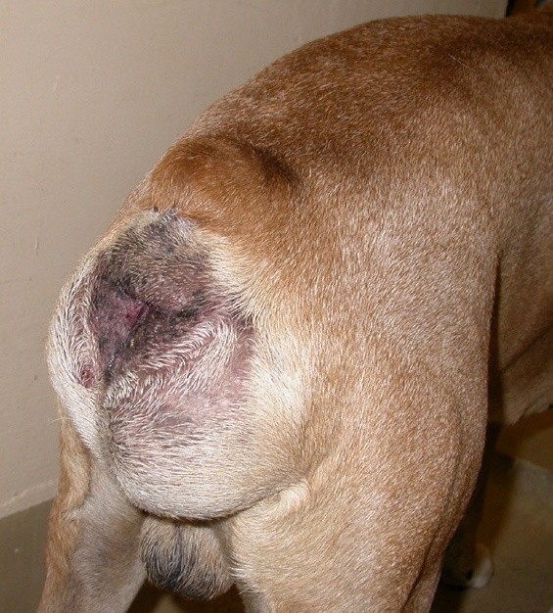
perineal hernia
Most common in uncastrated males, however it has also been reported in females and cat, though rarely.
Weakening of the pelvic diaphragm; hernia can occur due to the following factors:
  Hormonal disorders,
  Prostatic diseases,
  Rectal diseases and
  Anatomical factors – rectal deviations, diverticula etc.

Slide 3
perineal hernia: symptoms
A unilateral or bilateral swelling (Fluctuating/hard) ventral and lateral to the anus (in the ischiorectal fossa) in the perineal region.
The hernial contents are usually rectum, enlarged prostate and perineal fat, retroflexed bladder and uterus in case of females.
Incarceration of bladder in the perineal hernia should be considered an emergency.
Should be differentiated from perineal neoplasms.

Slide 4
perineal hernia: diagnosis
On the basis of clinical signs and history.
Gentle pressure over the swelling will reduce the contents if adhesions have not occurred.
Contrast radiography with barium enema will help to differentiate rectal deviation from rectal diverticulum.
Ultrasonography can be used to identify a retroflexed bladder.

Slide 5
perineal hernia: diagnosis
The pelvic diaphragm:
M. levator ani
Coccygeal muscle
Superficial gluteal muscle
External anal sphincter muscle
Internal obturator muscle
Arrows ‘A’ and ‘B’ show the sites of herniation.

Slide 6
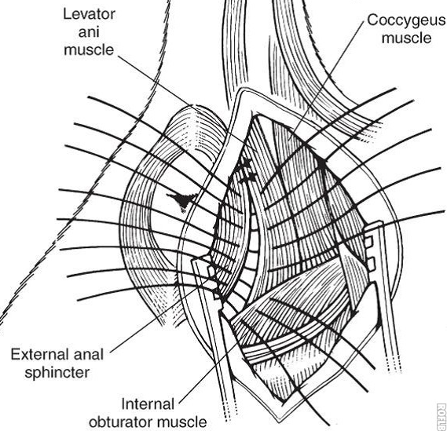
perineal hernia: treatment
1. Traditional (Anatomic) Herniorrhaphy
  Preplace simple interrupted 0 or 2-0 monofilament sutures using a large, curved needle
  Begin suture placement between the external anal sphincter and the levator ani, coccygeus, or both muscles.
  Space sutures less than 1 cm apart.
  As placement progresses ventrally and laterally, incorporate the sacrotuberous ligament for a secure repair if necessary.

Slide 7
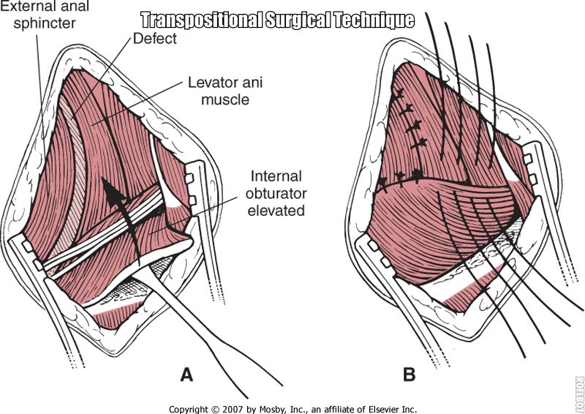
perineal hernia: treatment
2. Internal Obturator Transposition Herniorrhaphy
Separate the origin of the internal obturator muscle from the ischial tuber.
Elevate the periosteum and internal obturator muscle from the ischium to form a flap.
Transpose this flap dorsomedially into the defect to allow apposition between the coccygeus, levatorani, and external anal sphincter.

Slide 8
perineal hernia: treatment
2. Internal Obturator Transposition Herniorrhaphy
Preplace simple interrupted sutures the same as with the traditional technique.
Begin by apposing the combined levator ani and coccygeus muscles with the external anal sphincter muscle dorsally.
Then place sutures between the internal obturator and external anal sphincter medially and the levator ani and coccygeus muscles laterally.

Slide 9
Gut tie
Common in bullocks, rarely in others.
When a portion of intestine passes through and gets entangled in a tear in the fold of serous membrane suspending the spermatic cord in the sub lumbar region or in a hernial ring like slit/ring formed between adhesion of the cut end of the spermatic cord to the abdominal wall and the lateral abdominal wall.
The incised end of the spermatic cord retracts in to the abdominal cavity and adheres/heals to the abdominal wall forming a ring/slit.
A loop of bowels may pass through it and gets trapped preventing the function of the bowel.
Seen only on the right side as the rumen on the left side prevents its occurrence on the left.

Slide 10
Gut tie: diagnosis
Pain on palpation on the right flank.
Rectal examination wherein the distended and herniated portion of the bowels and the stretched spermatic cord can be palpated.

Slide 11
Gut tie: treatment
Sometimes it resolves on its own when the animal jumps from a height or walks down rapidly.
Attempts may be made to reduce the hernia by rectal manipulation
Right flank laparotomy may be done to reduce the hernia.

Slide 12
Diaphragmatic hernia- Dogs
The congenital form is peritoneo-pericardial diaphragmatic hernia.
Signs become apparent when the animal shifts to solid food or may be noticed incidentally on a thoracic radiograph or necropsy.
Acquired diaphragmatic hernia is usually traumatic leading to protrusion of omentum, stomach/liver or rarely, intestines into the thoracic cavity.
The extent of herniation depends upon size and location of tear.
Gradually develops through a small tear due to negative pressure in the thoracic cavity and bellowing action of the abdomen during respiration.
Weakest points in the diaphragm are Close to posterior vena cava, Costal margin, and close to the oesophagus.

Slide 13
Diaphragmatic hernia- signs
May not be noticed until the 6 months of age when starts feeding on solid foods.
Abdominal respiration, peculiar cough, tendency to tire easily, unthrift and tucked up abdomen.
Tendency to vomit after feeding, reluctance to move. Remains in standing position or sits on the hunches.
Difficulty and pain while walking down from a height.
Chronic stomach disorders, respiratory distress, gurgling sounds on auscultation of chest.
Absence of respiratory sounds on affected side. More pronounced respiratory distress immediately after feeding.

Slide 14
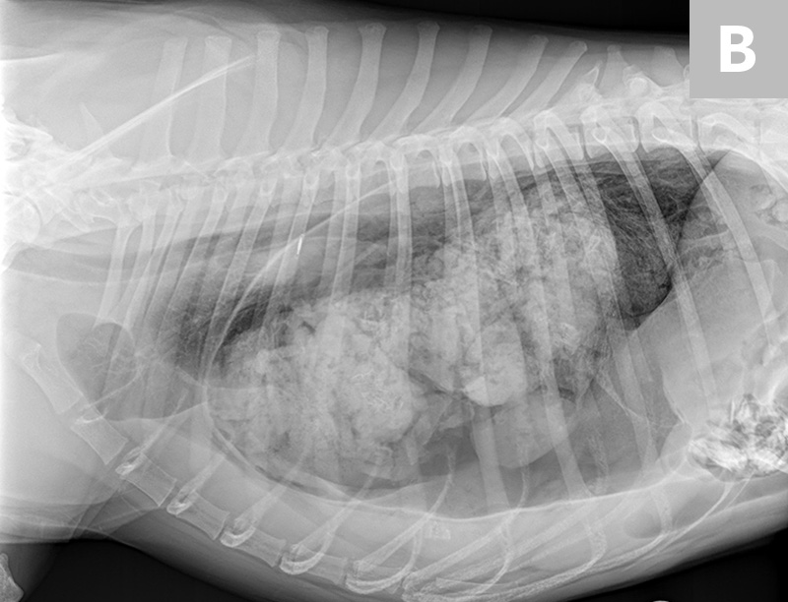
Diaphragmatic hernia- Diagnosis
On the basis of history, signs, auscultation (muffled heart sounds).
Radiography (Survey and contrast),
Ultrasonography
Exploratory laparotomy.

Slide 15
Diaphragmatic hernia- treatment
Only surgical treatment is possible. The diaphragm may be approached by:
  Abdominal approach,
  Lateral thoracic approach,
  Median sternotomy and rib splitting are rarely used,
In all approaches, positive pressure ventilation is required.
Restore the negative pressure in the thorax before final closure.

Slide 16
Diaphragmatic hernia- treatment
Thoracic approach:
Entered through 6th or 7th intercostal space.
The hernia is reduced and the tear in the diaphragm is sutured with a 1-0 synthetic absorbable suture material.
Avoid injury to lungs and other great vessels. The intercostal incision is closed including the adjacent ribs.
Abdominal approach:
Mid line incision starting from Xyphoid backwards is made.
The hernia is reduced and the tear in the diaphragm is closed in the same manner.

Slide 17
Diaphragmatic hernia- bovine
In cattle and buffaloes, reticulum is the common herniating organ, however the omasum, abomasum, loops of intestine, spleen or liver may also get involved.
Weakening of the diaphragm by lesions of traumatic reticulo peritonitis, congenital weak points of the diaphragm and physical force like increased intra abdominal pressure during pregnancy and parturition, or a violent fall.

Slide 18
Diaphragmatic hernia- signs
Recurrent tympany not responding to medical treatment. The tympany is mild if only a small portion of reticulum is herniated.
Progressively, the signs became severe due to development of adhesions between the reticulum and other structures like lungs, pericardium, thoracic wall and hernial ring.
Complete or partial cessation of milk, scanty, foul smelling pasty faeces, a degree of melaena, regurgitation may lead to aspiration pneumonia.
Brisket oedema and jugular pulse, abduction of fore limbs, rarely chronic cough may be present.
Muffled cardiac sounds and reticular sounds heard cranial to the 6th rib. If untreated cases, inanition, progressive emaciation, weakness and dehydration leading to death.
The diagnosis is confirmed by plain and contrast radiography.
Left flank exploratory laparotomy may be done.

Slide 19
Diaphragmatic hernia- treatment
Only surgical treatment is effective.
Rumenotomy to evacuate the contents of the rumen and reticulum followed by cud transplantation.
Administer I/v fluids for 48 hours and thereafter the soft diets with fluids, surgery to correct hernia may be delayed for 3-4 days.
The common approaches for surgery are abdominal and thoracic. Irrespective of the approach, proper ruminal evacuation and assisted ventilation during herniorrhaphy are required for successful procedure.

Slide 20
inguinal hernia
Also called Bubonocele, it is protrusion of an abdominal organ through the inguinal canal. If the hernial contents extend into the scrotum in male animals the condition is called as scrotal hernia .
Incidence: Bitches, horses, bulls and pigs.
Anatomy: the passage through which-
the contents of spermatic cord in males, or
the round ligament in females pass,
is an opening in the caudo-ventral abdominal wall termed the inguinal canal which is slit like, between the abdominal muscles connecting the internal and external inguinal rings.

Slide 21
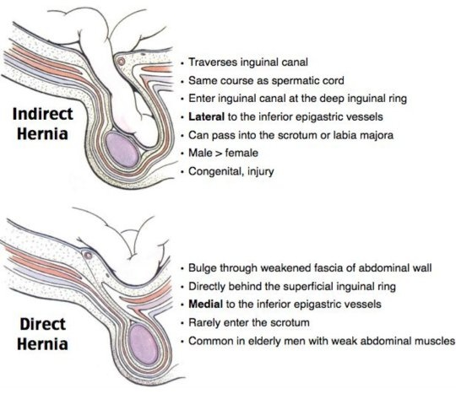
inguinal hernia
Inguinal hernias may be:
-direct (through a rent in the body wall) or
-indirect (through the already existing inguinal ring or umbilical ring).

Slide 22
inguinal hernia: symptoms
In female dogs, appreciable swelling is noticed in the inguinal region, difficulty in defecation,
In large animals swelling in the inguinal canal at the neck of scrotum,
Unilaterally enlarged scrotum; affected bulls or stallions may be reluctant to serve,
Refuse to move due to pain, Abduction of hind limbs
Systemic signs are evident only when the hernia gets strangulated.
Hernial contents may be intestines, urinary bladder, omentum or uterus in female.
Diagnosis is based on clinical signs, palpation, radiography & USG

Slide 23
inguinal hernia: treatment
In small animals:
A paramedian incision is made close to the inguinal swelling.
The contents are reduced by gentle pressure.
A kelotomy (extension of the hernial ring) may be performed if the hernial ring is small.
Debride the edges and close with absorbable suture material by overlapping pattern.
In large animals:
Reduce the contents and close the tunica vaginalis with purse string suture as high as possible.
Muscles & fascia closed with overlapping suture, the skin is closed in a routine manner.

Slide 24
other hernias
Hiatal Hernia:
A form of diaphragmatic hernia where the caudal end of the oesophagus and cardiac area of the stomach pass through the oesophageal hiatus of the diaphragm. The associated sign is the oesophagitis. Treatment consists of reducing the hernia and reconstructing the diaphragm.
Gut Tie:
Already discussed above.

Slide 25
Thanks

