Slide 1
Hernias Part I
Gulshan Kumar
Dept. of Veterinary Surgery & Radiology
College of Veterinary Science and Animal Husbandry
U.P. Pt. Deen Dayal Upadhyaya Pashuchikitsa Vigyan Vishwavidyalaya evam Go Anusandhan Sansthan, Mathura- 281 001

Slide 2
Hernia
The term appears to originate from Sanskrit ‘‘fgj’’ meaning band or strip representing bowels,
late 14th century, hirnia, from Latin hernia "a rupture," related to hira "intestine,"

Slide 3
Hernia
It is defined as a protrusion of an organ or a part through a defect in the wall of the cavity in which it lies.
Most hernias involve the protrusion of abdominal contents through:
the abdominal wall,
the diaphragm, or
the perineum
A defect or opening in the wall is the important factor in herniation, irrespective of whether a protrusion through the opening is present.

Slide 4
Hernia: classification
On the basis of anatomical site- e.g. perineal, abdominal etc.
Congenital or acquired- congenital if some defect is present at birth (umbilical hernia) or acquired if a defect occurs due to blunt trauma (motor accident) e.g. abdominal hernia.

Slide 5
Hernia: classification
Abdominal Hernia
External abdominal hernias: defects in the external wall of the abdomen that allow protrusion of abdominal contents. They may involve the abdominal wall anywhere other than the umbilicus, inguinal ring, femoral canal, or scrotum. E.g. ventral, prepubic, subcostal, hypochondral, paracostal, or lateral
Internal abdominal hernias: occur through a ring of tissue confined within the abdomen or thorax (e.g., diaphragmatic hernia, hiatal hernia).

Slide 6
Hernia: classification
True hernias are enclosed in a peritoneal sac (ring, sac, and contents).
False hernias allow protrusion of organs outside a normal abdominal opening E.g. omphalocele.

Slide 7
Hernia: classification
Direct hernia occurs through an actual defect/rent in the body wall. Traumatic hernias arising during dystocia or obstetrical manipulations are also direct hernias.
Indirect hernia occurs through an already existing ring, such as the inguinal ring or umbilical ring). Congenital hernias tend to be indirect, although direct, traumatic hernias may arise during dystocia or obstetrical manipulations.
Umbilical Hernias: • Umbilical hernias vary in size and may contain only fat or omentum, or in more severe cases, intestinal loops. • Many male dogs with umbilical hernias are cryptorchid.

Slide 8
Hernia: Types
On the basis of the fate of its contents hernias may be:
Reducible- if the herniated contents can be manipulated back into the cavity,
Incarcerated- if adhesions develop thereby preventing the movement back into its cavity (also called irreducible)
Strangulated- incarceration may obstruct the circulation in the herniated organ at the edge of the rent (hernial ring)or defect.
Note: both incarcerated and strangulated hernias are irreducible

Slide 9
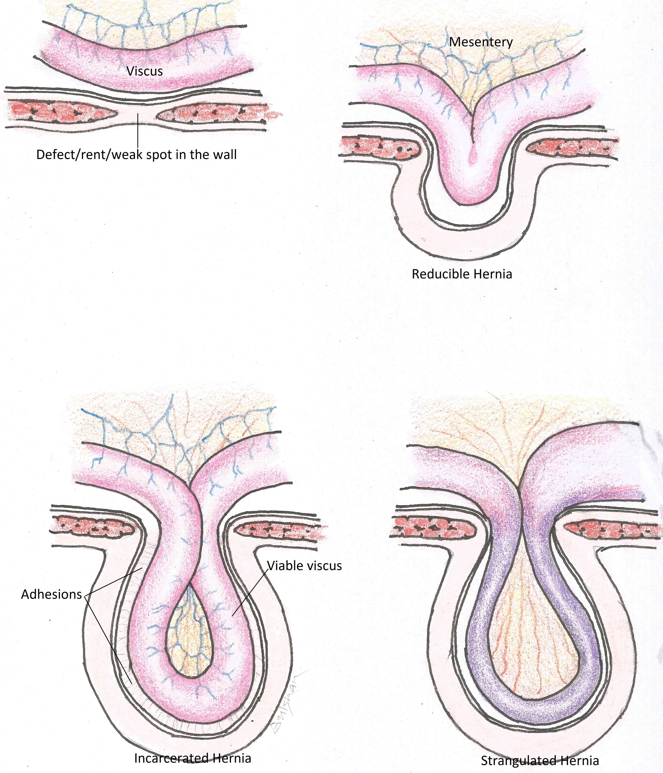

Slide 10
Hernia: parts
The parts of hernia are:
The hernial ring: the defect in the wall of the cavity forms the ring which may vary in size (a few millimetres to several centimetres),
The hernial sac: is the tissue that encloses the contents. It may be lined by a mesothelial lining (in congenital hernia) or peritoneal lining in later stages of acquired hernias.
Hernial contents are those organs/tissue which have been displaced to an abnormal location.

Slide 11
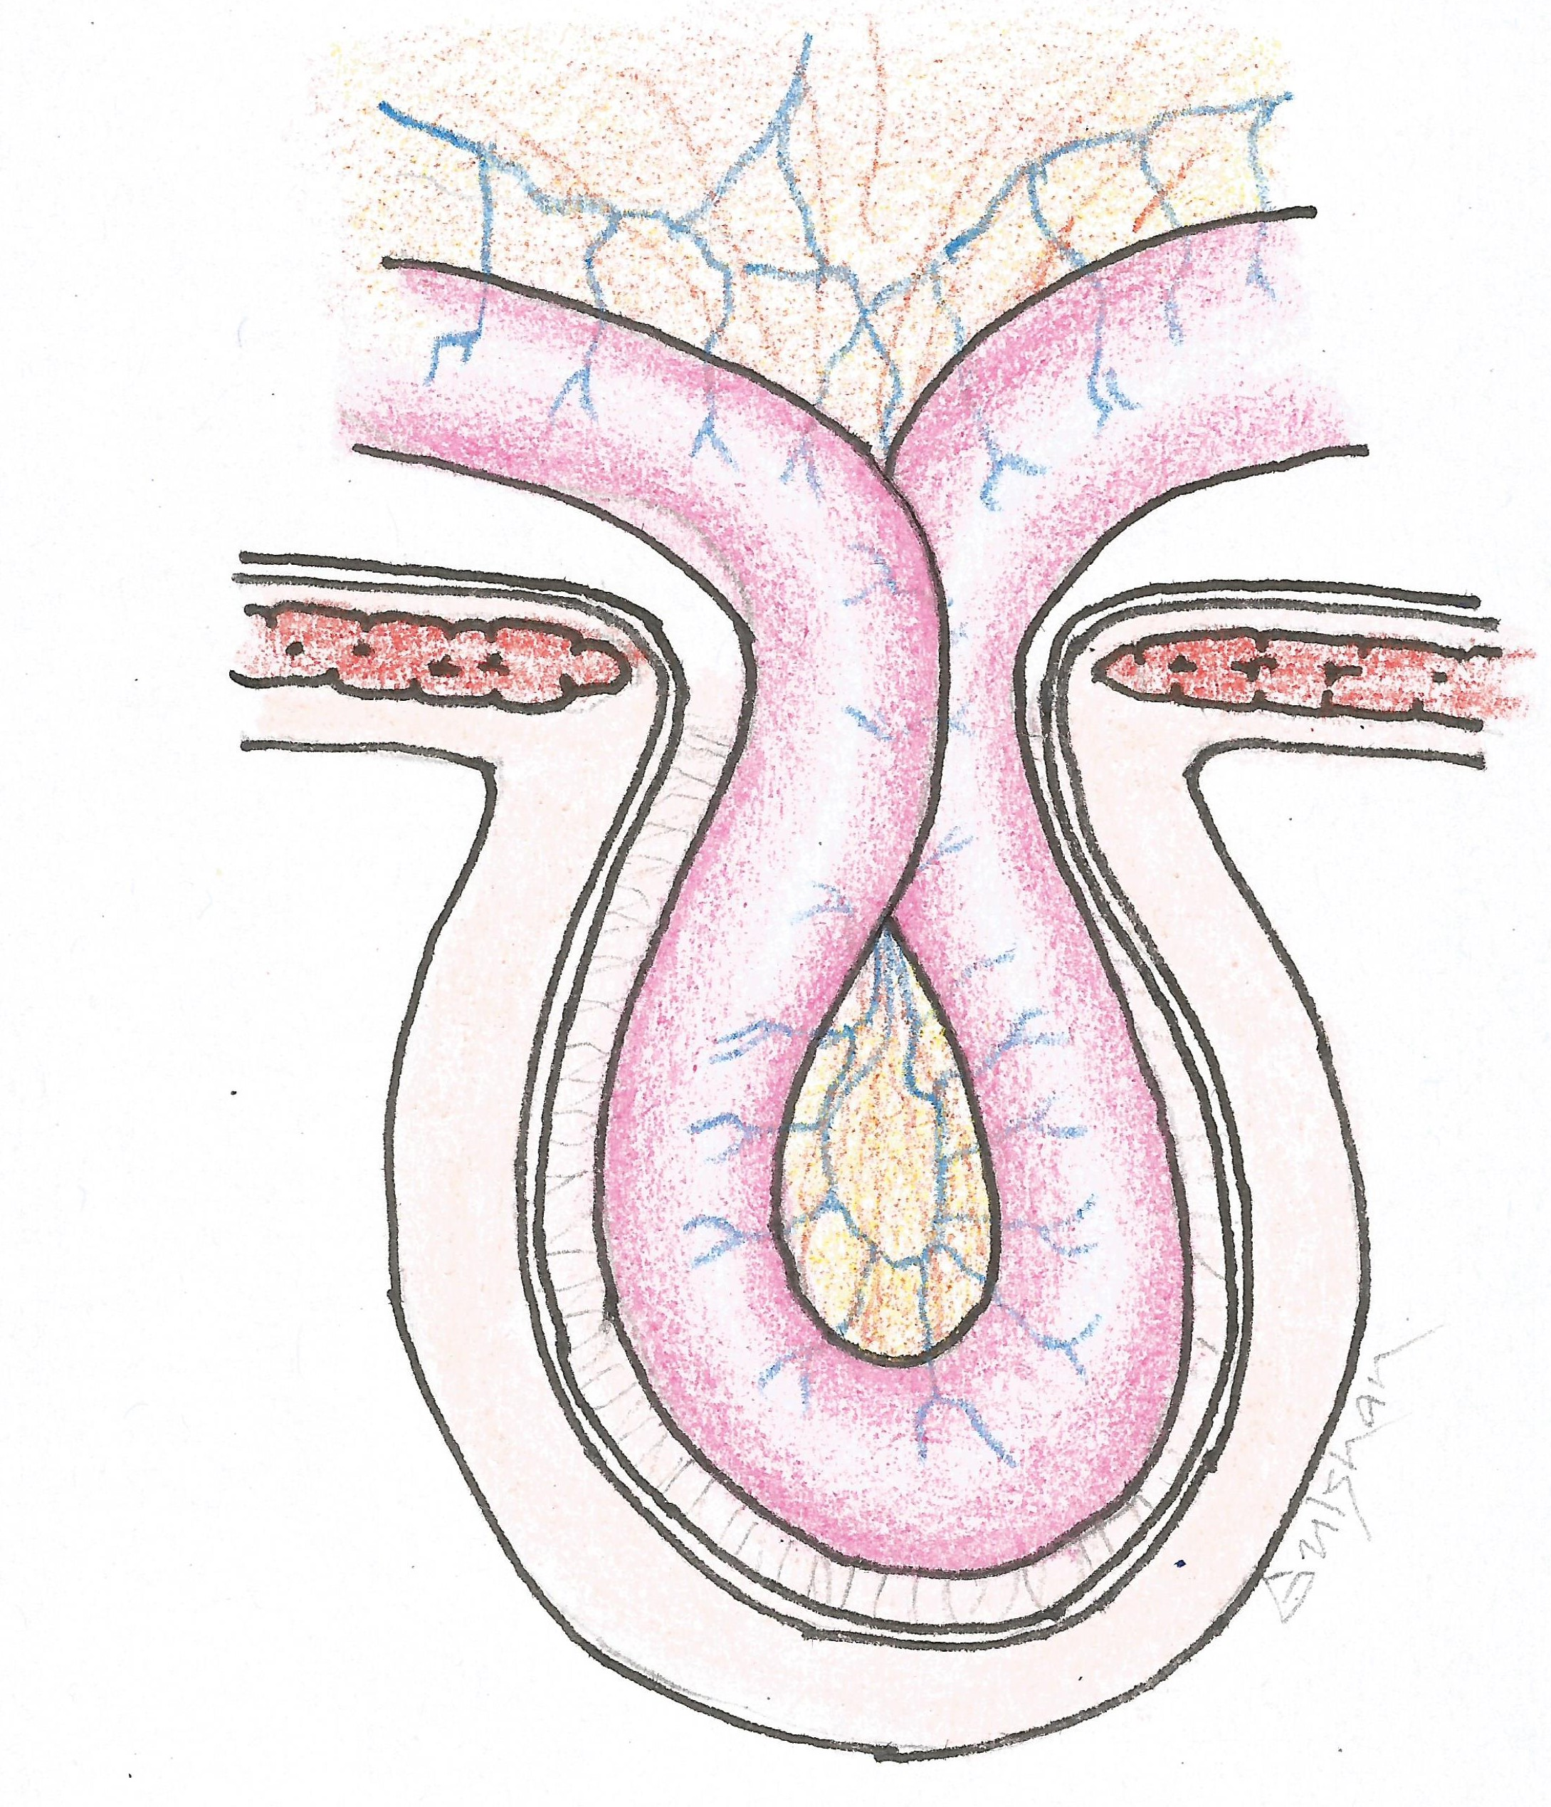
Hernial Ring
Hernial Contents
Hernial Sac

Slide 12
Hernia: pathophysiology
Herniation causes changes varying in severity from insignificant to lethal.
Lethality due to space occupying effect as in diaphragmatic hernia affecting both respiratory and cardiac functions,
Bowel lumen obstruction causing rapid accumulation of gas and fluid (fluid & electrolyte imbalance),
Bladder neck obstruction (perineal hernia) causing post-renal uraemia and fluid retention,

Slide 13
Hernia: pathophysiology
Incarceration of uterus in pregnancy or pyometra (as in inguinal hernia may lead to uterine rupture,
Strangulation, especially of the hollow viscus leads to obstruction of veins, venous engorgement progressing to arterial obstruction due to back pressure, this leadsto tissue death and organ rupture, loss of blood/fluid, toxaemia, septicaemia depending upon the organ involved.

Slide 14
Hernia: Signs
Classic sign is swelling. If uncomplicated, no pain on palpation. Consistency depends on contents.
Palpation is difficult in trauma or infection in the presence of inflammation.
Swelling is not usually seen in diaphragmatic hernia

Slide 15
Umbilical hernia (omphalocele)
Develops in the umbilical region and is comparatively more common in females than in males.
Usually consist of omentum and intestines.
Common in foals, pigs, calves and pups but rare in lambs and kids.
Congenital umbilical hernia results from failed or delayed fusion of the lateral folds (principally the rectus may primarily be abdominis m.)
Most omphaloceles are inherited.

Slide 16
Umbilical hernia (omphalocele)
Acquired hernia is noticed few weeks after birth.
The umbilical aperture in the foetus serves as a passageway of the umbilical blood vessels, small vitelline duct and allantoic stalk.
At birth, these structures are disrupted and the aperture closes around the cord forming a cicatrix (umbilicus in the later life). Acquired hernial ring may result from trauma, resection of cord too close to abdominal wall and excessive straining due to diarrhoea/ constipation. Infection delays natural closure of umbilicus.

Slide 17
Umbilical hernia: clinical signs
A spherical swelling at the umbilicus.
Contents are usually fat and omentum.
Later hernial sac may contain loops of small intestine.
A circular or oval hernial ring can be palpated.
Adhesions/ umbilical abscess prevent reduction.
Rarely, the contents get strangulated with symptoms of pain and intestinal obstruction (the umbilical sac is warm or painful and the contents are irreducible).
Diagnosis can be made on the basis of these signs.

Slide 18
Umbilical hernia: treatment
Conservative method: if reducible
umbilical hernia containing only a small part of the omentum or a small loop of intestine may respond favourably to abdominal pressure bandages or clamps.
Metal or wooden clamps: The main objective of the clamp application is to obliterate the hernial sac and to stimulate healing of the ring.

Slide 19
Umbilical hernia: treatment
Conservative method: if reducible
Metal or wooden clamps:
The animal in dorsal recumbency and the hernial contents reduced manually.
Apply the jaws of clamps longitudinally and directly over the hernial ring.
Push down the hernial sac through the jaws of the clamp .
Tighten the nuts of clamp to keep the clamp snugly against the abdominal wall.
The sac undergoes necrosis and sloughs down within 10-12 days and the skin wound heals by 2nd intention .

Slide 20
Umbilical hernia: treatment
Surgical Treatment:
Ventral midline approach
The initial skin incision is extended cranially over the hernia sac.
Alternatively, an elliptical incision is made around the base of a large sac to remove redundant tissue.
The contents are reduced and the hernial ring is debrided and sutured.
Preferably a synthetic non absorbable suture material is used.
The ring is closed in a double breasting or overlapping pattern. Excess skin if available is trimmed before suturing.
Hernioplasty is indicated if the hernial ring is large and weak which, could not be apposed.

Slide 21
Abdominal hernia
It is the term used to describe a hernia through any part of the abdominal wall other than a natural orifice.
Common in horse, goat and cattle and is generally acquired in nature.
May be caused due to trauma as in horn thrust/gore, violent contact with blunt objects, weakening of the abdominal muscles, violent straining during parturition (sheep),

Slide 22
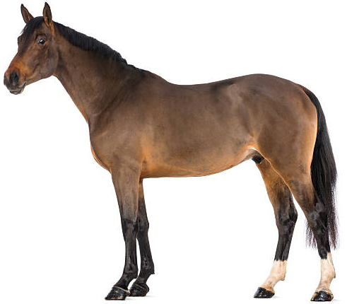
Flap of flank
Abdominal hernias occurring on the flank above the imaginary horizontal line passing through the “flap of flank” are ‘Dorsal’ hernias and those which occur below this line are ‘Ventral’ abdominal hernias
Dorsal Hernia
Ventral Hernia

Slide 23
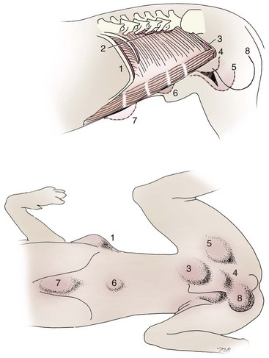
Location of common abdominal hernias in dogs:
Paracostal
Dorsal lateral
Inguinal
Cranial pubic lig. Rupture
Femoral
Umbilical
Ventral
scrotal

Slide 24
Abdominal hernia: clinical signs
Size of the hernial ring varies in diameter. The hernial swelling is usually very prominent.
It is difficult to palpate the hernial ring in initial stages due to oedema or haematoma surrounding tissue.
Nature of hernial contents depends on the site of herniation.
In case of incarceration, acute GI signs (vomiting, anorexia) and a firm, irreducible, painful swelling is seen

Slide 25
Abdominal hernia: treatment
When the hernia is harmless – herniorrhaphy is elective; not an emergency.
It is advisable to delay the surgical repair until the inflammation subsides.
However, prolonged delay may cause complications due to adhesions between the displaced viscera and subcutaneous tissue.
If hernia is complicated (due to incarceration/strangulation) immediate surgical intervention is required.

Slide 26
Abdominal hernia: treatment
Technique:
An elliptical or linear incision is made over the hernial swelling. The contents are reduced.
The peritoneal sac is ligated or sutured close to the ring and amputated.
The hernial ring is debrided and sutured using overlapping sutures with a non absorbable suture material, this is termed “Herniorrhaphy”.
When approximation of the edges of the hernial ring is difficult and there is a risk of tearing of tissue under tension, then a prosthetic graft (prolene mesh) is used to close the hernial ring. This is termed as “Hernioplasty”.

Slide 27
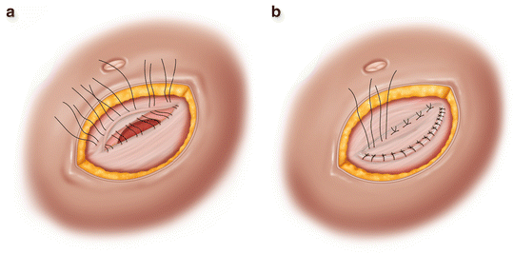
Hernial ring
Overlapping/vest-over-pants suture for herniorrhaphy

Slide 28
Abdominal hernia: treatment
Technique:
Hernioplasty:
The graft may be of biological origin (Glycerol preserved bovine pericardium and tunica vaginalis sac have been used by some workers), OR
It may be of synthetic origin (proline, nylon meshes)
On the basis of ‘where’ the graft is placed hernioplasty may be categorised as:
Onlay/overlay graft: graft laid over the closed hernial ring,
Inlay graft: graft sutured to the edges of the hernial ring to affect its closure, and
Underlay graft: graft laid beneath the parietal peritoneum

Slide 29
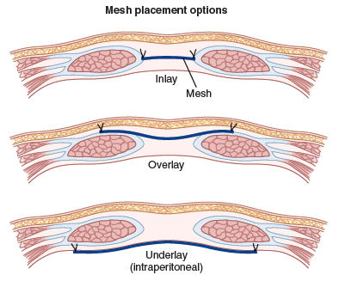

Slide 30
Abdominal hernia
Post operative considerations:
If the repair is uncomplicated, minimal post-operative care is required, however, in all cases they should be sincerely observed.
Exercise should be limited.
Complicated hernias (multiple, strangulated or open at birth) have a guarded to poor prognosis.

Slide 31
Thanks

