Slide 1

Affections of Teeth
………continued
Gulshan Kumar
MVSc, PhD

Slide 2
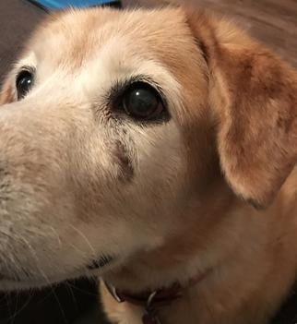
Dental fistula
Abuts on the root of the tooth
  Ætiology:
    Alveolar periostitis or dental abscessation
    Trauma

Slide 3
Tumours of gums and alveoli
Odontoma
  Benign odontogenic tumour in which both the epithelial and mesenchymal cells are well differentiated resulting in the formation of all dental tissue types.
  A hamartoma rather than a neoplasm.
  Compound odontoma: tooth-like structures are present indicating advanced cellular differentiation (radiographically, variable number of tooth-like structures-denticles.)
  Complex odontoma: the conglomerate of dental tissues bears no resemblance to a tooth ( radiographically, a sharply defined mass of calcified material surrounded by a narrow radiolucent band.)
  May be associated with un-erupted teeth, a dentigerous cyst, or may be attached to an otherwise normal tooth. The term ameloblastic odontoma is occasionally encountered in the veterinary literature. An ameloblastic odontoma is an ameloblastoma with focal differentiation into an odontoma

Slide 4
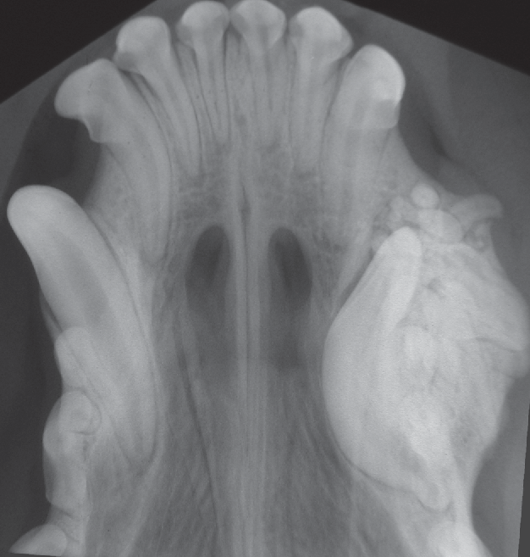
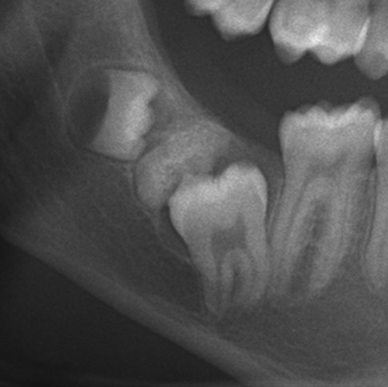
  Compound odontoma
  Complex odontoma

Slide 5
Tumours of gums and alveoli
Ameloblastoma: most common odontogenic tumors, occasionally incorrectly referred to as adamantinoma.
  Occur in young animals.
  Usually a locally invasive neoplasm with osteolysis around the tooth roots and cystic changes.
  Has a follicular arrangement of ameloblasts and stellate reticulum cells, resembling the basic structure of the enamel organ.
  In the dog, often characterized by focal keratinization. Metastasis has not been described.

Slide 6
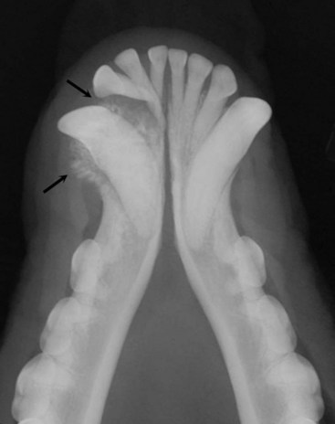

Slide 7
Tumours of gums and alveoli
Epulis: Hyper-reactive fibrous granuloma (Gum boil) of the gum arising from periodontal ligament.
  Mainly 3 types:
    Fibromatous -less aggressive.
    Ossifying epulides -less aggressive.
    Acanthomatous is most aggressive.

Slide 8
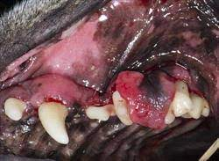
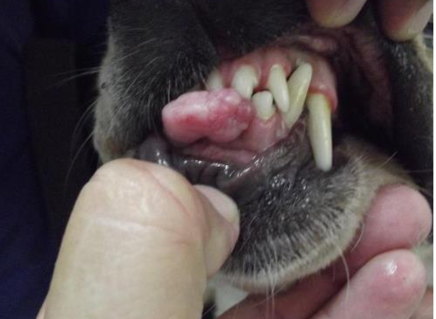
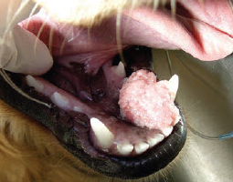
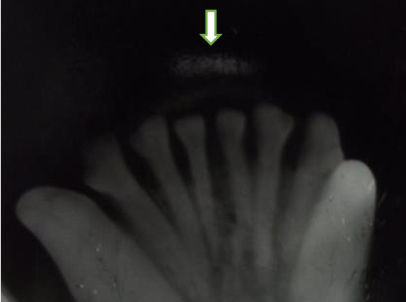

Slide 9
Bishoping: Normally the infundibular mark disappears from the central incisors by 6 yrs. And from corner incisors by 8 yrs. Bishoping is attempting to make an old mouth look younger, as follows:
  The teeth are filed short and level, a false “infundibular mark” is gouged out of the centre of the table and blackened with caustic to lessen the years.
  The trick may be detected by :
    closing the mouth, when the teeth will not meet naturally;
    by observing the absence of the enamel rim to the false mark and errors of its shape due to slips of the gouge;
    occasionally the traces of the rasp or file used to shorten the teeth are in evidence..

