Slide 1
oh;Z dh fofHkUu iSdsftax
M‚- fodkl lpku
eknk i'kq jksx foKku foHkkx

Slide 2
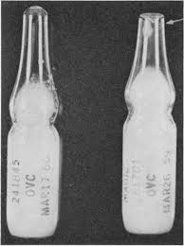
SEMEN AMPOULE
- 1945 USA
- Filling
- Sealing with heat
- In ethanol at 5⁰ C
Solid CO₂ or LN₂
Thawing in ice water

Slide 3
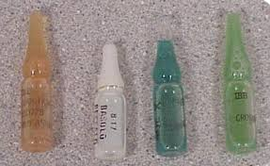

Slide 4
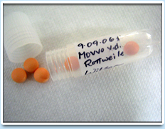
SEMEN PELLETS
- Japan
- Filling in beaker
- 5⁰ C for 5 Hrs.
0.1-0.2 ml in socket of
solid CO₂
Solid CO2 or LN₂
Thawing in sodium citrate
and fructose at 20⁰ C

Slide 5
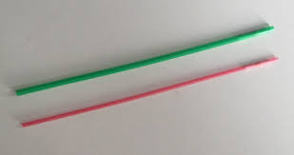
FRENCH SEMEN STRAW
1940, 1960
France, Germany, USA

Slide 6
S.No. | Type of straw | Length | Diameter | Volume
1 | French medium | 135 mm | 2.8 mm | 0.5 ml
2 | French mini | 135 mm | 2.0 mm | 0.25 ml
3 | German straw | 65 mm | 2.8 mm | 0.25 ml

Slide 7
Cotton plug
Polivenyl alcohol poewer
Air space
FACTORY SEAL LAB SEAL

Slide 8
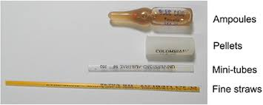

Slide 9
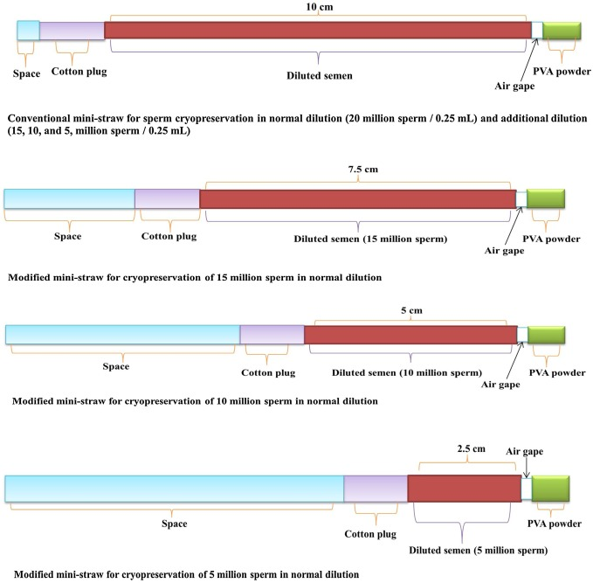
FRENCH SEMEN STRAW

