Slide 1
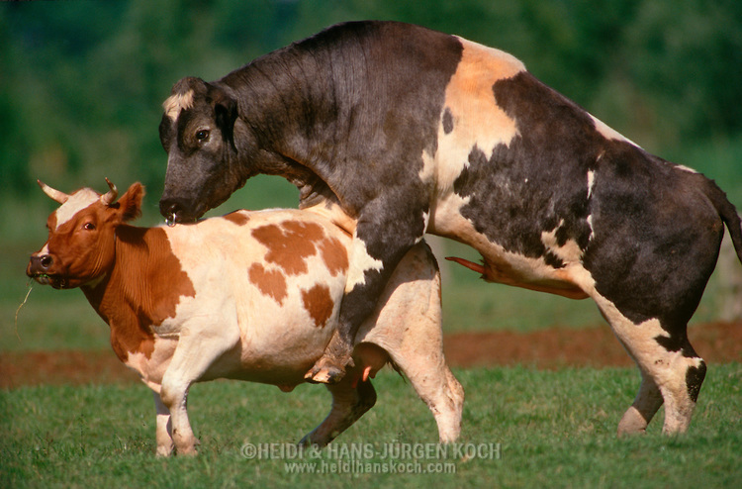
SEMEN COLLECTION
Dr. Vikas Sachan
Assistant Professor
Dept of Vet Gyn & Obst
DUVASU, Mathura

Slide 2
Male & female
- equally responsible for the conception
Hygienic & quality semen collection
- integral part of successful AI

Slide 3
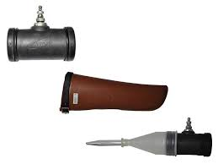
BUCK AND RAM
- Vagina of female after service
- Artificial vagina (AV)
- Electro-ejaculatory method.
Temperature of AV - 45⁰ C

Slide 4
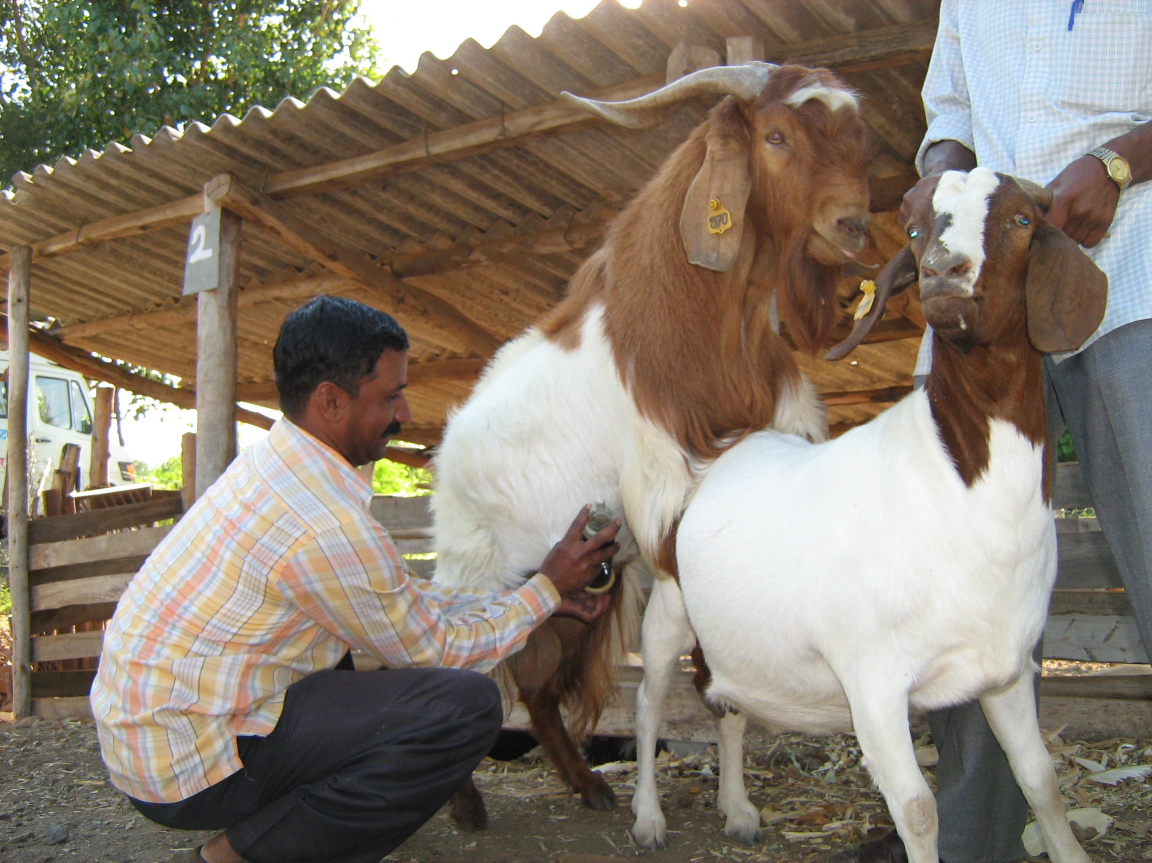

Slide 5
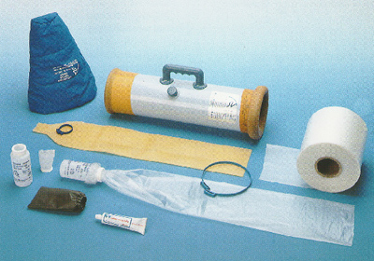
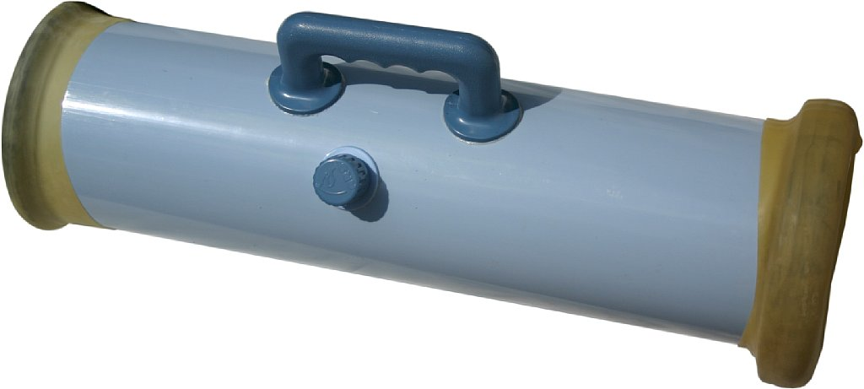
STALLION
- Aspiration from vagina
- Artificial vagina
- AV …….. 45⁰ C to 50⁰ C with proper pressure

Slide 6
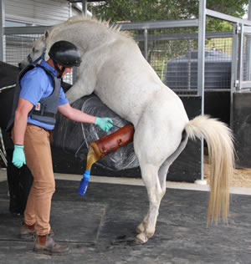

Slide 7
BULL (CATTLE AND BUFFALO)
- Directly from vagina after natural service
- Rectal massage method
- Electro-ejaculatory method
- Artificial vagina
- AV at the time of semen collection
- Temperature 39⁰ C to 41⁰ C
- Pressure is about 50 to 55 mmHg

Slide 8
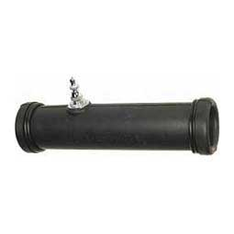
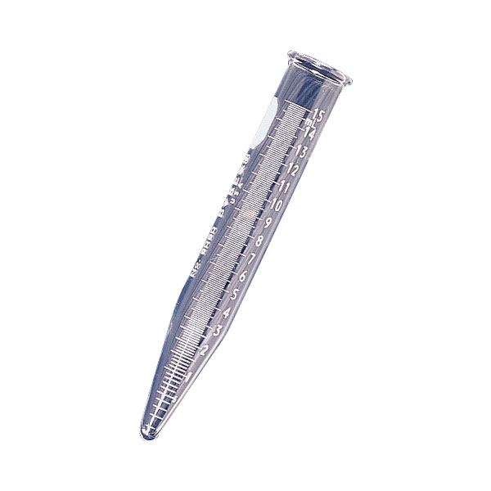

Slide 9
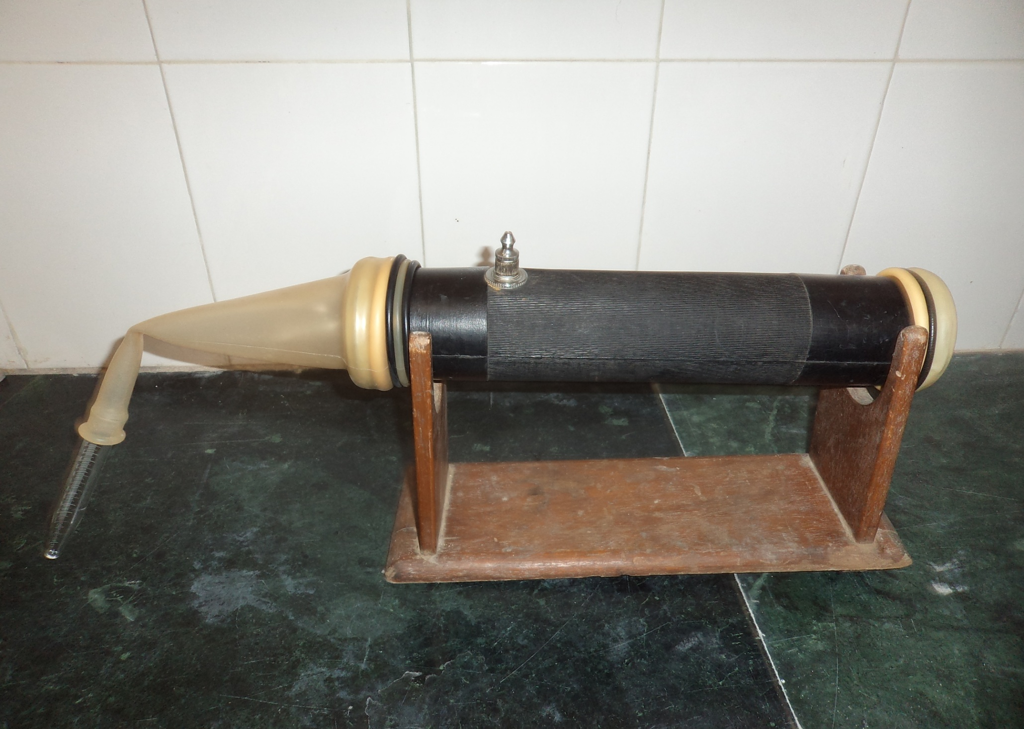

Slide 10
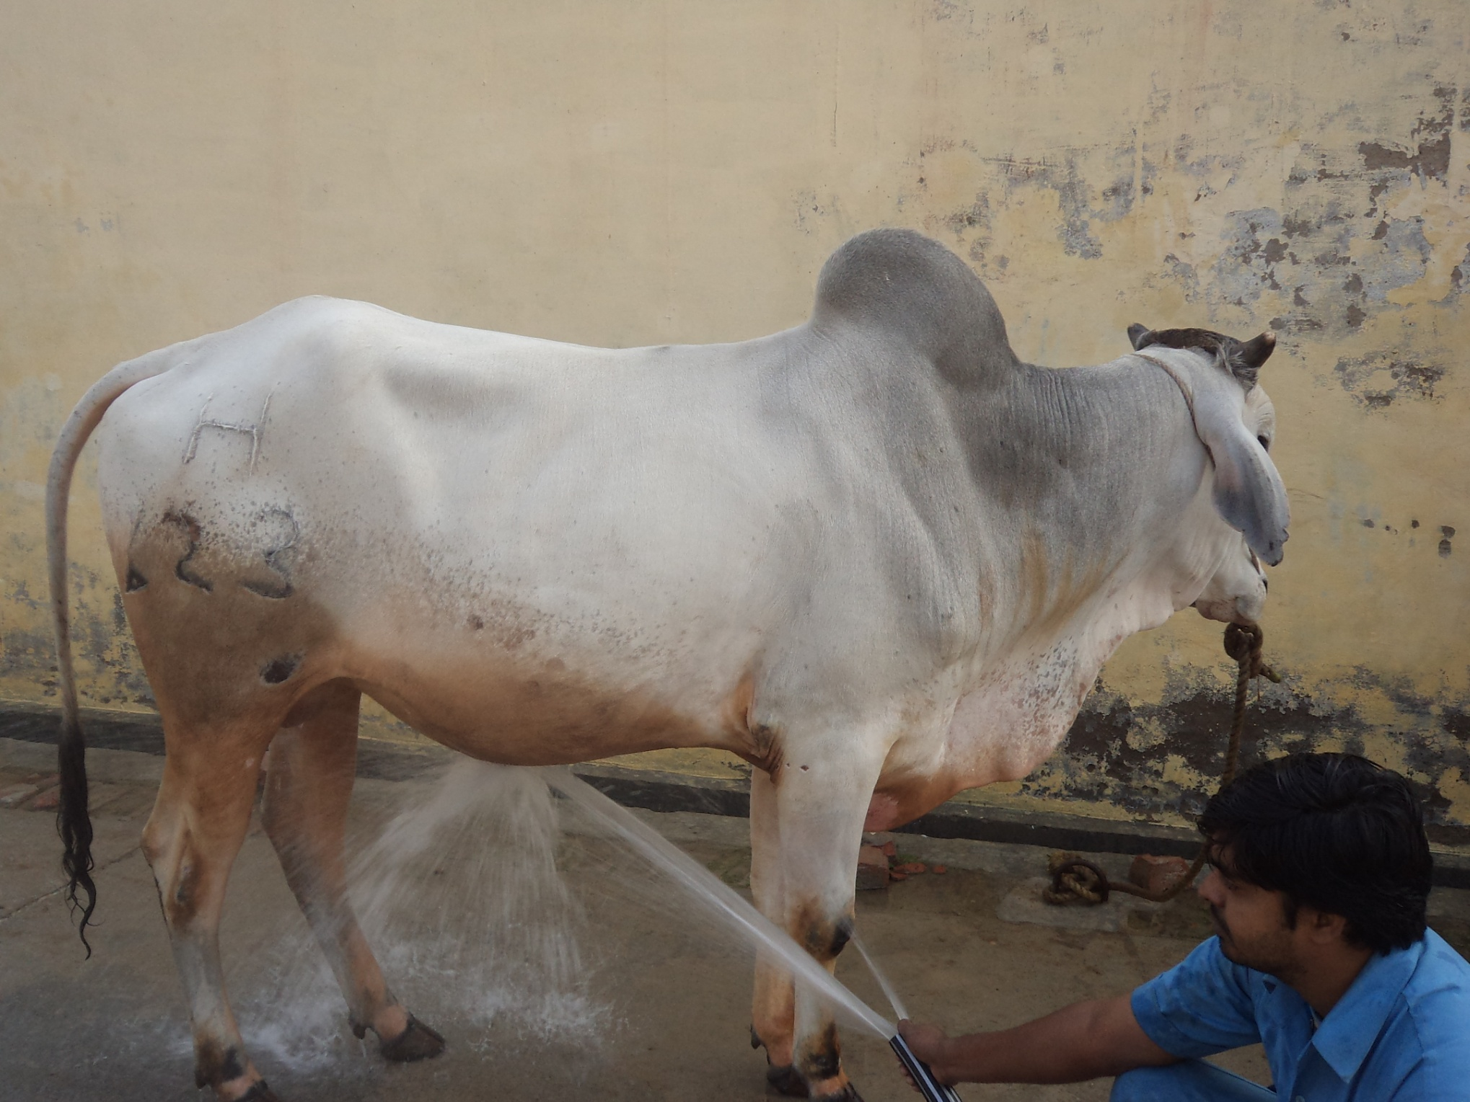

Slide 11
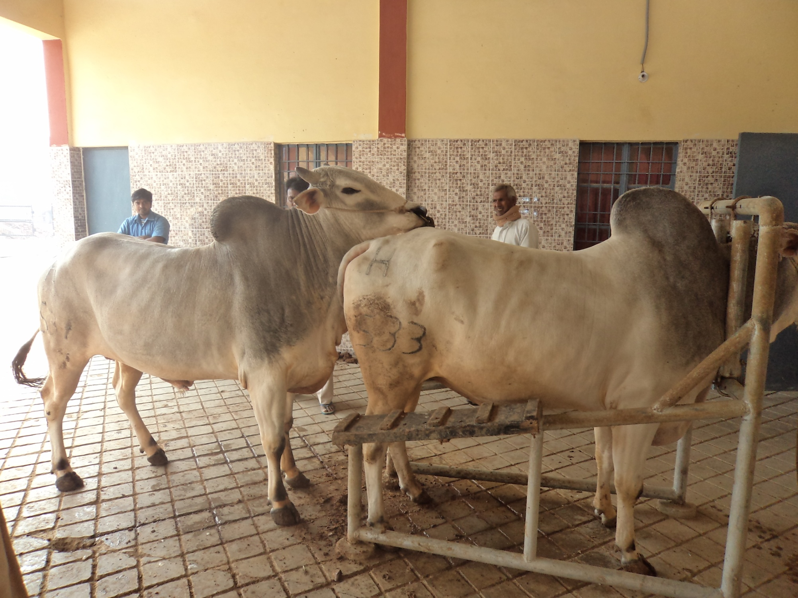

Slide 12
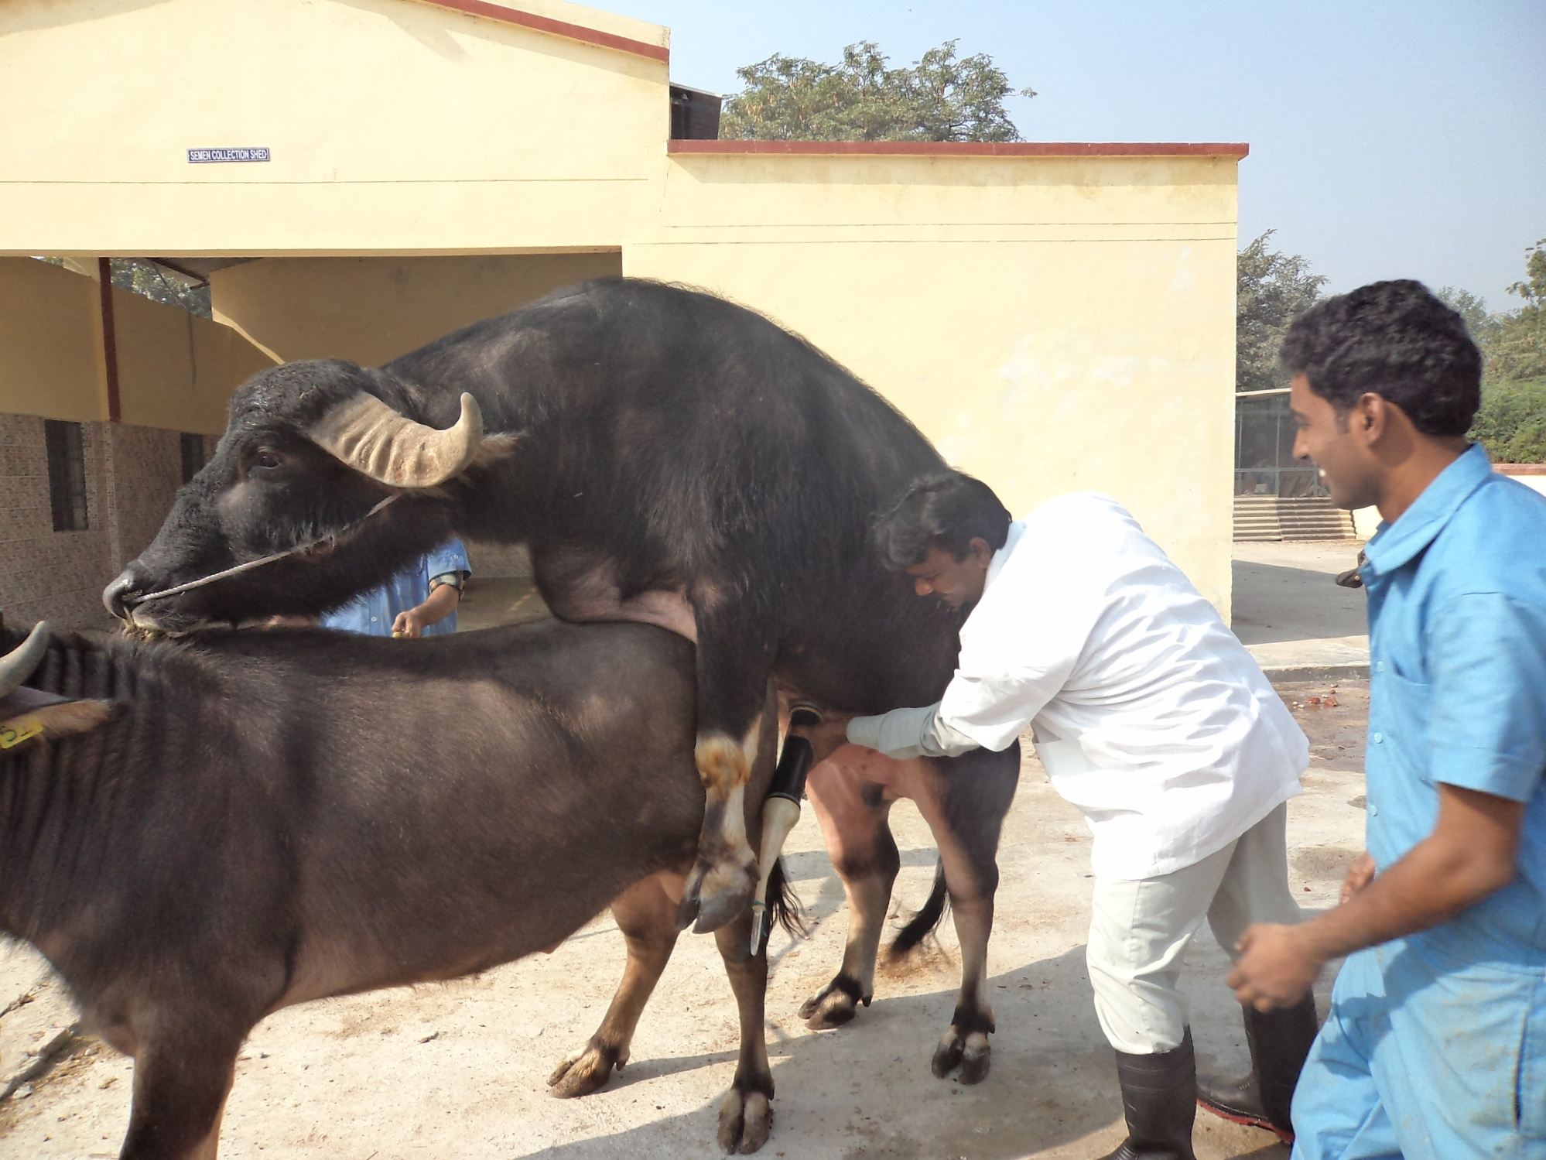

Slide 13
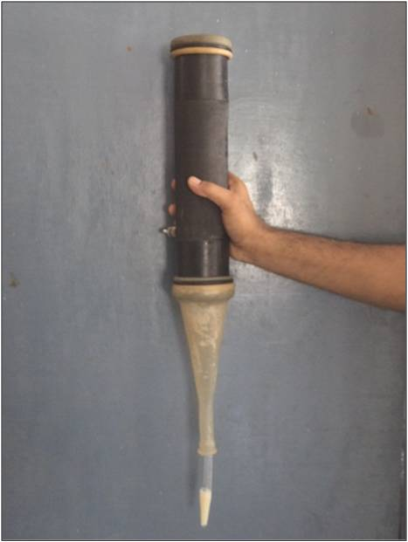

Slide 14
Precautions during the process of semen collection
No vigorous exercise on the day of semen collection
Early in the morning
- Empty stomach bull - active, fresh and alert
Early collection - sufficient day time to analyze the quality and to process the semen
Washing, cleaning and drying before semen collection

Slide 15
Preputial region washing with normal saline
Preputial hairs – Clipped (Not too short)
about 2 cm
Dummy - Clean and dry
Dummy – Not in estrous, pregnant or recently
parturited
Dummy - Docile nature
- Strong enough
- Appropriate size
- Preferably of same breed

Slide 16
Attendant or semen collector - not be new to bull
AV - Sterilized and dry
Open part of AV - Covered with aluminium foil
- Remove at the time of collection
AV - Separate for separate bull
- Separate for every ejaculate for same bull
Maintained AV temperature

