Slide 1
Male reproductive system
(Anatomy)
- Dr. Vikas Sachan

Slide 2
- The male reproduction system
testes, scrotum, reproductive ducts,
accessory sex glands, prepuce and penis
Production of - Spermatozoas
Male sex hormone
Primary sex organs – Testicles
Secondary sex organs (ductus system)-
Epididymis, Vas deference, urethra, penis
- Accessory sex glands –
Seminal vesicles, prostate and
bulbo-urethral glands/cowpers gland

Slide 3
SCROTUM –
. Cutaneous pouch
. Encloses the testis
. Testes fix by scrotal ligament
. Scrotal hairs (except buck, ram, stallion
and tom)

Slide 4
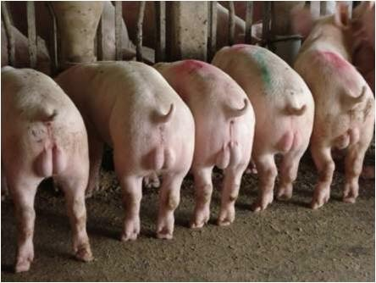
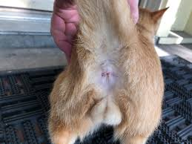
Scrotal position
Caudal to thighs – Boar and Tom
Between the thighs – All others
. Thermoregulation of testes
. Sebaceous and sweat glands (Stallion, dog)

Slide 5
SCROTUM LAYERS – (outward to inward)
1. Epidermis
2. Dermis
3. Tunica dartos
(fibroelastic CT & smooth muscles)
4. Tunica vaginalis communis/ reflexa
(Extension of parietal peritoneum)
5. Vaginal process/cavity (space in between)
6. Tunica vaginalis propria
(Extension of visceral peritoneum)
7. Tunica albuginea
(fibrous layer with some smooth muscles)
8. Tunica vasculosa
(layer with blood vessels)

Slide 6
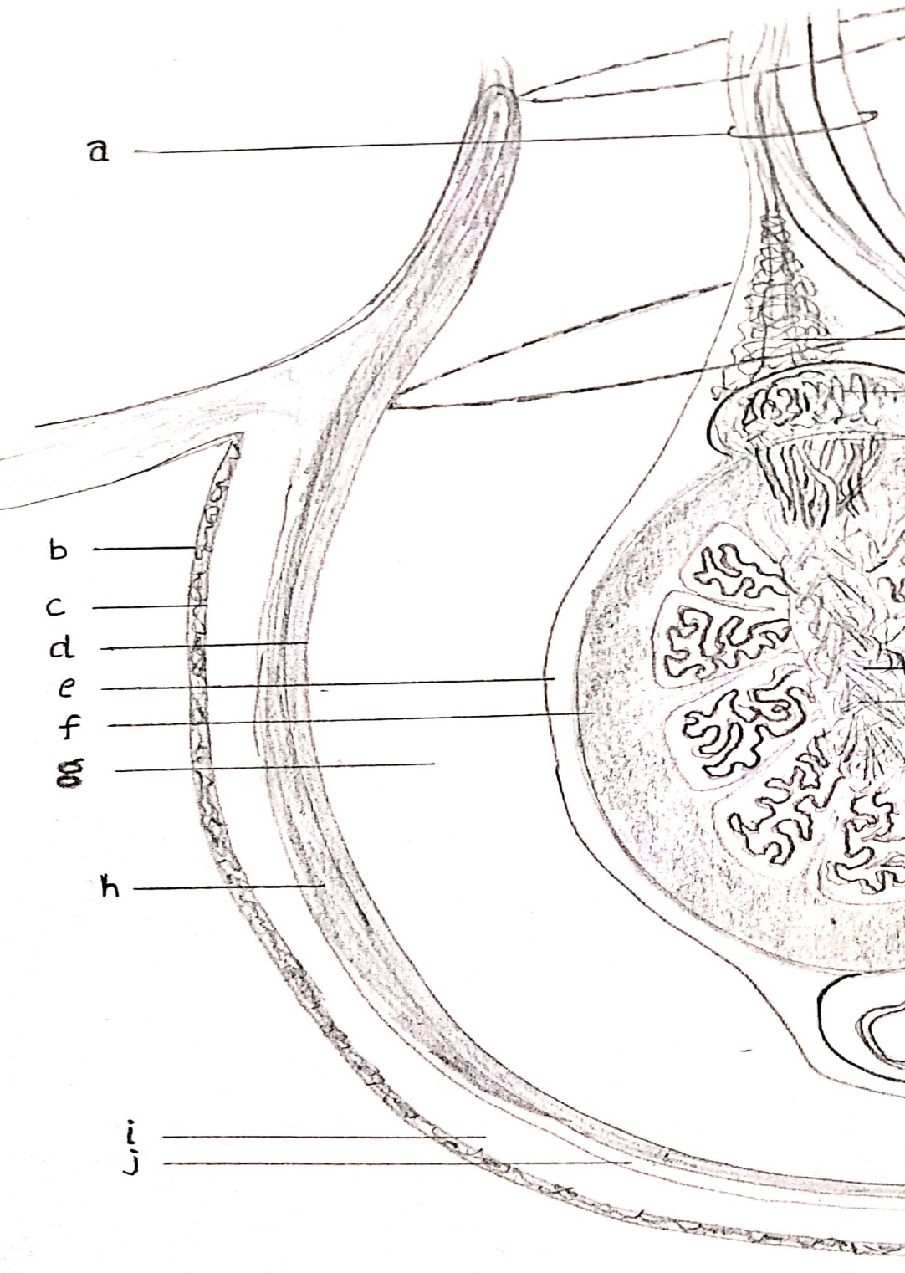

Slide 7
Tunica dartos
- Form intertesticular septum
Stallion scrotum - short and non-pendulous
Testes in camel - non pendulous scrotum
(in perineal region)

Slide 8
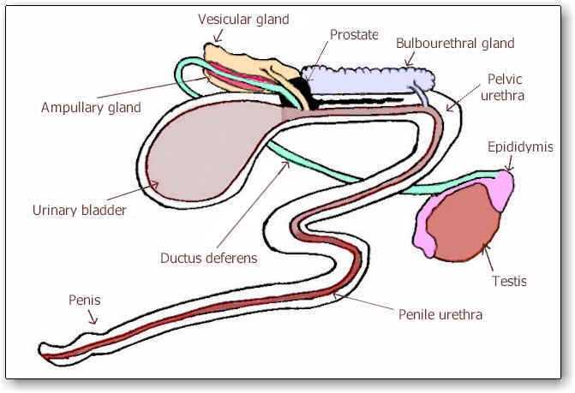
- The ductus system (in to out) :
Seminiferous tubules
Rete testes
Efferent duct
Caput epididymis
Corpus epididymis
Cauda epididymis
Vas deferense
Ampulla
Pelvic urethra
Penile urethra (in penis)
……. – Exit

Slide 9
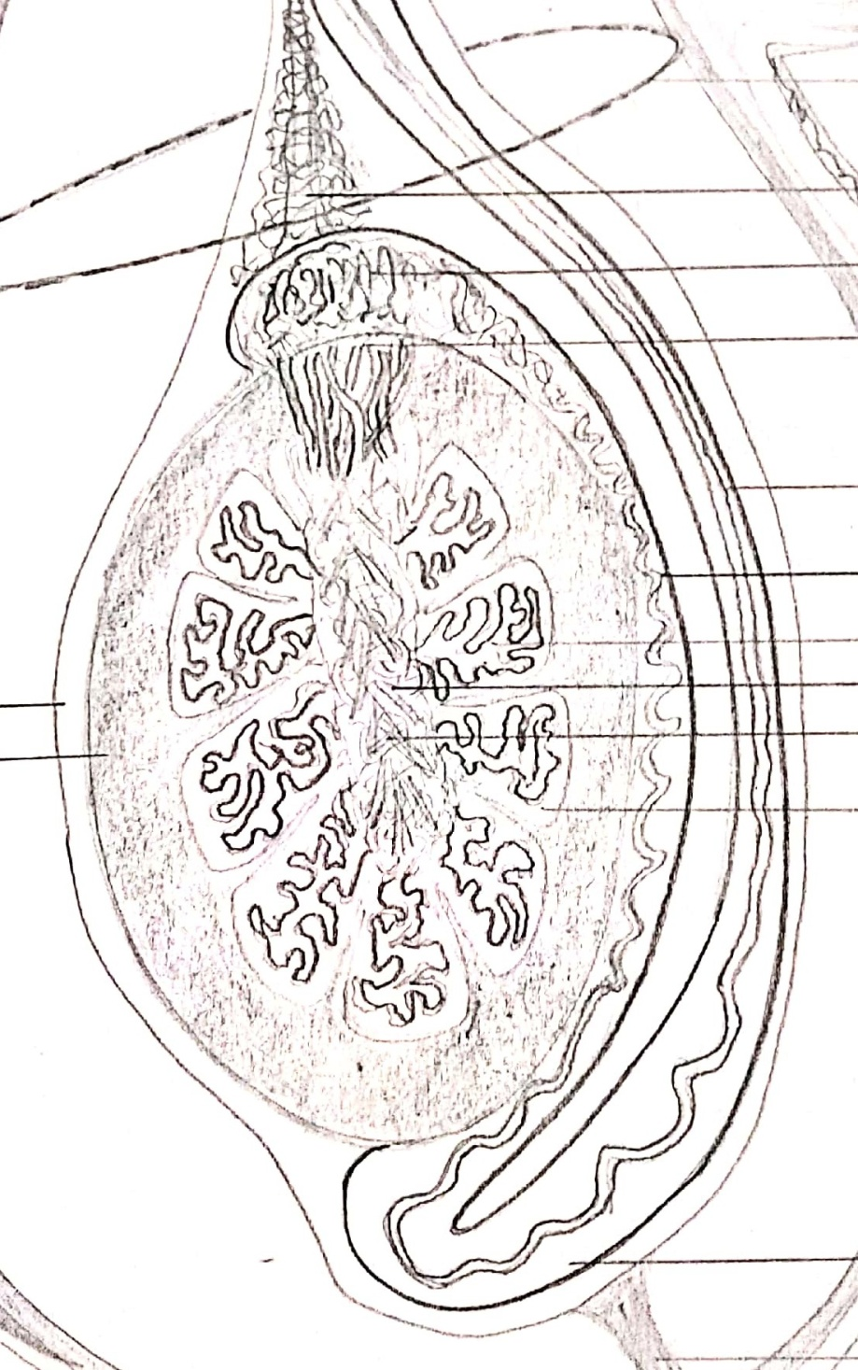

Slide 10
- SEMINIFEROUS TUBULES
Extension of tunica albuginea –
- Dividing testicular parenchyma into lobules
(encloses seminiferous tubules)
- Joins at mediastinum
Seminiferous tubules
- Highly convoluted & Unbranched
- Open at both ends
75% of total testicular mass
They Have
- Somatic sertoli cells/sustentacular/nurse
- Sperm producing germ cells
(spermatogonial germ cell line).

Slide 11
- The sertoli cells - Enrico Sertoli
- The leydig cells - Franz Leydig.
Sertoli cells secretes
mullerian inhibiting factor/hormone (MIH)
(inhibite paramesonephric or mullerian duct)
The number of sertoli cells doesn’t increase
after puberty i.e. it limits the spermiogenesis or
spermiogenic yield.
Sertoli cells form blood testes barrier just
before the puberty to separate differentiating
germ cells from blood circulation.

Slide 12
Interstitial space (out of Sem. tub.)
Leydig cells (interstitial cells)
Blood vessels & Lymphatics
In ram leydig cells are found in clusters around
blood vessels.
Length of seminiferous tubules :
Boar – 6 Km
Bull – 5 Km
Ram – 4 Km
Dog – 150 m
Tom – 25 m

Slide 13
- RETE TESTES – (in mediastinum)
Seminiferous tubules
Collecting tubules
Rete testes
Vas efferens
Lined by non secretory cuboidal epithelial cells

Slide 14
- TESTES (paired male gonads)
- In scrotum at inguinal region
- With help of tunics and spermatic cord
Covered with extra-abdominal tunic
- Tunica vaginalis…albugenia….vasculosa
Fluid in vaginal process
- Movement of testis within scrotum
- Plane of testes : Horizontal – Stallion
Vertical – Cattle, ram, buck
Oblique – Boar, Dog, Tom

Slide 15
Testicular diameter – Bull – 5-9 cm
Stallion – 4-8 cm
Ram and Buck – 4-7 cm
Boar – 5-9 cm
Dog – 1-3 cm
Tom – 0.7 – 1.5 cm
Shape of testes – Oval –stallion
Elliptical – boar
Elongates oval – bull, ram
Round to oval – Dog, Tom

Slide 16
Size of testes varies throughout the year in
seasonal breeder e.g. ram, stallion, camel
- Weight of testis –
Bull – 200-500 gm
Ram and buck – 200-400 gm
Stallion – 150-300 gm
Boar – 500-800 gm
Dog – 8-15 gm
In buffalo bull testes and scrotum are smaller
and the penile sheath is less pendulous than
cattle bull.

Slide 17
Testes –
Endocrine – Production of testosterone
(By leydig cells ….. LH/ICSH)
Exocrine – Spermatogenesis
(FSH & testosterone)
Body weight ….. positively correlated
with testicular weight, testicular volume,
total epididymal mass, total scrotal width
Castration (Removal of testicles)–
Reduces aggressive behavior of male animal
Rreduces the boar taint

Slide 18
Cremester muscle
-Internal abdominal oblique muscle to tunica
vaginalis propria
Loosening & Raising of testes
- In response to environmental temperature
any abnormal stimulus is the
- To maintain the testicular temperature
- Retracting the testes within abdomen
(Elephant, deer, and rabbit etc during their
non breeding season)

Slide 19
- Testes (in scrotum with help of spermatic cord)
Spermatic cord comprises of –
. Internal spermatic artery
. Spermatic veins (pampiniform plexus)
. Lymphatic vessels
. Autonomic nerves from renal and
mesenteric plexus
. Internal cremester muscle
. Tunica vaginalis propria
. Vas deferens
- Mesorchium & mesepididymis

Slide 20
THANK YOU

